Slide 1

Bull Management for a
Successful Breeding Season
Dr. Jacob Segers
Extension Animal Scientist
University of Georgia

Slide 2
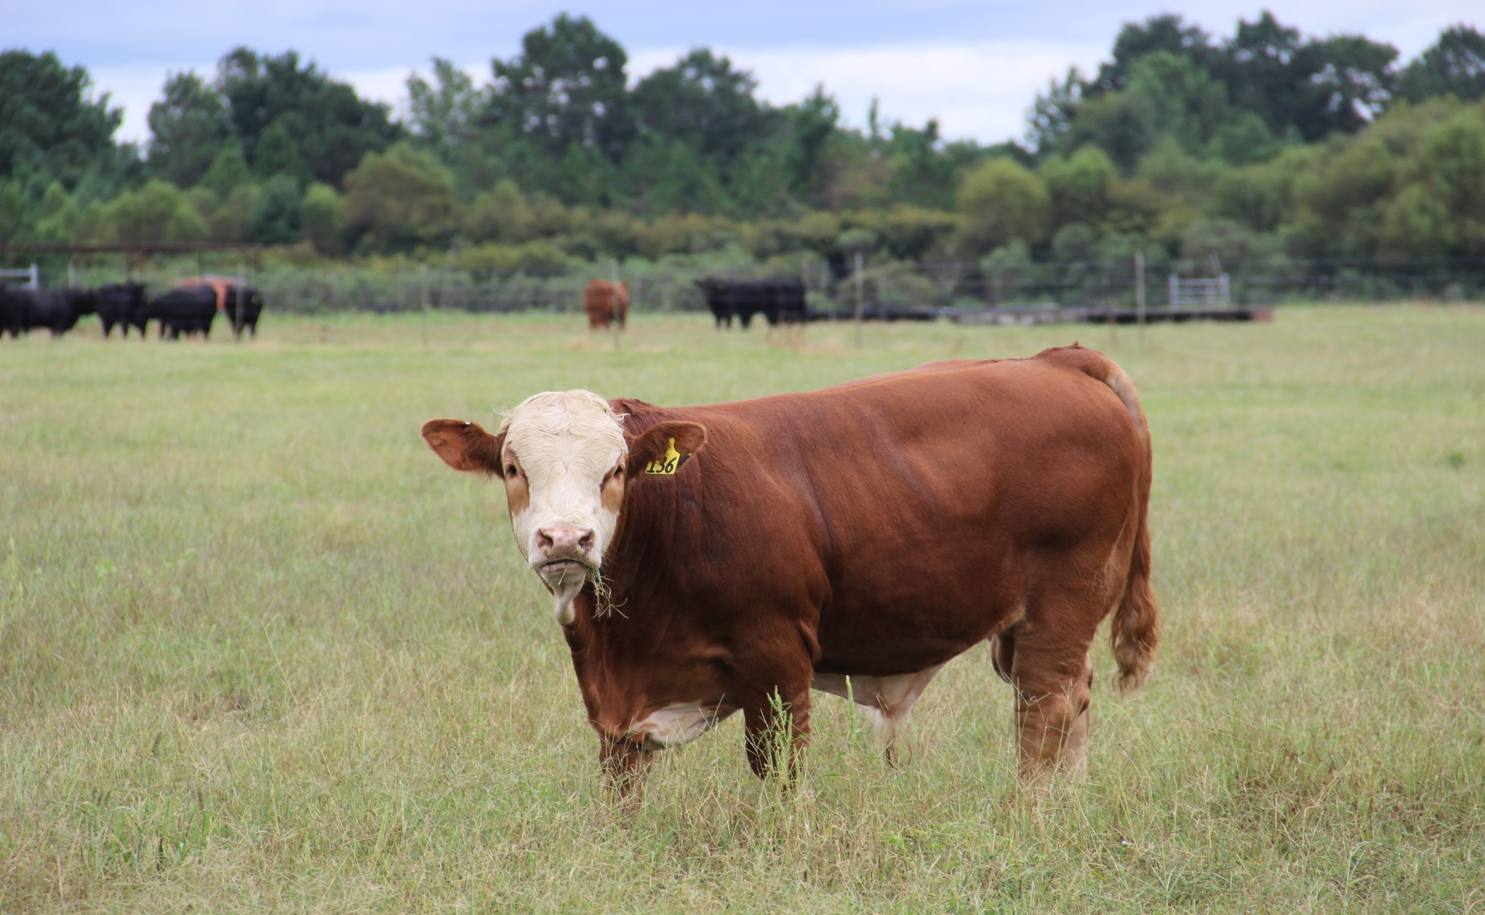
Bull Management
General Management Tips
  Fertility and Reproductive Traits
  Yearling vs Aged Bulls
Nutrition
  When to feed
  Effects of Nutrition
  Yearling Bull Nutrition
Ration Examples

Slide 3
Bull Fertility
Fertility predictors:
  Semen quality – breeding soundness exam
  Libido – desire to mate
  Serving capacity – ability to mate + libido
A bull SHOULD have all three!
  Important to note that libido and serving capacity are not correlated to BSE results
ARE BULLS THAT LOOK MORE MASCULINE BETTER BREEDERS?

Slide 4
Bull Reproductive Myths
Muscularity
Secondary sex characteristics
  Size of neck crest
  Size of foot
  Coarseness of hair
Pre-breeding level of testosterone
NONE of the above predict libido or serving capacity!

Slide 5
Serving Capacity and Libido
UF research suggests that 2 yr old bulls that are functionally sound = 60 day breeding season with a maximum 1:50 bull to cow ratio
  High serving capacity bulls = 83% preg rate
  Low serving capacity bulls = 67% preg rate

Slide 6
Serving Capacity and Libido
Research also suggest:
  High serving capacity bulls increase lbs of calf weaned/cow exposed by 60-90 lb
  Higher preg rates
    Earlier conception rates
    Purchase fewer bulls
Hard to quantify
  Observation during the breeding season is the best we can currently do

Slide 7
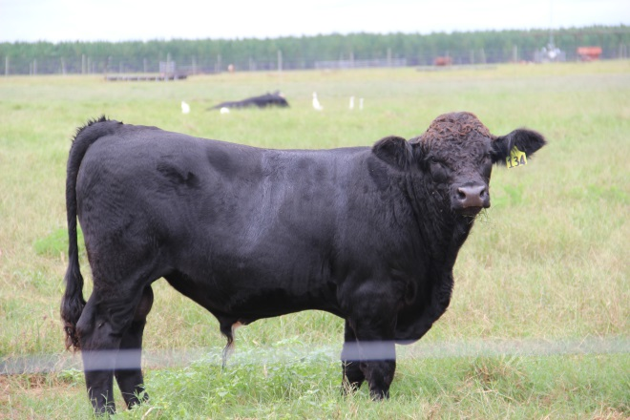
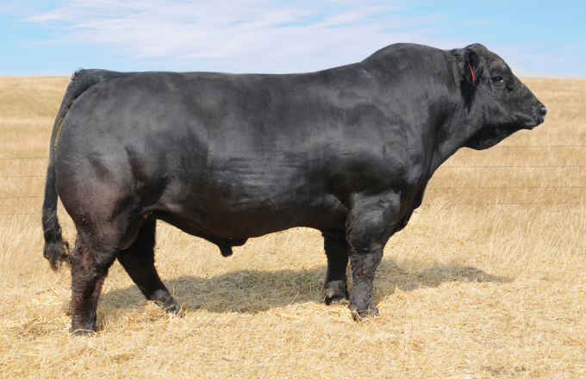
Breeding Pressure
1:25 or 1:30 is recommended for mature bulls
  More realistically, 1:40 with known serving capacity
Do NOT expect this from yearlings

Slide 8
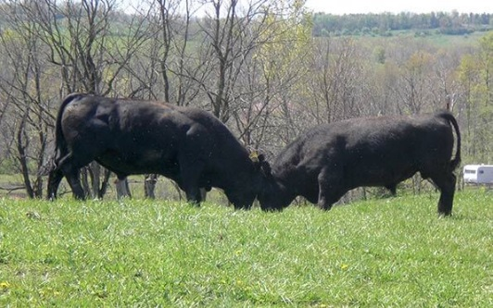
Pen Assignment
Bulls love a good fight
Turn bulls out that are similar in age/size
  Yearlings
  2 yr olds
  3 yr olds
  Mature bulls
In multi-sire operations, turn out young bulls with pen mates
  Social order already established
No direct effect on fertility, but bulls tend pay more attention to cows and less to other bulls

Slide 9
Yearling Bulls: Advantages
You increase the number of calves from a bull
  reduces bull cost
Higher libido
Yearling bulls generally cost less
Typically more yearlings are available
  Less “picked over”

Slide 10
Yearling Bulls: Disadvantages
Yearling bulls will lose more weight during the breeding season
  100-400 lbs
Require more feed for reconditioning
Yearling bulls tend to fall in love
If used “hard” as a yearling BCS tends to be compromised for extended amount of time
  They look “rough” until they are 4-5 years old

Slide 11
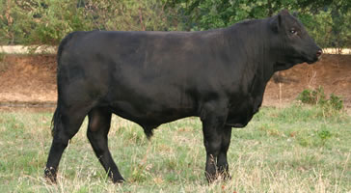
How many cows per yearling?
Yearling bull breeding pressure should equal months of age
  12 month bull = 12 cows
  18 month bull = 18 cows
  2 year old bull = 24 cows

Slide 12
What about rotating bulls?
Helps preserve BCS, but….
  Thin bulls are the ones working
  They are likely your high libido bulls
  They are likely your high serving capacity bulls
  Frequent mating events does not reduce sperm quality or number
  Introducing new bulls will increase fighting
  Questionable practice???

Slide 13
Rotating Bulls: The Exception
May be good idea for new yearling bulls
  “All in all out” reduces problems
Consider turning out yearlings at the end of the breeding season (last 30 days)
  Not recommended if breeding season ends mid-summer

Slide 14
Culling: How old is too old?
Semen quality starts to decline at 6-7 years of age
As testosterone drops, social dominance is lost to younger bulls.
Bull’s physical ability to mate begins to decline
  Heavy fronted
  Foot and leg problems associated with weight and service

Slide 15
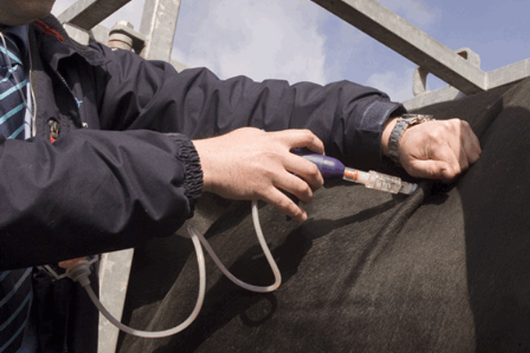
Disease Prevention
Vaccinate bulls for the same diseases that you would vaccinate breeding females
  leptospirosis
  Vibriosis
  4 way viral
Internal and external parasite control
One month quarantine for new bulls
Introduce only virgin bulls to prevent trichomoniasis

Slide 16
Feeding Bulls – Are you doing the right thing?
In herds with two breeding seasons bulls may need a higher plane of nutrition to recover condition more quickly
Supplementation of mature bulls may depend on type of breeding program
  Terminal – more supplement is acceptable
  Maternal – would like them to make it on the same thing the cows are surviving on

Slide 17
Diet Effects on Bull Fertility
High concentrate diets fed to young bulls:
  increase sperm abnormalities
  decrease sperm motility
Deposition of fat within the scrotal tissue and around the neck of the scrotum reduces radiation of heat
High energy diets increase scrotal surface temp
These effects are rarely permanent
Seen more often in bulls with higher genetic potential to get fat = British breeds

Slide 18
Characteristics of Bull Rations
Growth Phase
Maintenance/Working Phase
Think Bull Test Diet
High Energy Concentrate
Low Fiber
Low Physical Activity
Purpose: Maximize Growth and Condition
High Fiber
Low Concentrate
High Physical Demand
  Requires more planning due to variation in physical demand
Supplementation may be necessary in some stages
Dietary transitions should be minimum of 21 days

Slide 19
Can Bulls Get Too Thin?
BCS BSE Pass Rate
<4 55%
5 72%
6 67%
>6 62%
Adapted from Barling et al., 1998

Slide 20
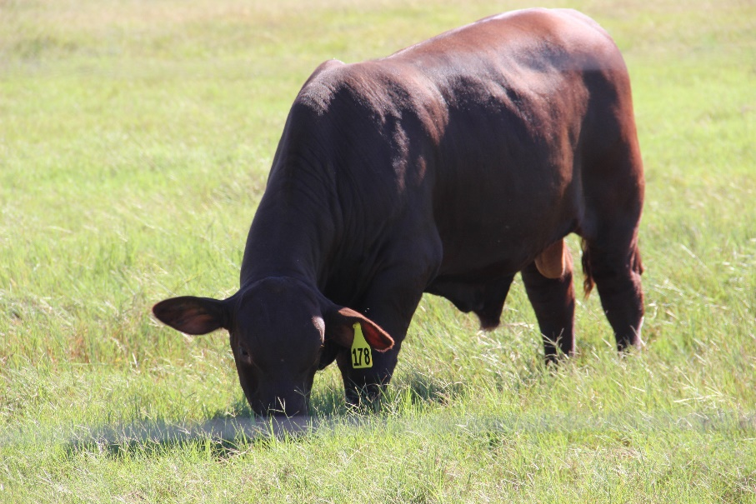
Young Bulls
12 months to 2 years of age
Usually heavier conditioned
  Performance testing, marketing
  Let down (~ 6 months)
    Provide plenty of exercise
    Over a minimum of 21 days ↓ grain, ↑ roughage
  Ideal BCS before turnout = 5-6
Will, almost certainly drop weight during 1st breeding season
  Youth = high “cow chasing” activity

Slide 21
“ Letting Down Purchased Bull”
Critical Period
  Transitioning from high-energy diet
  Still has growing to do
  Diet transition
    Metabolic/Physiological transition
  Exercise: growth without exercise can lead to mobility problems
Example: Brangus Bull (BCS = 6) 18 months old wt = 1,400lb.
  Target = 1,500 lb in 4 mo → breed at 24 mo
  Mature BW = 2,000 lb
  DMI = 25 lb/d

Slide 22
Bull Nutrition:
“ Letting Down Purchased Bull”
 | Option #1 | Lb of feed | Option #2 | Lb of feed
 | Grass Past | 10 | Grass Past | 10
 | Grass Hay | 7 | Grass Hay | 7
 | Soybean Hulls | 4 | Wheat Midds | 2
 | Corn Gluten Feed | 4 | Citrus Pulp | 4
 | Molasses | 0.5 | SBM | 2
Estimated Average Daily Gain, lb/d
Month 1 | 1.12 |  | 1.13
Month 2 | 1.13 |  | 1.14
Month 3 | 1.06 |  | 1.08
Month 4 | 1.01 |  | 0.99
Adapted From Presentation by Dr. Matt Hersom, UF

Slide 23
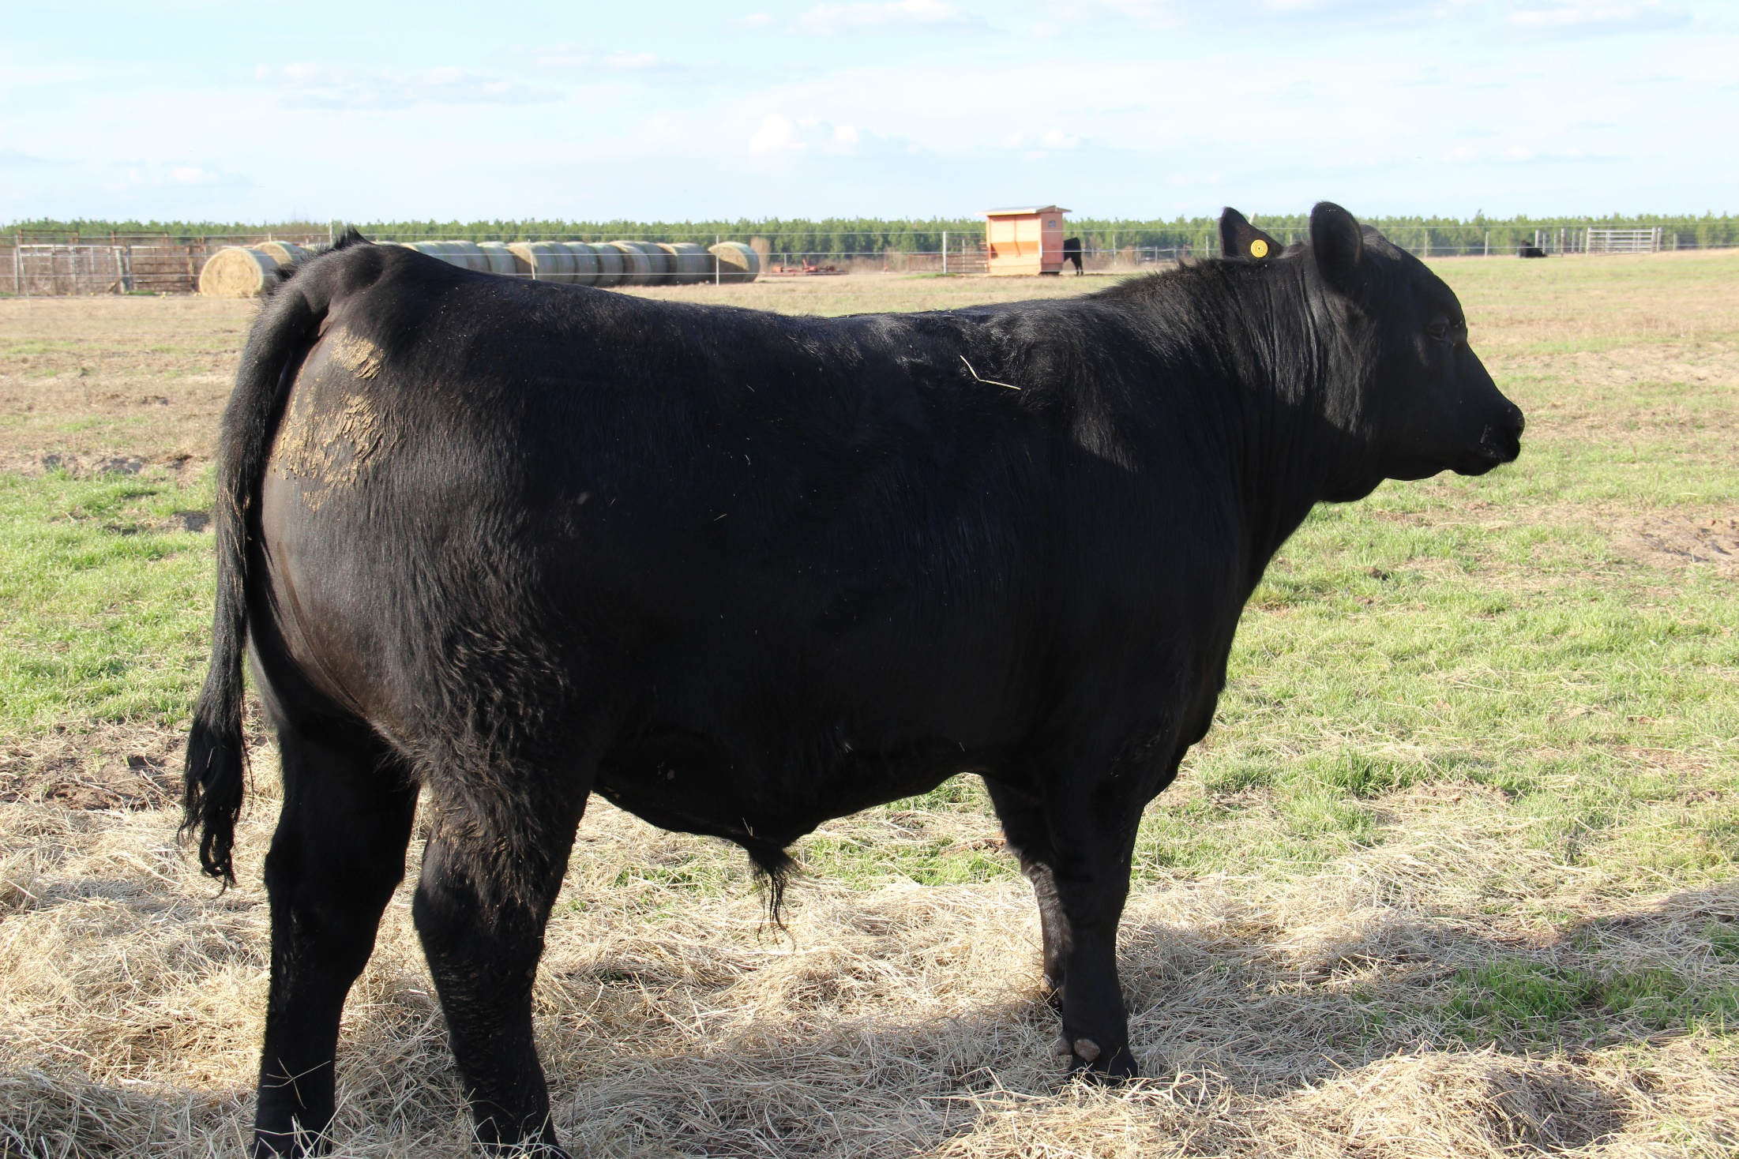
Bull Nutrition:
“Utilized Yearling Bull”
Reconditioning a yearling bull after breeding season.
Yearling Bull
April Turn-out
1,200 lb, BCS=5
90 days
End of Breeding Season
(Early July)
900 lb, BCS=3
90 days
End of Summer
Grazing
(Sept - Oct)
Start Breeding Season
(April)
1,500 lb, BCS=6
120 days
Winter Graze and
Supplement Feeding
(Oct)
Adapted From Presentation by Dr. Matt Hersom, UF

Slide 24
Bull Nutrition:
“Utilized Yearling Bull Summer Pasture Gain”
Assumptions:
Pasture availability is not limiting.
Intake potential greater than estimated for current BW
Supplementation displaces pasture intake.
50 lb BW increases each month.
Month | Pasture Intake | Predicted ADG, lb/d
Initial Period BW=900; Initial Period BCS=3
July | 25 | 1.81
August | 25 | 1.68
September | 25 | 1.54
Adapted From Presentation by Dr. Matt Hersom, UF

Slide 25
Bull Nutrition:
“Utilized Yearling Bull Fall Grazing and Supplementation”
Month | Pasture Intake | SBH/CGF/MOL | WM/CP/SBM
Initial Period BW=1,050; Initial Period BCS=4
Supp Feeds, lb |  | 4.5 / 4.5 / 1.0 | 3.0 / 4.0 / 1.0
 | Predicted ADG, lb/d
October | 18 | 2.21 | 2.33
November | 18 | 2.24 | 2.17
December | 19 | 2.22 | 2.16
Adapted From Presentation by Dr. Matt Hersom, UF

Slide 26
Bull Nutrition:
“Utilized Yearling Bull Winter/Spring Grazing and Supplementation”
Month | Pasture Intake | SBH/CGF/MOL | WM/CP/SBM
Initial Period BW=1,250; Initial Period BCS=5
Supp Feeds, lb |  | 5.0 / 5.0 / 1.0 | 5.0 / 5.0 / 1.0
 | Predicted ADG, lb/d
January | 17 | 2.07 | 2.11
February | 17 | 1.97 | 2.11
March | 17 | 2.01 | 2.14
Initial Period BW=1,400; Initial Period BCS=6
 |  | 6.0 / 6.0 / 1.0 | 5.5 / 6.0 / 1.5
April | 17 | 2.20 | 2.45
Adapted From Presentation by Dr. Matt Hersom, UF

Slide 27
Summary
Know your bull
  Current bodyweight / body condition score
  Expected mature bodyweight
  Nutrient Requirements
  Maternal vs. Terminal sire types
Have a plan
  Adequate pasture
  Appropriate supplements
  Nutritional management
Understand Individual Nutritional Needs
  Bull nutrition is a function of the Bull and his expected or past service
  Heavy use of young bulls increases feeding requirements
  Pasture alone is often not fully adequate to recondition bulls
Sale day and turn out should not be the only times you think about your bull.

Slide 28
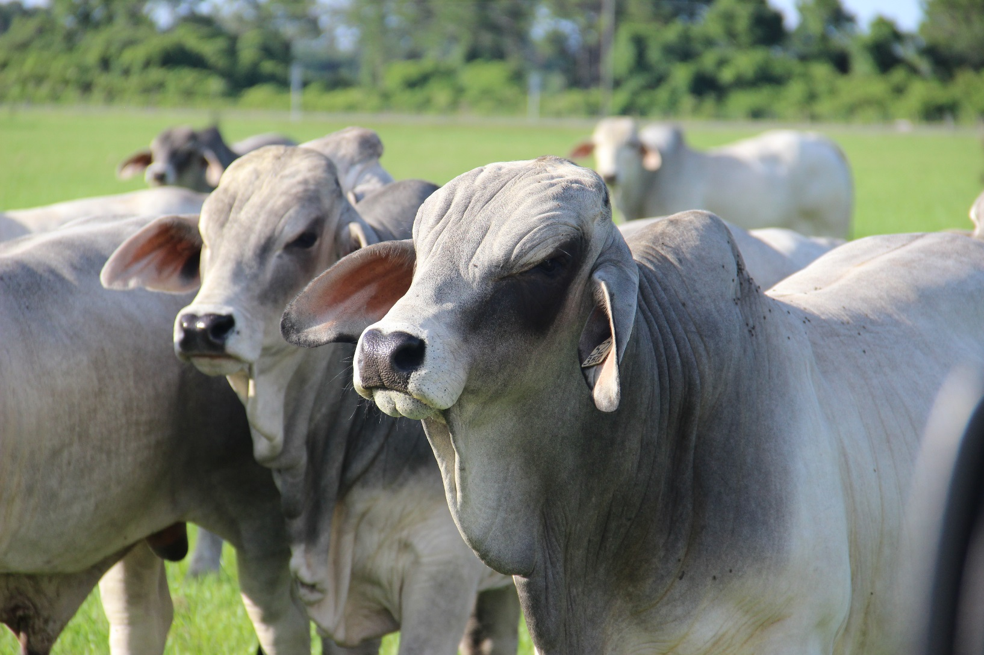
Questions

