Slide 1
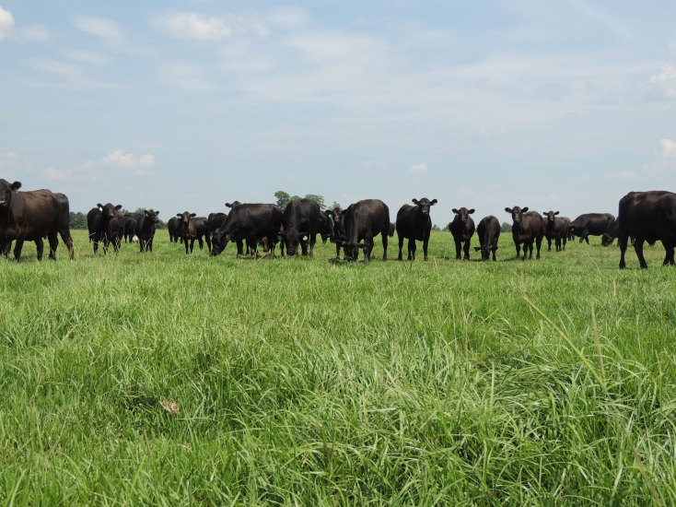
Interactive Decision Tools for Cattlemen
Kim Mullenix, Ph.D.
Assistant Professor/Extension Specialist
Beef Cattle Production Systems
Auburn University
ASAS Southern Section Webinar Series
January 12, 2016

Slide 2
Outline
Online Coursework
Electronic Publications
Ration Balancer Tools
Apps
Social Media
  Implications for Agents – Reporting Impacts

Slide 3
Online coursework

Slide 4
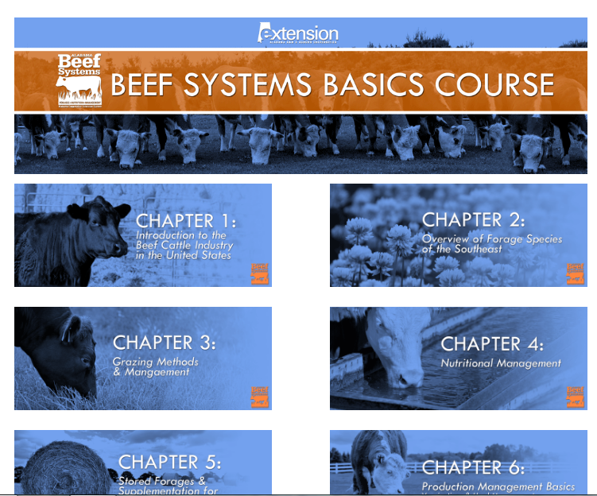
Beef Basics Online Course
8 week course
8 modules
  Forages/Nutrition
  Health
  Breeding/Genetics
  Meat Science
Quizzes and References

Slide 5
Beef Basics Online Course
Integrated into existing programs
  Basic training concepts for new and beginning farmers
Online at: http://www.aces.edu/agriculture/livestock-poultry/beef/BeefBasicsOnlineCourse.php

Slide 6
Regional Online Coursework
Master Cattle Producer’s Programs
  Mississippi State University – YouTube
  Move to integrate this material into an online platform by other states in region

Slide 7

Webinars
Shorter (max about 30 mins)
Timely Topic
Publicity
  Alabama: Monthly webinar – 2nd Wednesday of the month – 10 am CT

Slide 8
Electronic publications

Slide 9
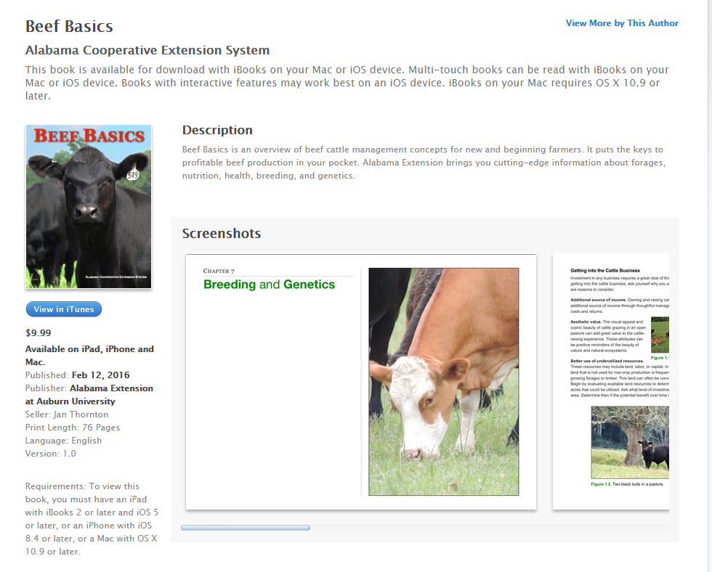

Beef Basics iBook – Apple iTunes Store
Open iTunes Store on phone or iPad
Search ‘Beef Basics’

Slide 10
Ration Balancer and Nutrition Tools

Slide 11
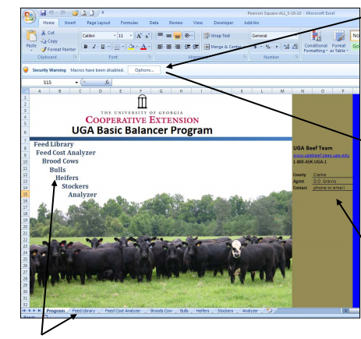
UGA Basic Balancer
UGA Basic Balancer Program (B 1371)
  Excel spreadsheet decision aid to formulate basic rations
  Uses NRC (2000) recommendations
  Updated in 2016
Download at: http://extension.uga.edu/publications/detail.cfm?number=B1371

Slide 12
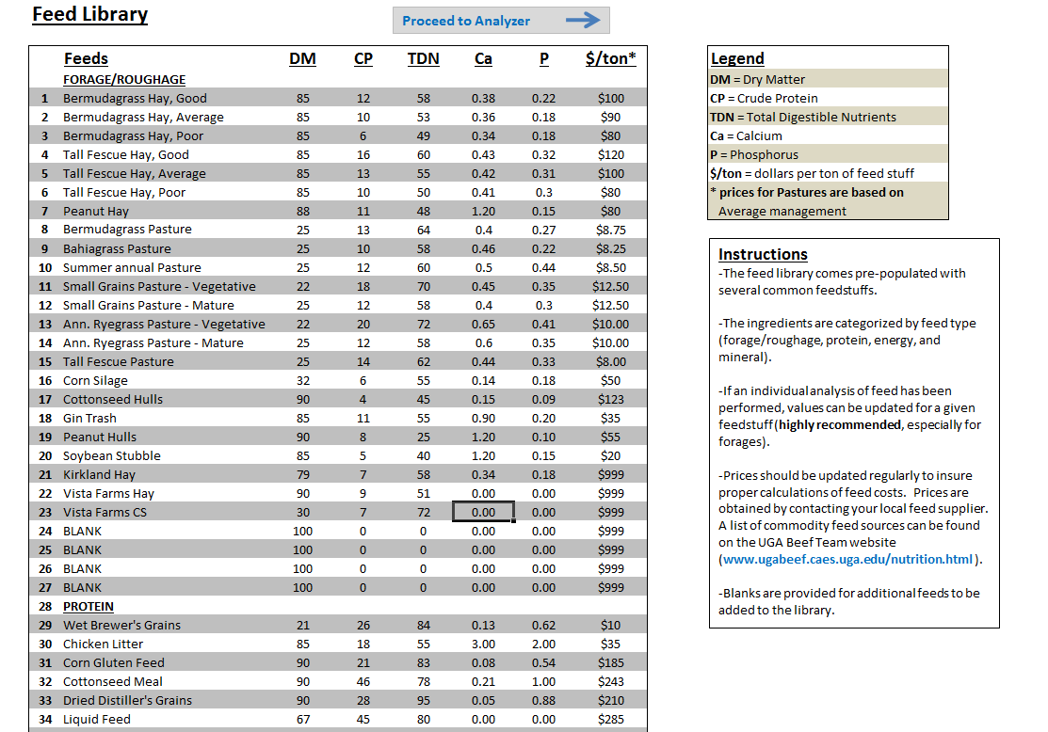

Slide 13
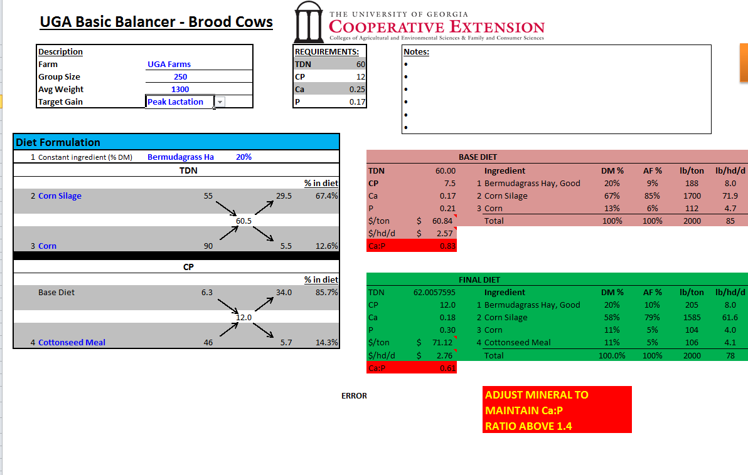

Slide 14
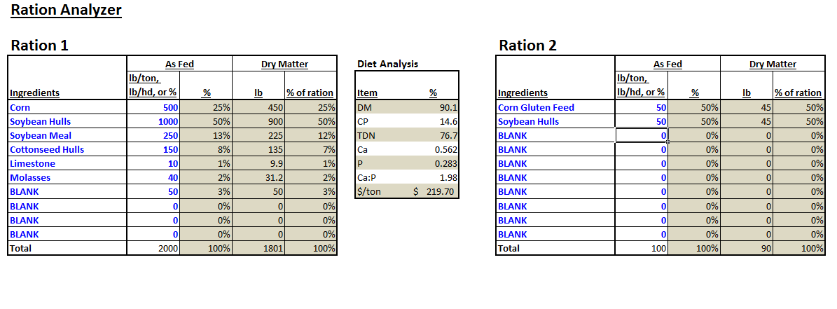

Slide 15
Additional Regional Resources
University of Arkansas
    Cattle Grower Ration Balancer
    Only for stocker cattle
Oklahoma State University
  Ration balancer, forage value calculator
  Cows, stockers, etc.

Slide 16
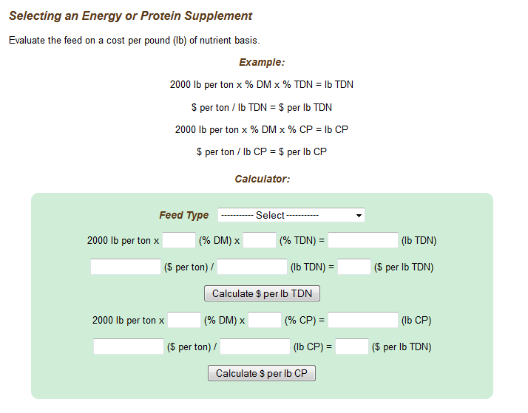
Supplemental Feeds Cost Calculator
(aces.edu/beefsystems)

Slide 17
Apps for Cattle Producers

Slide 18
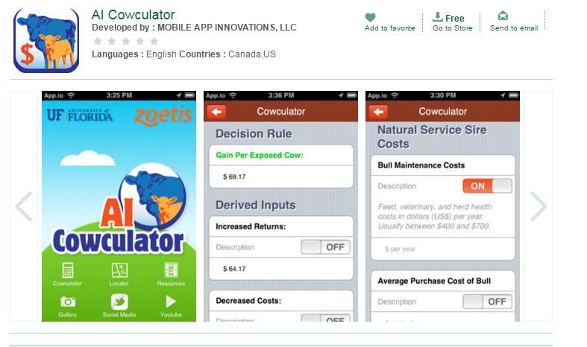
AI Cowculator
Keys: Cost of AI vs. natural service
Protocols, references, etc.

Slide 19
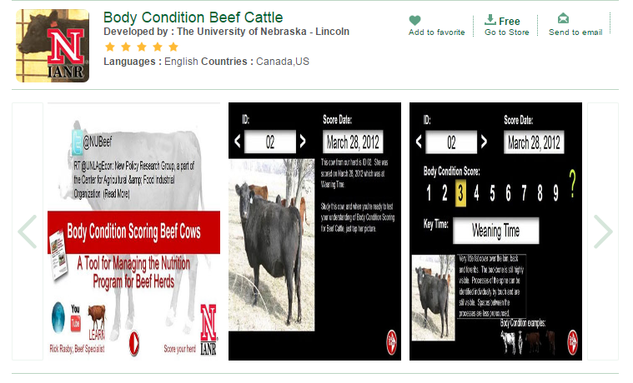
UNL Body Condition Scoring App
BCS Beef Cows – Take photos of cows in herd, indicate time of year, ID info, and score. Keeps reference points for multiple inputs

Slide 20
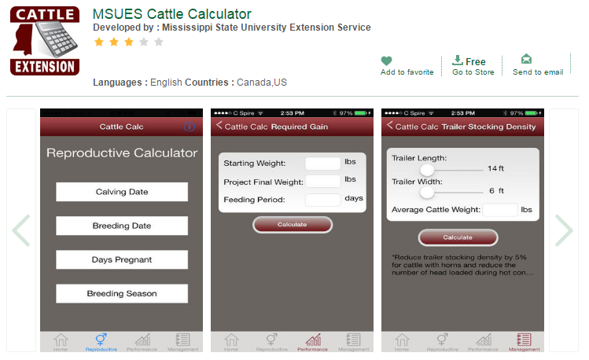
Mississippi State Cattle Calculator
Basic cattle management calculations – reproductive measures, animal performance, trailer stocking density

Slide 21
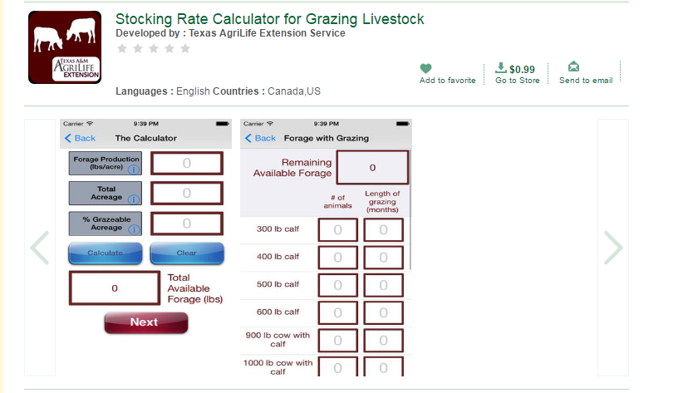
Stocking Rate Calculator for Grazing Livestock
Small cost, but powerful tool. Need estimation of forage production

Slide 22
Social media

Slide 23
Pros and Cons
Pros
Cons
Quick way to reach large numbers of stakeholders
Popular
Easy
Free (generally)
Builds a following
How do we measure what is really going on with social media?

Slide 24
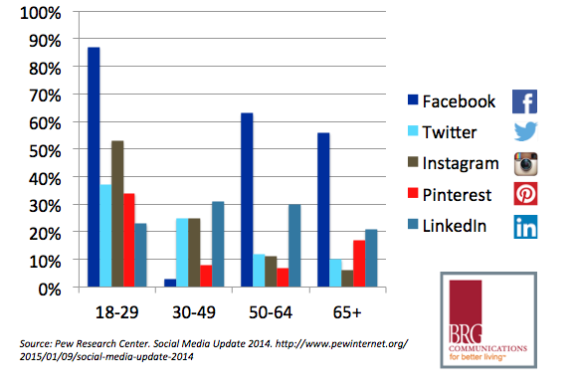
Background – Who is using social media?

Slide 25


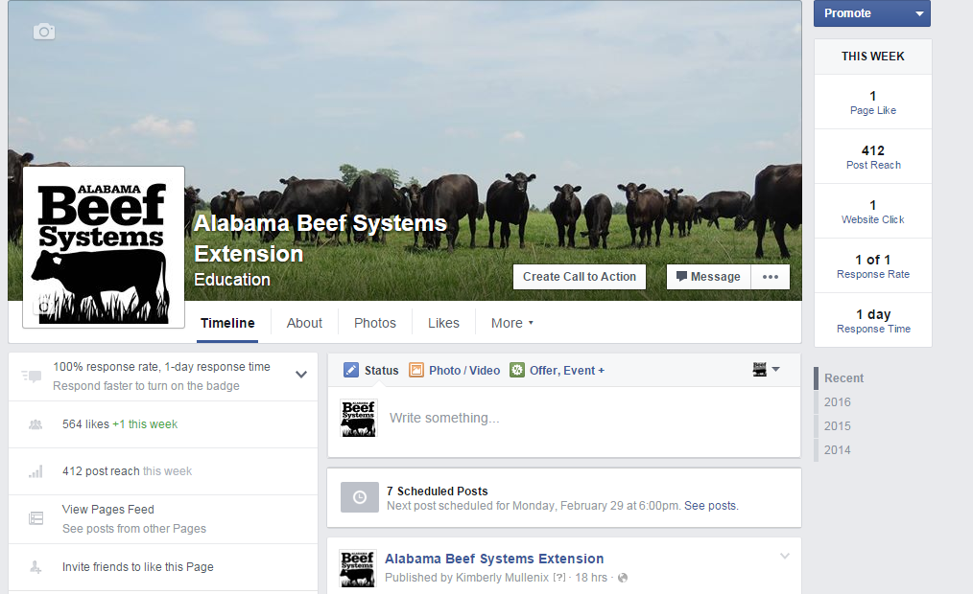
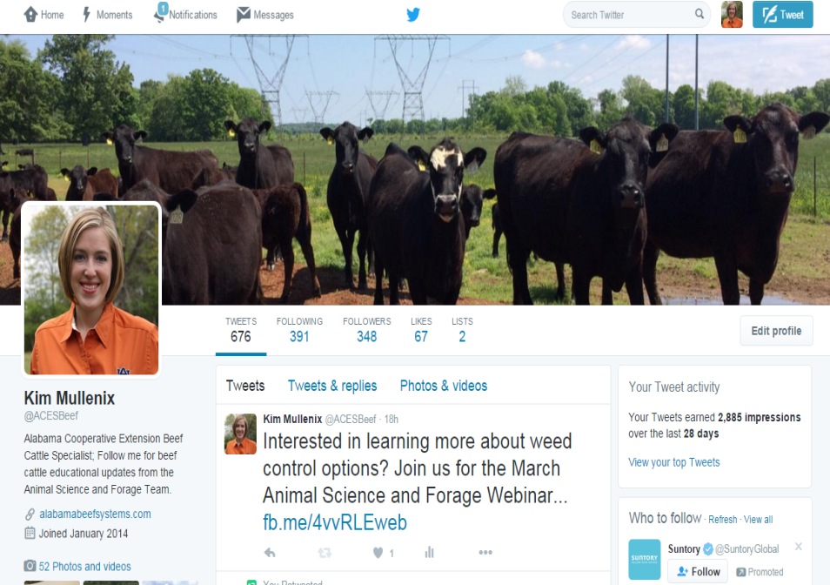
Social Media
Facebook
Twitter
Alabama Beef Systems Extension
@ACESBeef @ACESedu

Slide 26
Post Examples
Upcoming Events
Videos
Blog Posts and Newsletters
Popular Press Resources
New Extension Publications and Resources

Slide 27
Social Media
Easy to create an account
Check with individual university extension communications office about standard formatting requirements
Schedule, schedule, schedule!

Slide 28
Making Social Media Work For You
Post
Timely topic linked to university source
Frequency
Share
On your personal page
With others in your network
Summarize
Monthly
Yearly

Slide 29
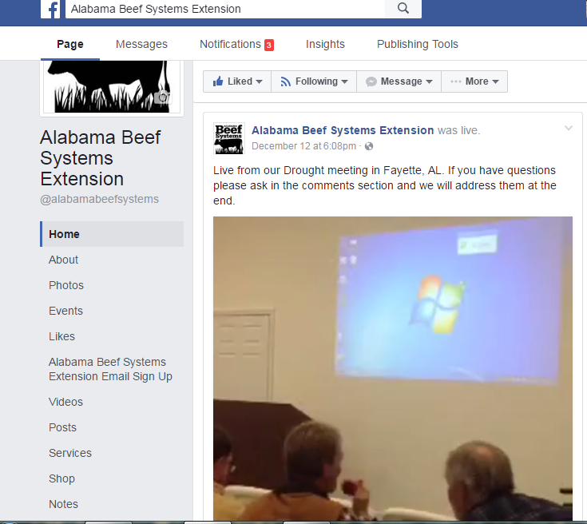
Facebook Features
Live streaming
  Short informational clips
  Meetings/conferences
    Ex. Drought programming in Alabama 2016
Frequency is important

Slide 30
So what….how can we report impacts?
Monthly
  Number of posts
  Reach of posts
Yearly
  Change in number of followers
  Change in demographics

Slide 31


Questions?
Special thanks to the following for creating these regional resources:
Dr. Brandi Karisch
Dr. Dave Lalman
Dr. Lawton Stewart
Dr. Nicolas DiLorenzo
Dr. Cliff Lamb
Dr. Rick Rasby
Dr. Shane Gadberry
Dr. Kim Mullenix
Dr. Jennifer Tucker
Dr. Lisa Kriese-Anderson
Dr. Soren Rodning

