Slide 1
Utilizing Enterprise Budgets in Beef Cattle Operations
Chris Prevatt
Beef Cattle and Forage Economist
University of Florida
ASAS Southern Section Extension Webinar Series
November 1, 2016

Slide 2
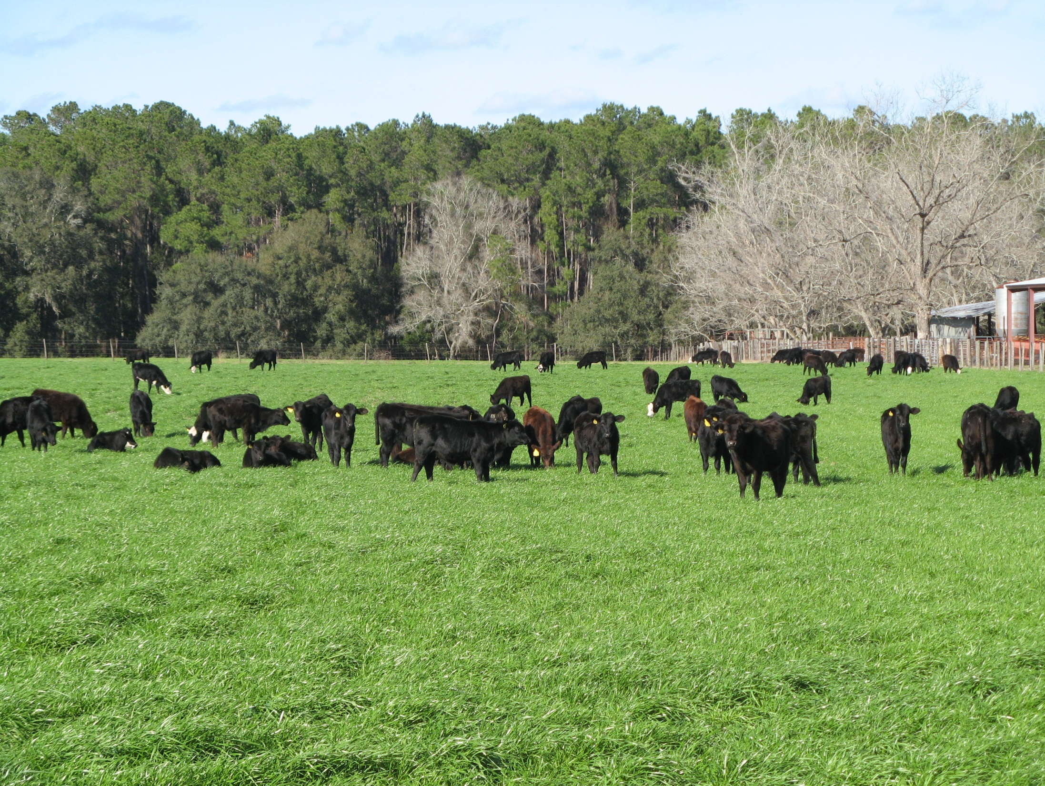
Cow-Calf
Production Budgets
UF/IFAS Beef
Cow-Calf Budget

Slide 3
UF/IFAS Beef Cow-Calf Budget
Why should we want to prepare
a beef cow-calf enterprise budget?
We should want to prepare a beef cow-calf budget to help with:
Planning, monitoring, and controlling costs
Evaluating alternative production strategies
Determining economic levels of performance
Monitoring and evaluating marketing opportunities
Projecting profitability

Slide 4
UF/IFAS Beef Cow-Calf Budget
What is a beef cow-calf budget?
A beef cow-calf budget is simply a financial assessment of the costs and returns of your beef cow-calf operation. It can be an “actual” or “projected” budget. The beef cow-calf budget is unique and specific to your operation. Each producer’s cow-calf budget is different.

Slide 5
UF/IFAS Beef Cow-Calf Budget
Are there different types of beef cow-calf budgets?
Yes, there are different types of cow-calf budgets. Here are some examples:
A) Returns Over Cash Expenses (ROCE)
B) Net Farm Income (NFI)
C) Net Income (NI)

Slide 6
UF/IFAS Beef Cow-Calf Budget
Are there different types of beef cow-calf budgets?
Yes, there are different types of cow-calf budgets. Here are some examples:
A) Returns Over Cash Expenses (ROCE)
(Gross Revenue minus Cash Expenses)
B) Net Farm Income (NFI)
(ROCE - Fixed Costs +/– Inv. Adj.)
C) Net Income (NI)
(NFI – Opportunity Costs)

Slide 7
Cow-Calf Costs & Returns Budgets
IRS Form 1040 - Schedule F is an example of a costs and returns budget.

Slide 8
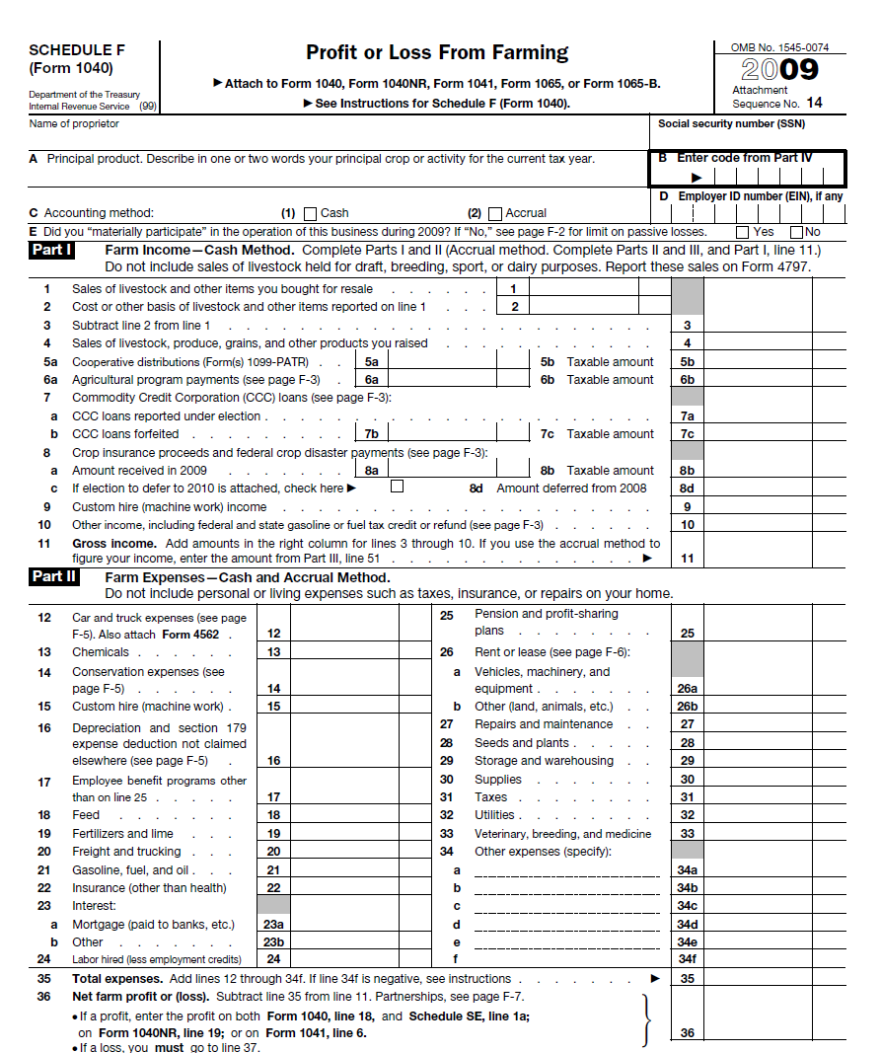

Slide 9

UF/IFAS Beef Cow-Calf Budget

Slide 11
UF/IFAS Beef Cow-Calf Budget
Input Sections
Reproduction Information
Marketing Information
Grazing Information
Purchased/Raised Feed Information
Animal Health Information
Annual Ownership Costs
Operating Costs for Mach. And Equipment
Other Expenses

Slide 13
Reproduction Information
  Number of Females Exposed
  Brood Cow and Replacement Heifer Death Loss
  Number of Females Confirmed Pregnant
  Number of Females Confirmed Open
  Number of Females Weaned a Calf
  Number of Females Culled
  Number of Bulls

Slide 15
2) Marketing Information
  Number of Steers and Heifer Calves Sold, head
  Avg. Feeder Steer Weaning Weight, lbs.
  Avg. Price at Weaning, $/cwt.
  Number of Cull Animals Sold, head
  Avg. Cull Cow Weight, lbs.
  Avg. Cull Cow Sale Price, $/cwt.

Slide 17
3) Grazing Information
  Land Rent
  Fertilizer Costs
  Lime Costs
  Weed Control

Slide 19
4) Purchased/Raised Feed Information
  Feed Prices (Hay, Supplements, Mineral)
  Pounds Fed/Head/Day and Number of Days
    Brood Cows
    Replacement Heifers
    Bulls
    Feeder Calves

Slide 21
5) Animal Health Information
  Vaccines, ID Tags, Dewormer, Implant, Pregnancy Check
    Brood Cows
    Replacement Heifers
    Bulls
    Feeder Calves

Slide 23
6) Annual Ownership Costs
  Depreciation, Interest, Repairs, Taxes, and Insurance
  Buildings and Improvements, Machinery and Equipment, Facilities, Fencing, Purchased Livestock
    Initial Cost, Salvage Value, Useful Life

Slide 25
7) Operating Cost for Mach. and Equipment
  Repairs and Maintenance, Total Fuel and Labor Cost, Total Operating Cost of Mach. and Equip.
    HP, Hours Used Per Year, Fuel Cost, Labor Wage

Slide 27
8) Other Expenses
  Full Time Management and Labor Information
  Part-Time Management and Labor Information
  Miscellaneous Expenses
    Utilities
    Family Living Withdrawal
    Property Taxes
    Etc.

Slide 28
UF/IFAS Beef Cow-Calf Budget
Results of
Beef Cow-Calf Budget

Slide 35
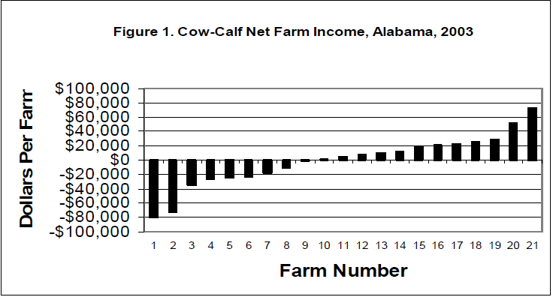

Slide 36
UF/IFAS Beef Cow-Calf Budget
Where can improvements be made?

Slide 37
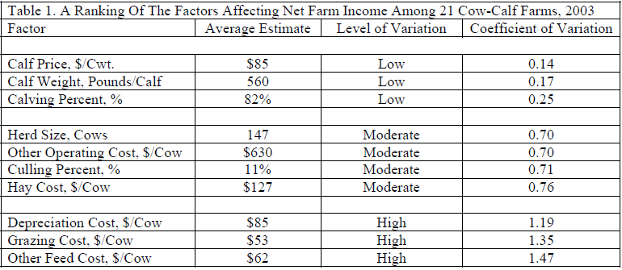

Slide 38
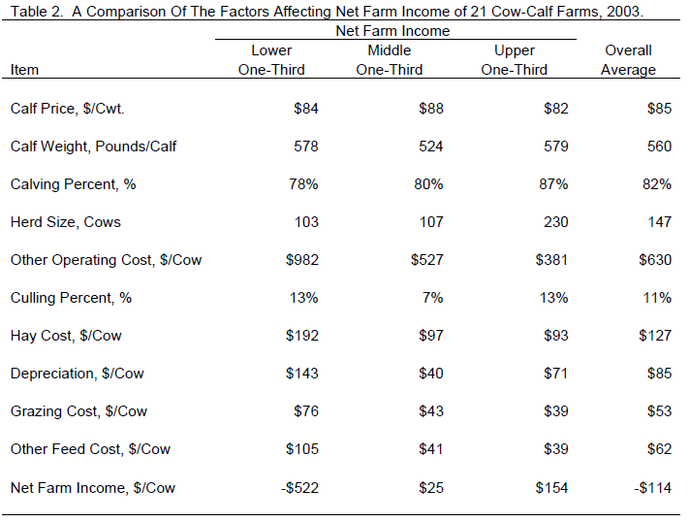

Slide 40
2015 UF Beef Cow-Calf Budget
Summary

Slide 41
SUMMARY
The UF/IFAS beef cow-calf budget provides you with:
A way to document your current production and marketing programs.
A way to evaluate the profitability of future alternative production and marketing programs such as:
a) changing your stocking rate
b) increasing the number of days of grazing
c) comparing the use of alternative feed supplements
d) creep feeding calves
e) increasing performance
f) preconditioning feeder calves
g) animal culling and replacement rates
A way to look at the sensitivity of various levels of costs and returns.

Slide 42
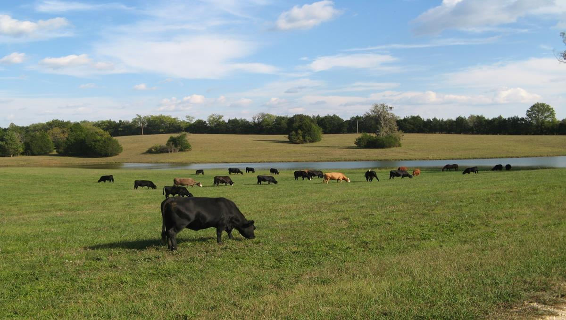
Thank you!
Good Luck developing a
Beef Cow-Calf Budget for your Operation.
(863) 735-1314 prevacg@ufl.edu

