Slide 1
Winter Supplementation Strategies
Brandi Karisch, PhD
Assistant Extension/Research Professor
Beef Extension Specialist

Slide 2
Importance of Nutrition
Healthy body
  animal maintenance needs, survival
Breeding and rebreeding
  reproduction and nutrition closely linked
  poor nutrition impairs reproductive performance
Milk production
  nutrient needs increase with lactation
Growth
  tissue building weight gain
Notes:
Beef cattle require nutrients to support body maintenance, reproduction, lactation, and growth. Proper nutrition is critical for animal productivity. Calving rates, weaning weights, and stocker average daily gains are all affected by the nutritional program of the operation. The market values of cows and bulls are also influenced by previous nutrition.

Slide 3
2014 Cow-Calf Production Operating Costs, $/bred cow

Slide 4
Three Steps to a Winter Supplementation Plan:
Evaluate your forage base
  How much do you have and what quality is it?
Determine animal needs (nutrient requirements)
Match forage to animal needs
  Determine what might be deficient
Determine supplement needs
  Efficiency!

Slide 5
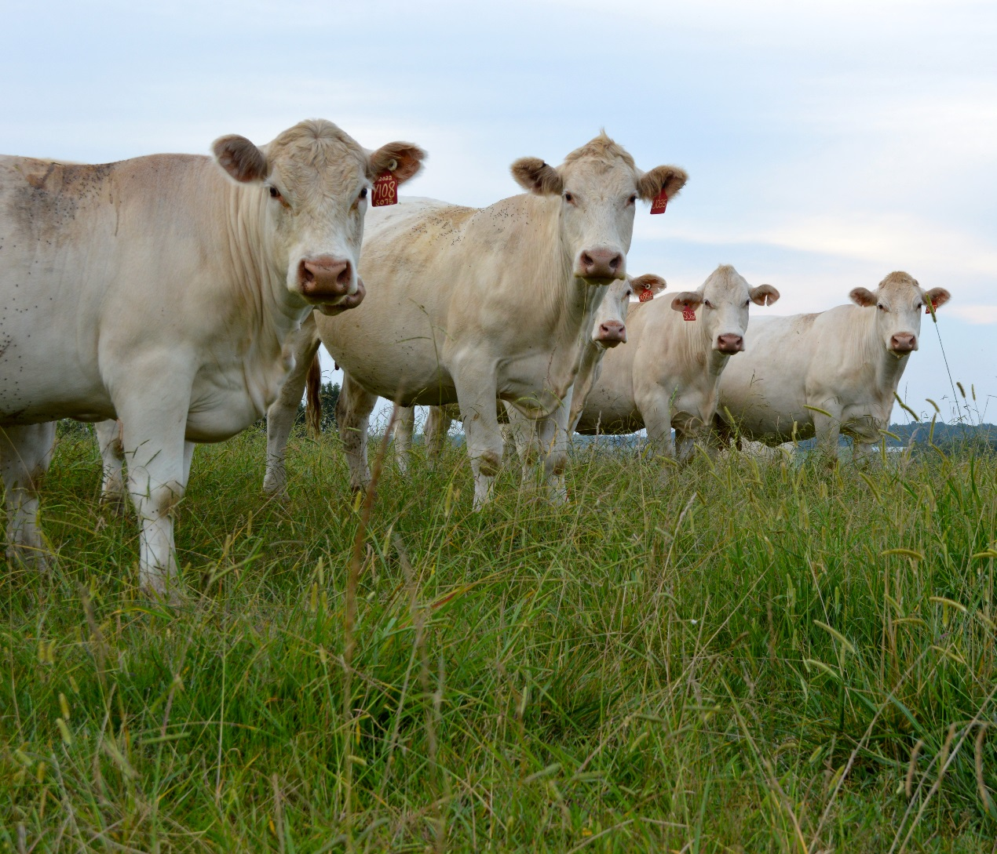
Start with a Forage Base

Slide 6
Forage digestibility ranges and their suitability for different classes of livestock
80
Dairy cow,
50 lbs milk/day
70
450-lb steer,
1.5 lb ADG
First calf heifer
60
Percent digestible dry matter
Beef cow/calf to
wean 500-lb calf
Dry, pregnant cow,
gaining condition
50
Warm-
season
perennial
grasses
Warm-
season
annual
grasses
Cool-
season
perennial
grasses
Cool-
season
annual
grasses
Legumes
Adapted from: H. Lippke and M.E. Riewe. 1976. Texas Agric. Exp. Stn. Res. Monograph RMGC:169-206.

Slide 7
Forage Quality Standards
Forage Type | Standard | Total Digestible Nutrients¹ | Crude Protein¹ | Moisture | pH
Silage² | Excellent | 65% or above | 8% or above | 70% or below | 4.2 or below
 | Good | 60 to 64% | 7 to 8% | 71 to 74% | 4.3 to 4.7
 | Fair | 55 to 59% | 6 to 7% | 75% and above | 4.8 to 5.1
 | Poor | Below 55% | Below 6% | 75% and above | 5.2 or above
Grass Hay³ | Excellent | 58% or above | 12% or above
 | Good | 55 to 57% | 10 to 11%
 | Fair | 52 to 54% | 8 to 9%
 | Poor | Below 52% | Below 8%
Legume Hay³ | Excellent | 64% or above | 18% or above
 | Good | 60 to 63% | 16 to 17%
 | Fair | 57 to 59% | 14 to 15%
 | Poor | Below 57% | Below 14%
¹Dry matter basis. ²Determine silage quality by total digestible nutrients rating. If silage does not meet either crude protein or moisture requirement for quality, lower one standard. ³Determine hay quality by total digestible nutrients rating. If hay does not meet crude protein requirement or is less than 83% dry matter, lower one standard.

Slide 8
Why Forage Test?
To determine nutrient levels in forage and eliminate guesswork
Match forage/feed supply to animal nutrient requirements
Design supplemental feeding program
Evaluate forage production

Slide 9
Forage Testing Labs
State labs and Commercial Labs
http://extension.msstate.edu/publications/publications/forage-and-manure-analysis-laboratories

Slide 10
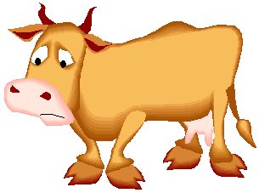
Southeast Research
Forage Quality
P.O. Drawer
Franklinton, LA
John Ribeye
1234 Steak Road
Bay Springs MS 39474
Producer 1936
Sample 1608
Product Summer mixedgrass hay
Sample #5 8-23-04
Comments
Parish/County Jasper
Dry Matter As Received
Dry Matter % 100.00 Dry Matter 90.93
Crude Protein 8.36 Crude Protein 7.60
ADF % 42.97 ADF % 39.07
NDF 77.33 NDF 70.32
TDN 49.12 TDN % 44.67
Calcium 0.00 Calcium 0.00
Phosphorus 0.00 Phosphorus 0.00
Magnesium 0.00 Magnesium 0.00
Potassium 0.00 Potassium 0.00
Copper (ppm) 0.00 Copper (ppm) 0.00
Zinc 0.00 Zinc 0.00
Manganese (ppm) 0.00 Manganese (ppm) 0.00
Results are based solely on sample submitted.
What should I look at on my forage test results?

Slide 11
Calculating per Cow Daily Hay Needs
1200-lb lactating cow with average milk prod.
2.5% of
body weight
30 lbs. dry
matter (DM)
X
=
30 lbs. dry
matter (DM)
88% hay
DM
34.09 lbs. of
hay “as fed”
÷
=

Slide 12
Calculating per Cow Winter Hay Needs
4090.8 lbs.
hay “as fed”
for winter
feeding period
34.09 lbs. of
hay “as fed”
X
120 Days
=
4090.8 lbs. hay per cow
4.81 bales of
hay per cow
=
850 lbs. per bale

Slide 13
Calculating Cow Herd Winter Hay Needs
4090.8 lbs.
hay per cow
163,362 lbs.
hay for herd
40 cows
=
X
163,362 lbs.
hay for herd
1 ton
81.82 tons
hay for herd
X
=
2,000 lbs.
4.81 bales of
hay per cow
192.4 bales of
hay for herd
X
40 cows
=

Slide 14
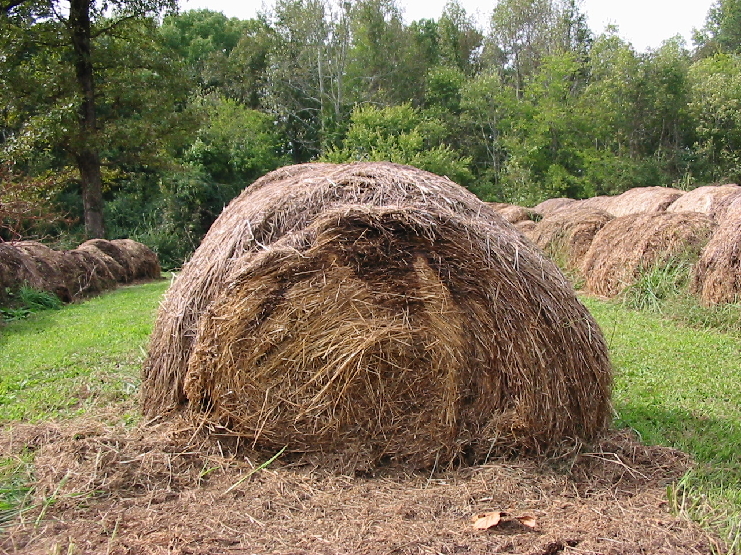
Storage Losses

Slide 15
Hay Storage Losses
 | Storage Period (months)
Storage Method | 0 to 9 | 12 to 10
 | ----------------------------% DM Loss--------------------------
Ground
Covered | 5 to 10 | 10 to 15
Exposed | 5 to 20 | 20 to 35+
Elevated
Covered | 2 to 4 | 5 to 10
Exposed | 3 to 15 | 12 to 35
Under Roof (open building) | 2 to 5 | 3 to 10
Enclosed Barn | <2 | 2 to 5
http://extension.msstate.edu/sites/default/files/publications/publications/p2540.pdf
http://pods.dasnr.okstate.edu/docushare/dsweb/Get/Document-1772/BAE-1716web.pdf

Slide 16
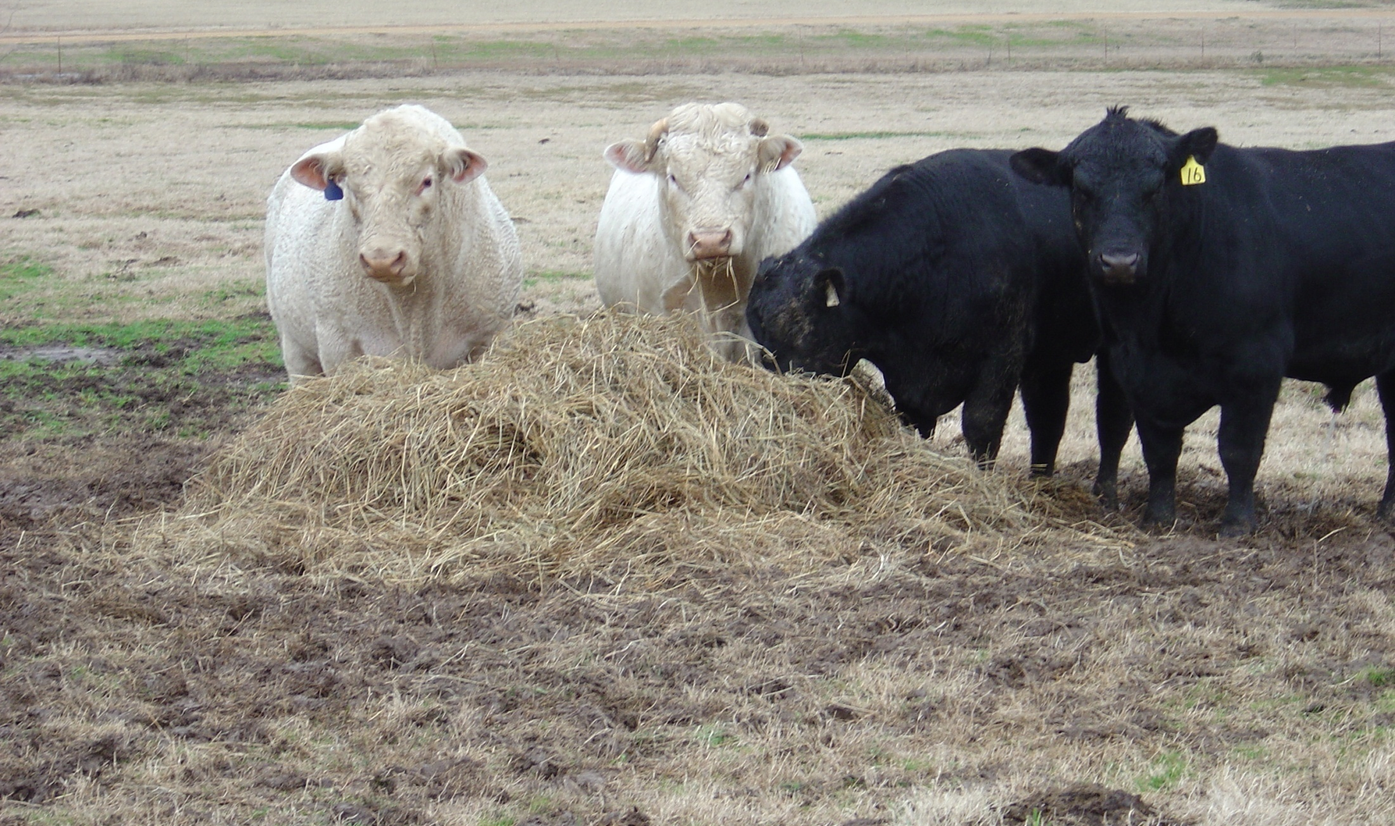
Feeding Losses

Slide 17
Factoring in Hay Losses
100% - 28% storage loss = 72% of hay remaining
100% - 5% feeding loss = 95% of hay remaining
72% x 95% = 68.4% of hay after all losses
Needed 192.4
bales of hay
for herd before
losses
Actually need
281.29 bales of
hay for herd
÷
68.4%
=
281.29 bales ÷
40 cows =
7 bales/cow

Slide 18
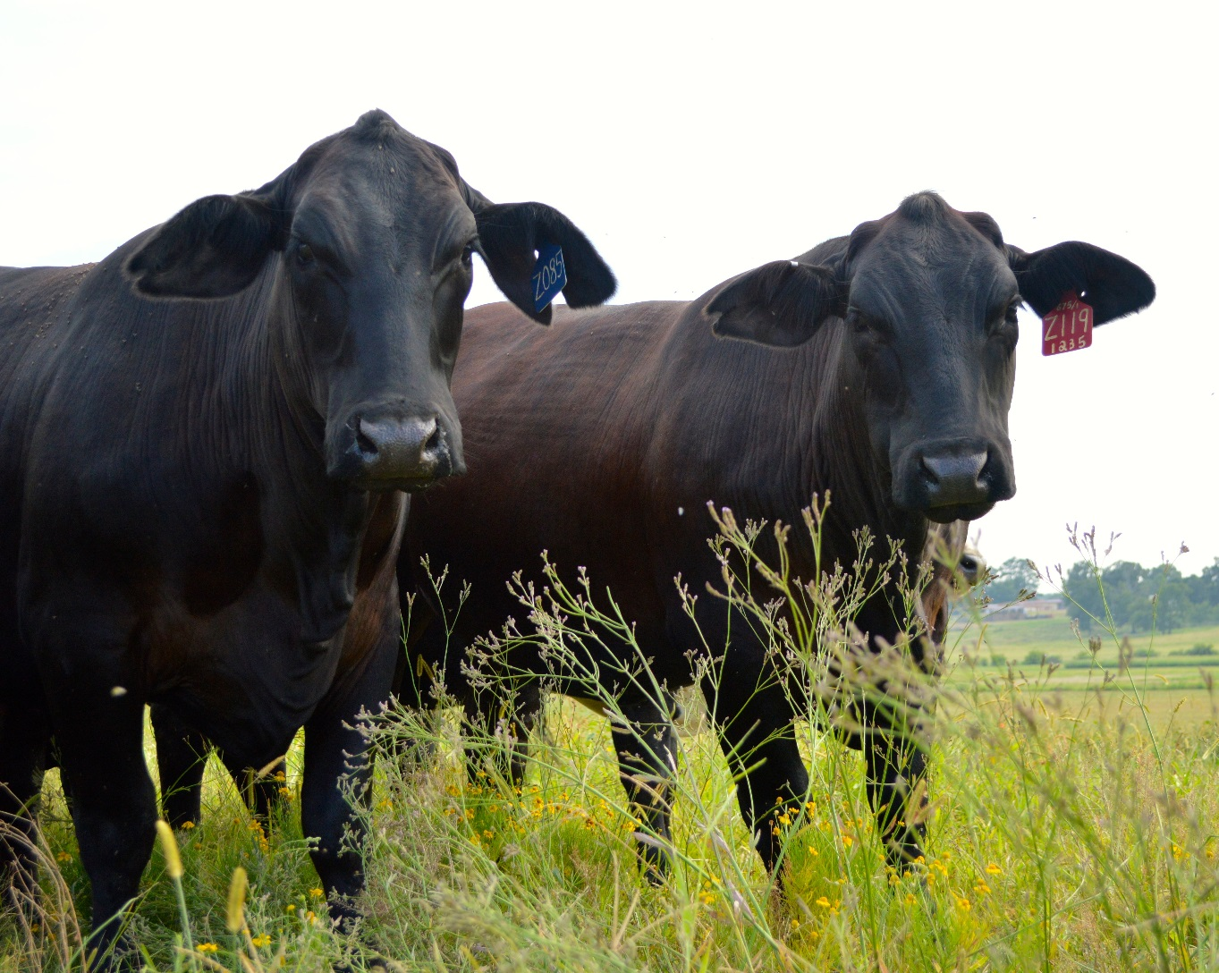
Nutrition For the Cowherd

Slide 19
Predicting Forage Intake
Forage
Quality No Suppl. Protein Energy
Low 1.5 1.8 1.5
Moderate 2.0 2.2 2.0
High 2.5 2.5 2.5
*Protein supplement
Each 1 lb over 4 lb/d, ↓ forage intake .6 lb
**Energy supplement
Each lb fed will ↓ forage intake is ≈ 1 lb

Slide 20
Impact of forage CP level on DMI in beef cattle--nonlactating cows
Dry matter intake, % of body weight

Slide 21
Protein Supplementation
Protein supplementation stimulates the intake of low quality forage:
    Nitrogen from protein increases microbial population in the rumen
    Increased microbes = increased digestion = increased intake
    Feed the microbes!

Slide 22
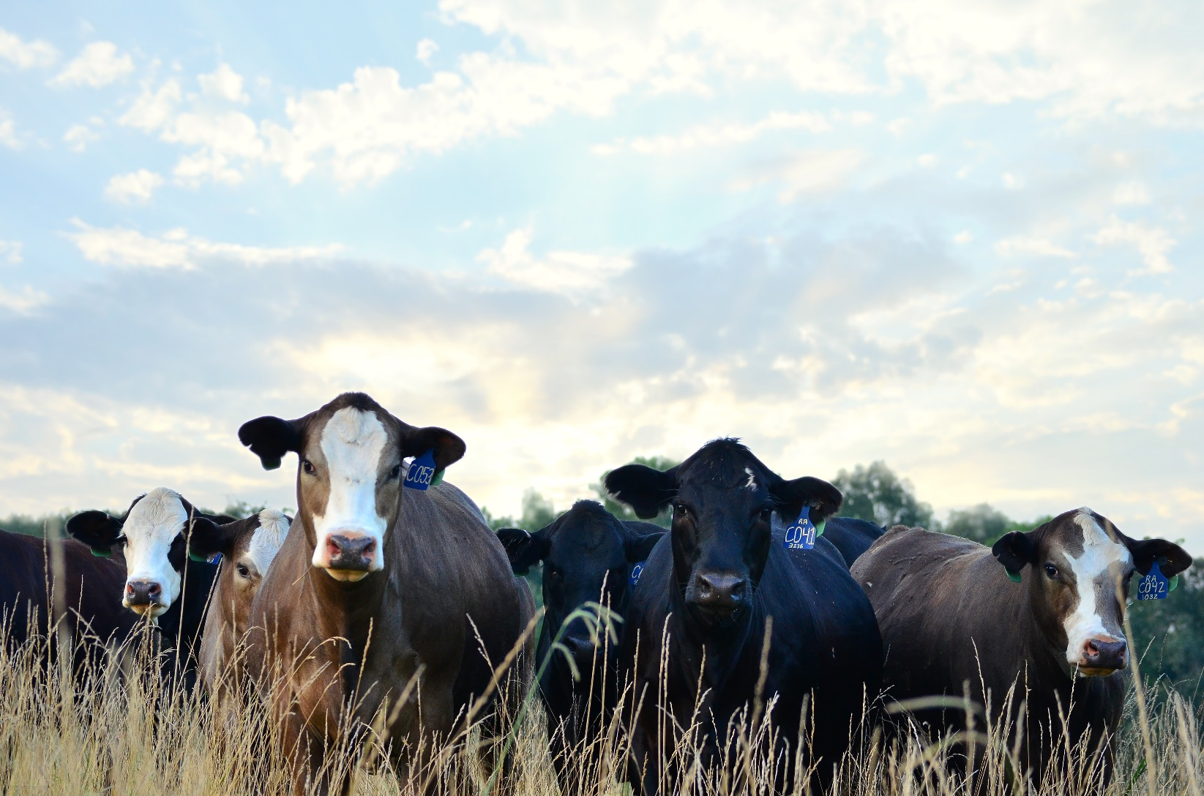
Nutrient Requirements

Slide 23
Stages of production for cow herd
1.Calving to breeding
(82 d):
early lactation
prepare cow for rebreeding
2.Breeding to weaning (83-205 d):
late lactation
slow fetal growth
3.Weaning--late gestation (206-315 d):
slow fetal growth
4. Late gestation
(316-365 d):
rapid fetal growth

Slide 24
Where to find requirements?
National Research Council updates Nutrient Requirements of all livestock species as needed.
Recent Beef Cattle update- Eighth Revised Edition (2016)
Extension Publications-Nutrient Requirements tables

Slide 25
Mature Dry (Non-lactating) Cow Nutrient Requirements
 |  |  | Diet Nutrient Density |  | Daily Nutrients / Animal
Body weight, lb | Months after calving | Dry matter intake, lb/day | TDN, % dry matter | CP, % dry matter | TDN, lb | CP, lb
1,000 | 7 | 19.5 | 46.8 | 6.5 | 9.1 | 1.26
 | 8 | 19.8 | 47.2 | 6.6 | 9.3 | 1.30
 | 9 | 20.3 | 47.9 | 6.7 | 9.7 | 1.35
 | 10 | 21.1 | 48.9 | 6.9 | 10.3 | 1.45
 | 11 | 21.0 | 52.1 | 7.7 | 10.9 | 1.61
 | 12 | 21.4 | 55.9 | 8.7 | 12.0 | 1.86
1,200 | 7 | 22.4 | 46.9 | 6.5 | 10.5 | 1.45
 | 8 | 22.8 | 47.3 | 6.5 | 10.8 | 1.49
 | 9 | 23.3 | 47.9 | 6.7 | 11.2 | 1.56
 | 10 | 24.3 | 49.0 | 6.9 | 11.9 | 1.67
 | 11 | 24.1 | 52.3 | 7.7 | 12.6 | 1.86
 | 12 | 24.6 | 56.2 | 8.8 | 13.8 | 2.16
1,400 | 7 | 25.2 | 46.9 | 6.5 | 11.8 | 1.63
 | 8 | 25.6 | 47.3 | 6.5 | 12.1 | 1.67
 | 9 | 26.2 | 48.0 | 6.7 | 12.6 | 1.75
 | 10 | 27.3 | 49.1 | 6.9 | 13.4 | 1.89
 | 11 | 27.0 | 52.6 | 7.8 | 14.2 | 2.11
 | 12 | 27.6 | 56.6 | 8.9 | 15.6 | 2.45

Slide 26
Mature Lactating Cow Requirements: 20 lb/day peak milk
 |  |  | Diet Nutrient Density |  | Daily Nutrients / Animal
Body weight, lb | Months after calving | Dry matter intake, lb/day | TDN, % dry matter | CP, % dry matter | TDN, lb | CP, lb
1,000 | 1 | 24.0 | 59.6 | 10.5 | 14.3 | 2.53
 | 2 | 25.0 | 60.9 | 11.2 | 15.2 | 2.79
 | 3 | 25.4 | 58.6 | 10.4 | 14.9 | 2.64
 | 4 | 24.4 | 57.0 | 9.7 | 13.9 | 2.36
 | 5 | 23.5 | 55.4 | 8.9 | 13.0 | 2.08
 | 6 | 22.7 | 54.0 | 8.2 | 12.3 | 1.85
1,200 | 1 | 26.8 | 58.7 | 10.1 | 15.7 | 2.71
 | 2 | 27.8 | 59.9 | 10.7 | 16.7 | 2.97
 | 3 | 28.4 | 57.6 | 9.9 | 16.4 | 2.82
 | 4 | 27.4 | 56.2 | 9.3 | 15.4 | 2.54
 | 5 | 26.5 | 54.7 | 8.5 | 14.5 | 2.26
 | 6 | 25.7 | 53.4 | 7.9 | 13.7 | 2.04
1,400 | 1 | 29.5 | 58.0 | 9.8 | 17.1 | 2.88
 | 2 | 30.5 | 59.1 | 10.3 | 18.0 | 3.14
 | 3 | 31.3 | 56.8 | 9.6 | 17.8 | 2.99
 | 4 | 30.3 | 55.5 | 8.9 | 16.8 | 2.70
 | 5 | 29.4 | 54.1 | 8.3 | 15.9 | 2.44
 | 6 | 28.6 | 53.0 | 7.7 | 15.2 | 2.21

Slide 27
Does each cow have all she can eat in the pasture?
YES
Forage supply is adequate
What color is the forage?
BROWN
Protein is likely <7% and limiting forage intake and digestion
GREEN
No supplement
Protein is sufficient
Energy is sufficient
Are cows in adequate body condition (i.e., ≥4.5)?
YES
Supplement with High - CP
1.2 -3.6 lb/day
improve rumen efficiency
price $/lb CP
NO
Supplement with Medium-CP
3 to 4.8 lb/ day
improve rumen efficiency
provide extra energy
consider $/lb CP and $/lb TDN

Slide 28
Does each cow have all she can eat in the pasture?
NO
Forage supply is inadequate; energy deficient
Reduce the forage needs of herd by lowering stocking rate and/or feeding supplement
GREEN
Supplement energy with Low-CP
4.8 to 9.6 lb/day
Protein is sufficient
Energy is deficient
Price $/lb TDN
BROWN
Supplement with Medium-CP
3.6 to 6.0 lb/day
Energy is deficient
Protein is likely <7% and limiting forage digestion
consider $/lb TDN and $/lb CP
If forage shortage is severe, supplement with <20% CP
4.8 to 9.6 lb/day
Price $/lb TDN
What color is the forage?

Slide 29
Selecting the Best Feedstuff for the Situation
Identify what is needed to achieve goals.
  “Decision Guide” may help
Evaluate potential feedstuffs according to cost/unit nutrient
  Make a cost comparison table
Example cost calculation:
  20% CP supplement
  $233/ton
2000 lb X 20% CP = 400 lb CP
$233/ton ÷ 400 lb CP =
$ .58 / lb CP

Slide 30
Cost/Unit Nutrient Example
Cottonseed meal 41% CP
  $290/ton
  2000 lbs * 0.41 = 820 lbs CP/ton
  $290/ton ÷ 820 lb/ton = $0.35/lb CP
Soy Hull Pellets 12% CP
  $120/ton
  2000 lbs * 0.12 = 240 lbs CP/ton
  $120/ton ÷ 240 lb/ton = $0.50/lb CP
DDGS 27% CP ****
  $140/ton
  2000 lbs * 0.27 = 540 lbs CP/ton
  $140/ton ÷ 540 lb/ton = $0.26/lb CP
Whole Cottonseed 24% CP
  $218/ton
  2000 lbs * 0.24 = 480 lbs CP/ton
  $218/ton ÷ 480 lb/ton = $0.45/lb CP
http://agebb.missouri.edu/dairy/byprod/bplist.asp
https://www.ams.usda.gov/market-news/feedstuffs-reports

Slide 31
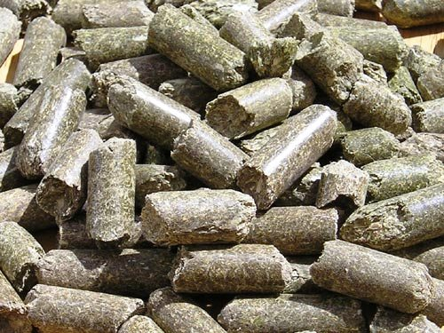
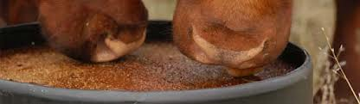
Cost/Unit Nutrient Example
14% CP Pellet
  $320/ton ($8 per 50 lb bag)
  2000 lbs * 0.14 = 280 lbs CP/ton
  $320/ton ÷ 280 lb/ton = $1.14/lb CP
30% CP Tub
  $782/ton ($88 for a 225 lb tub)
  2000 lbs * 0.28 = 600 lbs CP/ton
  $782/ton ÷ 600 lb/ton = $1.30/lb CP
32% CP Liquid Feed
  $443/ton ($2.39/gallon and 10.8 lbs/gallon)
  2000 lbs * 0.32 = 640 lbs CP/ton
  $443/ton ÷ 640 lb/ton = $0.69/lb CP

Slide 32
Mature Cow Example
1,200 lb mature beef cow (dry, 8 months since calving) is being fed Bermudagrass hay
  This hay contains:
    49% TDN (DM basis)
    6% CP (DM basis)
    90% DM.

Slide 33
Mature Cow Example
Follow with cow requirements:
  TDN requirements for this cow:
    10.8 lbsTDN/day
  Protein requirements
    1.49 lbs CP/day

Slide 34
Mature Cow Example
How much hay does she need to meet her TDN requirements?
(Requirement ÷ amount in hay)
10.8 ÷ .441 = 24.5 lbs hay as fed
How much hay does she need to meet her CP requirements?
1.49 ÷ .06 = 24.8 lbs hay as fed
22.3 lbs Dry Matter to meet her needs
EXPECTED DRY MATTER INTAKE is 22.8 lbs

Slide 35
What happens if we add lactation (2 months after calving)?
 |  |  | Diet Nutrient Density |  | Daily Nutrients / Animal
Body weight, lb | Months after calving | Dry matter intake, lb/day | TDN, % dry matter | CP, % dry matter | TDN, lb | CP, lb
1,200 | 1 | 26.8 | 58.7 | 10.1 | 15.7 | 2.71
 | 2 | 27.8 | 59.9 | 10.7 | 16.7 | 2.97
 | 3 | 28.4 | 57.6 | 9.9 | 16.4 | 2.82
 | 4 | 27.4 | 56.2 | 9.3 | 15.4 | 2.54
 | 5 | 26.5 | 54.7 | 8.5 | 14.5 | 2.26
 | 6 | 25.7 | 53.4 | 7.9 | 13.7 | 2.04
    From 10.8 lbsTDN/day and 1.49 lbs CP/day
    to
    16.7 lbs TDN/day and 2.97 lbs CP/day
Can she eat enough?

Slide 36
Lactating Mature Cow Example
    Needs 16.7 lbs TDN/day and 2.97 lbs CP/day
Eating approximately 26 lbs of (AF) hay
  49% TDN (DM basis)
  6% CP (DM basis)
  90% DM.

Slide 37
Lactating Mature Cow Example
 | Requirement | Forage Supply | Deficient
Crude Protein | 2.97 lbs | 1.56 lbs CP (26 × .06) | (1.42 lbs)
TDN | 16.7 lbs | 12.74 lbs TDN (26 × 0.49) | (3.96 lbs)
Must provide supplement, but how much?

Slide 38
Lactating Mature Cow Example
If we feed Soyhull pellets, the cows would need:
1.42 lbs of CP
SHP have 12% CP so…
1.42/.12 = 12 lbs of SHP
to meet her protein needs
3.96 lbs of TDN
SHP have 57 % TDN/lb so…
3.96/.57= 7 lbs of SHP
to meet her energy needs
Supplement cows with 12 lbs SHP per head per day to meet their needs

Slide 39
Lactating Mature Cow Example
Better option? Higher protein feed?
If we feed Corn Gluten, the cows would need:
1.42 lbs of CP
Corn Gluten has 24% CP so…
1.42/.24 = 6 lbs of SHP
to meet her protein needs
3.96 lbs of TDN
Corn Gluten has 83% TDN/lb so…
3.96/.83= 4.7 lbs of SHP
to meet her energy needs
Supplement cows with 6 lbs CG per head per day to meet their needs

Slide 40
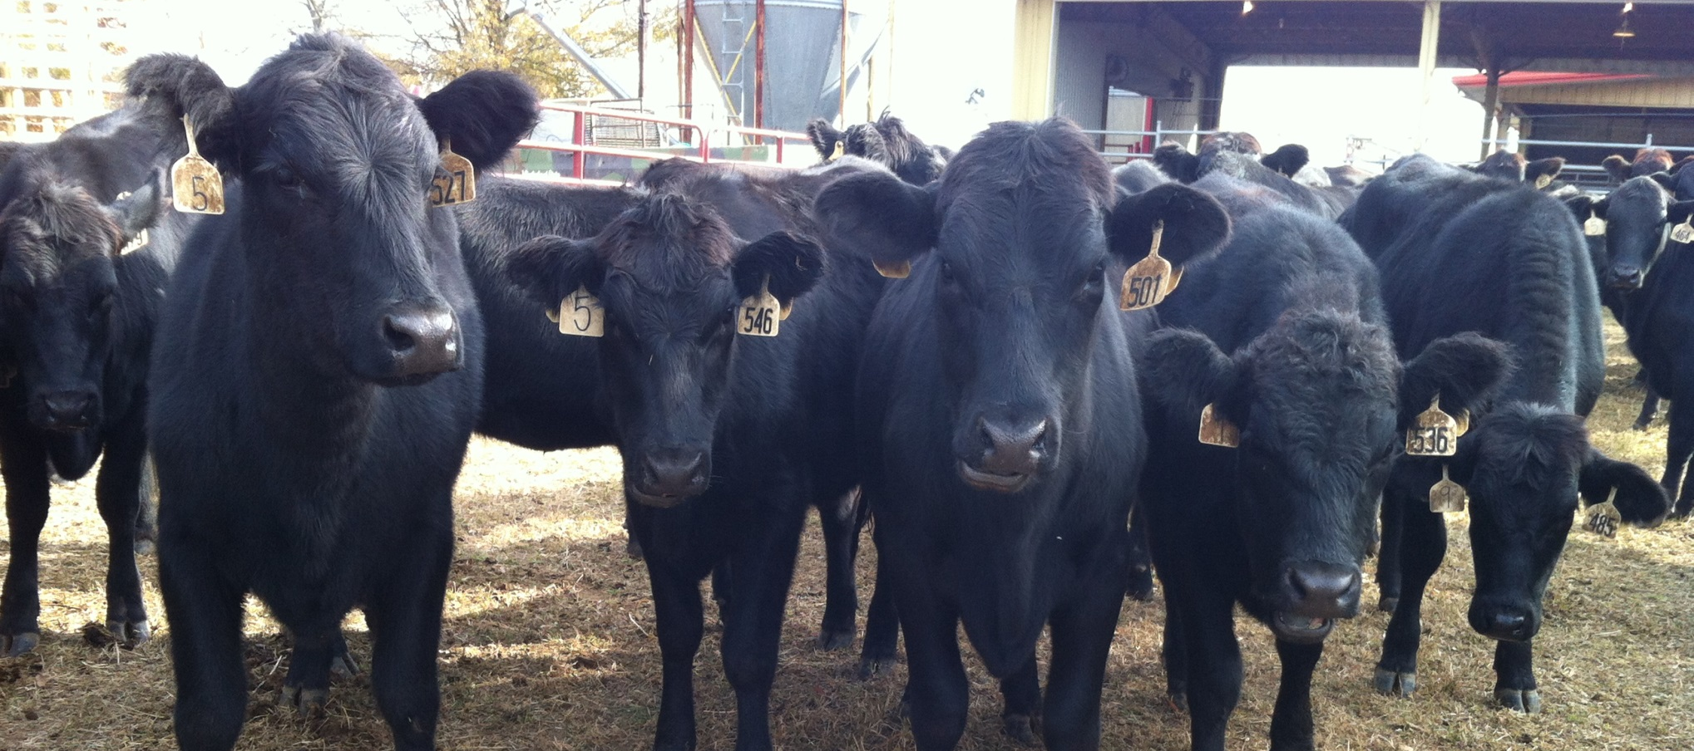
Nutrition for growing cattle

Slide 41
Nutrient Requirements
 |  |  | Diet Nutrient Density |  | Daily Nutrients / Animal
Body weight, lb | ADG, lb | Dry matter intake, lb/day | TDN, % dry matter | CP, % dry matter | TDN, lb | CP, lb
300 | 0.5 | 7.8 | 54 | 9.4 | 4.2 | 0.73
 | 1.0 | 8.3 | 58 | 11.5 | 4.8 | 0.95
 | 1.5 | 8.6 | 63 | 13.7 | 5.4 | 1.17
 | 2.0 | 8.6 | 68 | 16.2 | 5.8 | 1.40
 | 2.5 | 8.6 | 73 | 18.7 | 6.3 | 1.61
 | 3.0 | 8.3 | 80 | 22.0 | 6.6 | 1.83
400 | 0.5 | 9.7 | 54 | 8.8 | 5.2 | 0.85
 | 1.0 | 10.3 | 58 | 10.4 | 6.0 | 1.07
 | 1.5 | 10.6 | 63 | 12.2 | 6.7 | 1.30
 | 2.0 | 10.7 | 68 | 14.1 | 7.3 | 1.51
 | 2.5 | 10.7 | 73 | 16.1 | 7.8 | 1.72
 | 3.0 | 10.4 | 80 | 18.7 | 8.3 | 1.94
500 | 0.5 | 11.5 | 54 | 8.4 | 6.2 | 0.97
 | 1.0 | 12.2 | 58 | 9.8 | 7.1 | 1.19
 | 1.5 | 12.6 | 63 | 11.2 | 7.9 | 1.41
 | 2.0 | 12.6 | 68 | 12.9 | 8.6 | 1.63
 | 2.5 | 12.6 | 73 | 14.6 | 9.2 | 1.84
 | 3.0 | 12.2 | 80 | 16.8 | 9.8 | 2.05

Slide 42
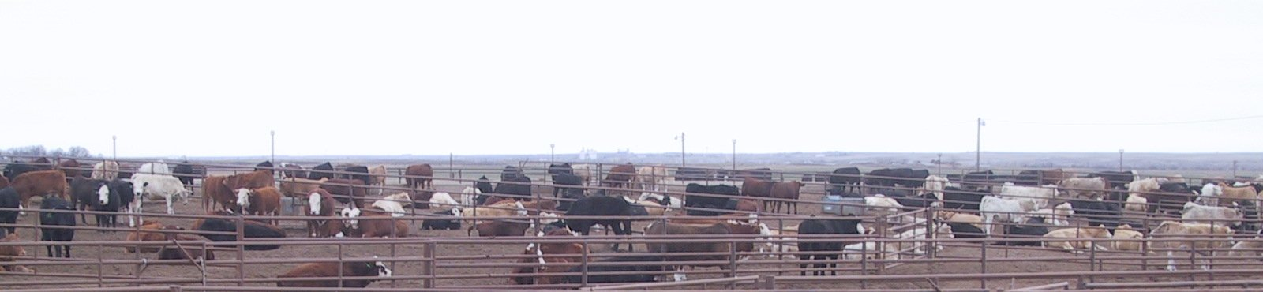
Preconditioning Programs
Goal:
Create weaned, properly immunized calves that will perform well when stockered or fed.
  Minimize stress
  Add value

Slide 43
Preconditioning Programs
Develop a nutritional program based around on farm forage resources targeting a desired rate of gain at a sensible cost.
Implement proper vaccination and other herd health management practices.
  Work closely with your veterinarian

Slide 44
How to reach target gains?
Manipulate intake or nutrient density (within limits)
  More concentrated on receiving to still reach target gains
Think back to nutrient requirements
  More gain = more nutrient requirements
  Hard to increase intake so increase nutrient density

Slide 45
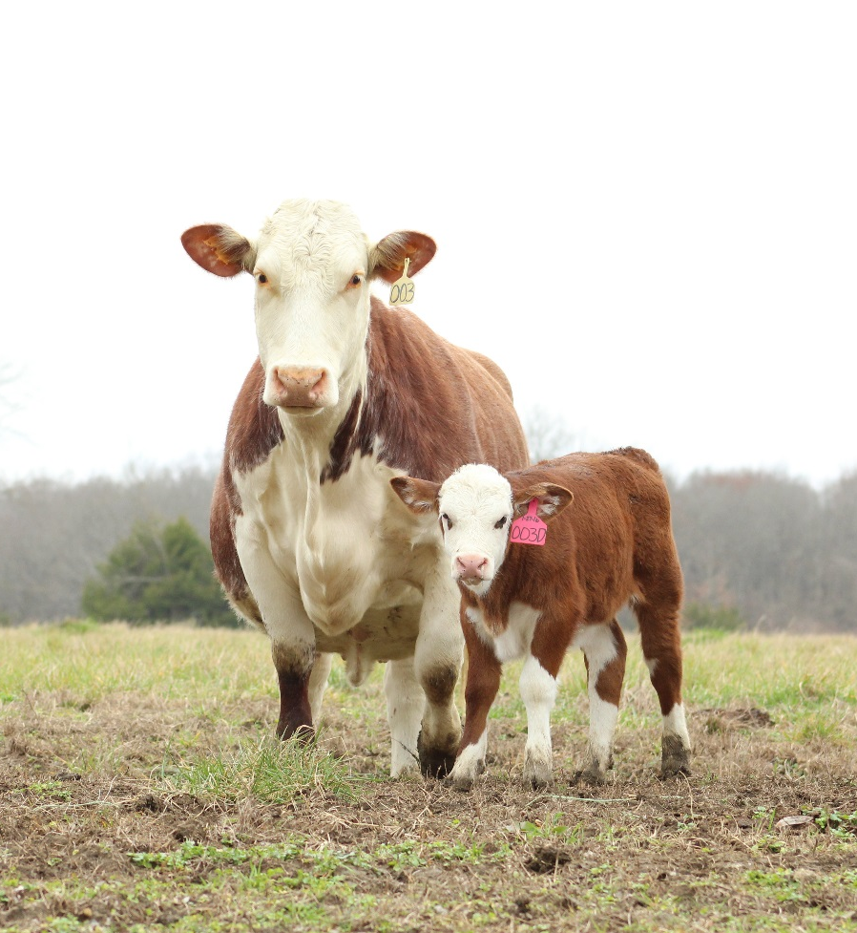
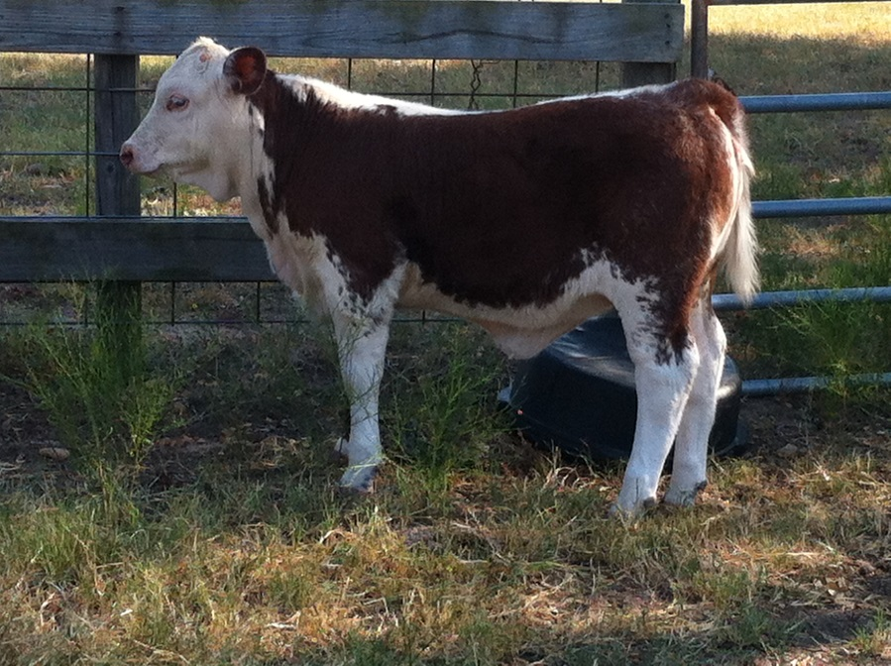
Heifer Development

Slide 46
What’s the GOAL?
Puberty
12 months
Breeding
15 months
Gestation
Parturition
24 months
Rebreeding 26 months
65% mature body weight
80% mature body weight

Slide 47
Making a plan…
Day
- 555
- 315
- 255
- 30
0
Targeted Growth
Breeding
Gestation and Development
Calving to Breeding
(240 days)
(60 days)
(225 days)
Age
(months)
6
14
16
23
24
# of days to reach target breeding weight
285 days
Notes:
The day the cowherd begins calving is our reference point to coordinate our heifer development calendar.
(Click mouse)
We want our heifers to begin calving about 30 days prior to the cowherd in which they will eventually enter. The reason being is that it generally takes a first calf heifer an extra heat cycle, relative to a mature cow, to rebreed for her second calf. The heifers age at first calving is about 23 months.
Then we simply backtrack from that point to set critical target dates and ages that become our development calendar.
From day minus 30 we back up 285 days, the gestation period, and that is the day we begin breeding or turn in the bulls. This is 30 days before bulls are placed with the main cowherd. The heifers are about 14 months of age at this time. In this scenario the bulls will come out 90 days later or when the heifers are 17 months of age.
(Click mouse)
Then we determine our age at weaning from the cows calving date this determines the number of days we have to grow the heifers to the target breeding weight.

Slide 48
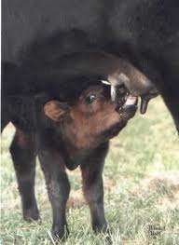
Birth to weaning
Heifer is cared for by dam
  Diet: milk and pasture forages
Management practices:
  Creep feeding
  Growth-promoting implants

Slide 49
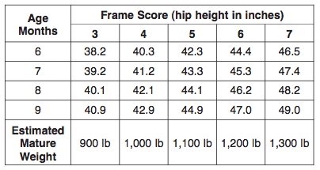
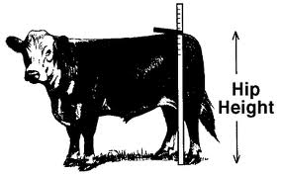
Weaning to breeding
Heifers need to be approximately 65% mature body weight by breeding
How do you determine “mature” body weight??
Notes:
INSERT TABLE OF TRANSLATING HIP HEIGHT TO MATURE BODY WEIGHT

Slide 50
Weaning to breeding
Calculating weight gain needed
Desired breeding date
Count days from weaning until desired breeding date
Days until start of breeding
Expected mature weight
x
65%
=
Target weight
Target weight
-
Starting weight
=
Lbs. of gain needed
Lbs. of gain needed
Days until start of breeding
÷
=
Required ADG

Slide 51
Example
Heifer birthdate: February 1, 2016
Weaning date: August 25, 2016
Weaning weight: 450 lbs.
Expected mature weight: 1200 lbs.
Desired breeding date: April 22, 2017
65% of mature weight
Weight gain needed
Days from weaning to breeding
ADG
= .65 x 1200 = 780 lbs.
= 780 – 450 = 330 lbs.
= 240 days
= 330 / 240 = 1.38 lbs/day

Slide 52
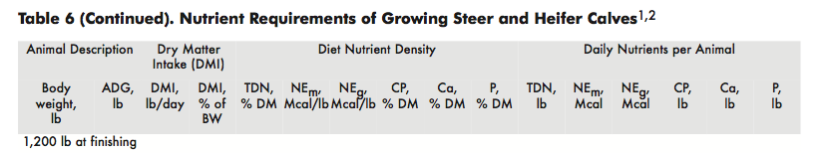
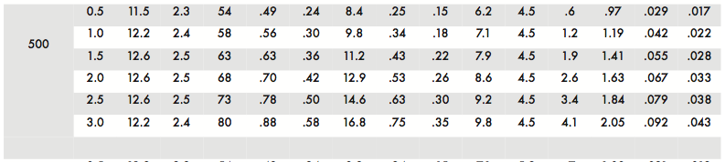
Weaning to breeding
Beef Cattle Nutrient Requirements, http://msucares.com/pubs/publications/p2528.pdf
Notes:
DMI: amount of forage or intake consumed in a day
TDN: total amount of nutrients that are digestable; for practicle purposes of balancing rations and determining energy supp in diets, TDN is the key value to consider
Energy is more likely to be deficient in MS beef cattle diets than protein because of forage base

Slide 53
Growth Scenario
Heifer Status:
  6 months
  450 lbs
  1.5 ADG
Requirements:
  1.4 lbs crude protein
  7.9 lbs TDN
Forage Status:
  Mature/Processed forage
  CP 8%
  58%TDN
  DMI (%BW) 2.5 %
Daily requirements of growing heifers, NRC 1996
Notes:
Preconditioning is very important and will set the stage for performance until breeding. Targeting a 1.5 ADG will put these heifers a little ahead of the curve at this point.

Slide 54
Growth Scenario:
What does she get from the forage?
Total DM Intake:
  450 lbs x 2.5% = 11.25 lbs
Total Protein Intake:
  11.25 lbs x 8% = .90 lbs
Total Energy Intake:
  11.25 lbs x 58%= 6.53 lbs TDN
Notes:
If we do the math we can calculate the daily intake of protein and energy.

Slide 55
Does the forage alone meet her needs for growth?
 | Requirements | Forage Supply | Deficient
Crude Protein | 1.4 lbs | 0.90 lbs | (0.50 lbs)
ME (Mcal) | 7.9 lbs | 6.53 lbs | (1.36 lbs)
Need to provide a supplement to meet her remaining needs.
Daily requirements of heifers, NRC 1996
Notes:
We compare the requirements with the supply from the forage and calculate the difference. In order to reach our target weight we will need to supplement these cattle both protein and energy.

Slide 56
Growth
If we feed Soyhull pellets, the heifers would need:
0.50 lbs of CP
SHP have 12% CP so…
0.50/.12 = 4.16 lbs of SHP
to meet her protein needs
1.36 lbs of TDN
SHP have 57% TDN so…
1.36/0.57= 2.39 lbs of SHP
to meet her energy needs
Supplement heifers with 4.16 lbs SHP per head per day to meet their needs to gain 1.5 lbs/day during the growth phase

Slide 57
Conclusions
Feeding cattle is dynamic
Feed hay and supplements as efficiently as possible
Test feeds whenever possible
Value feeds based on nutrient of interest
Don’t forget about minerals!

Slide 58
Questions?
Dr. Brandi B. Karisch
Beef Cattle Specialist
Animal and Dairy Sciences
Office: 662-325-7465
Fax: 662-325-8873
Email: brandi.karisch@msstate.edu

