Slide 1
Shifting the paradigm: A Systems approach to Beef Producer education
Dr. Matthew G. Burns
Extension Beef Specialist
Clemson University Cooperative Extension
10/25/16

Slide 2
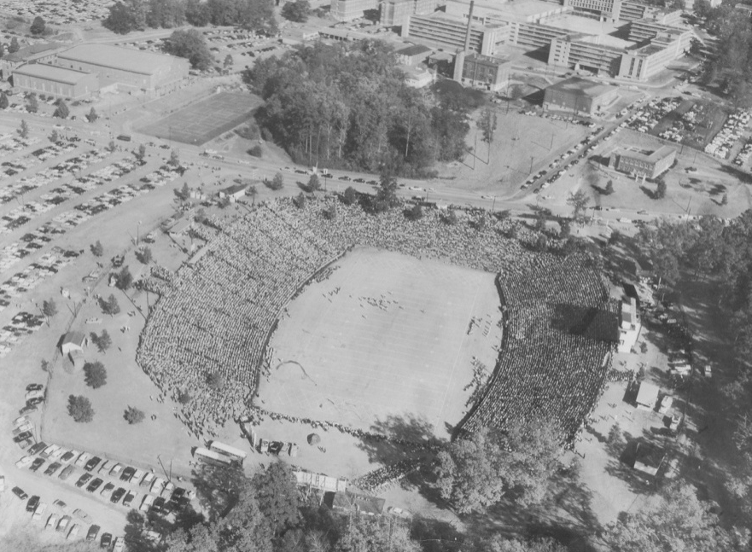
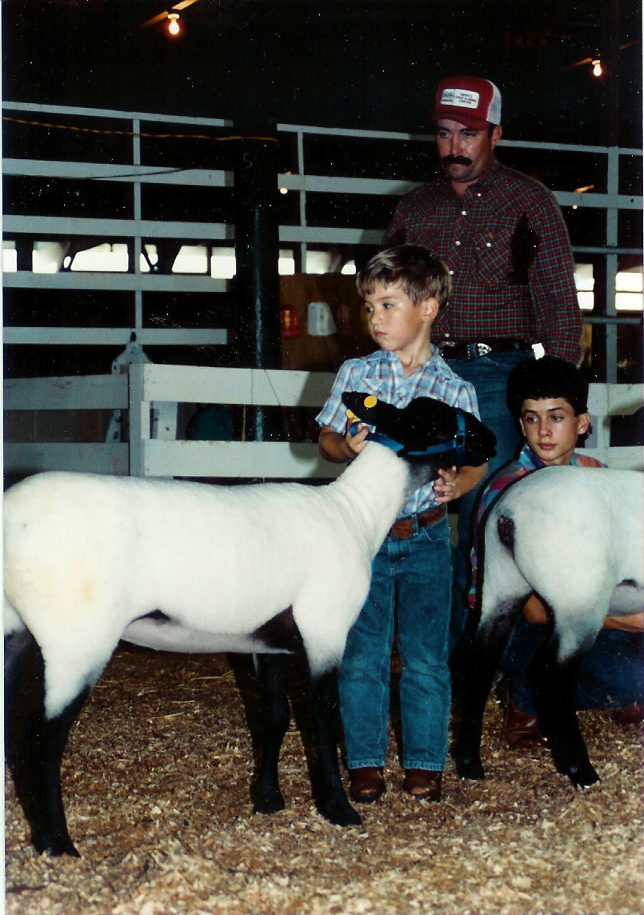
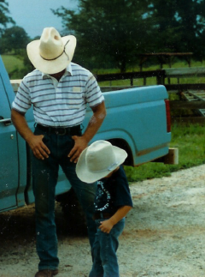
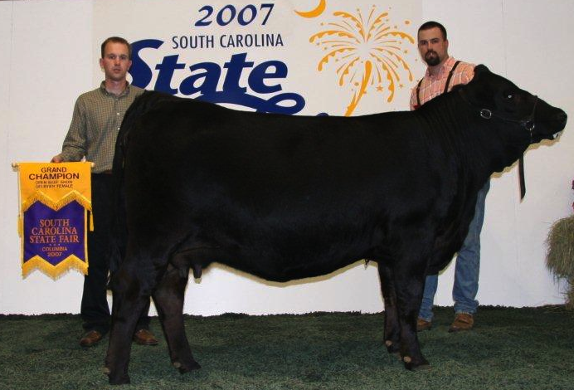
Growing Up
Grew up in Pendleton, SC on small family farm showing sheep and cattle in 4-H &FFA
Father manages Clemson University’s Beef Farm
Grandfather played on Clemson’s 1939 Cotton Bowl football team
Sooo naturally...

Slide 3
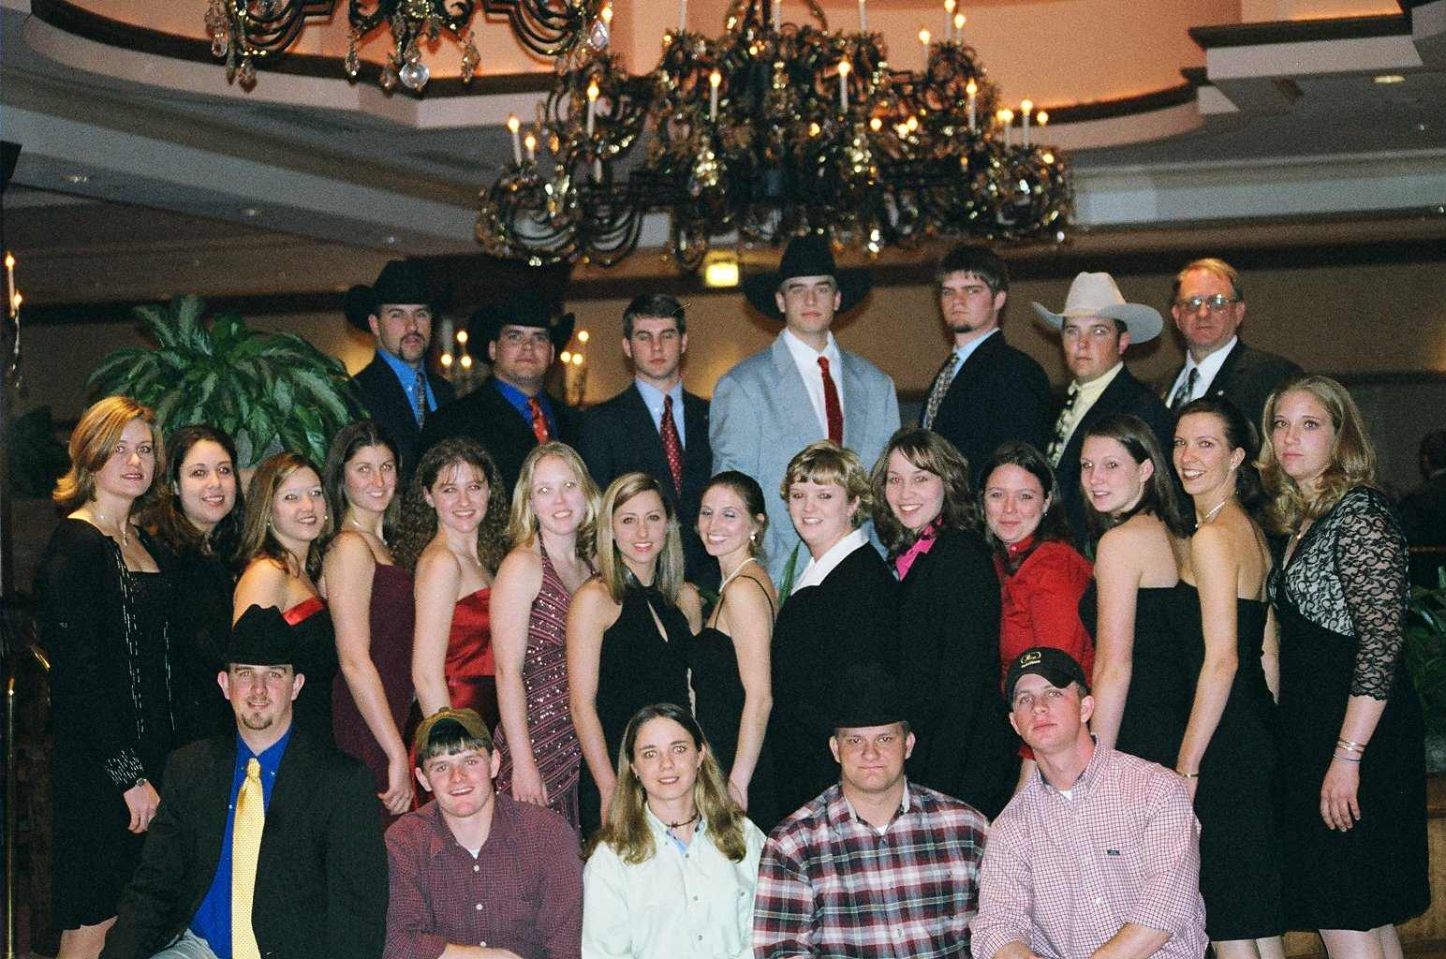
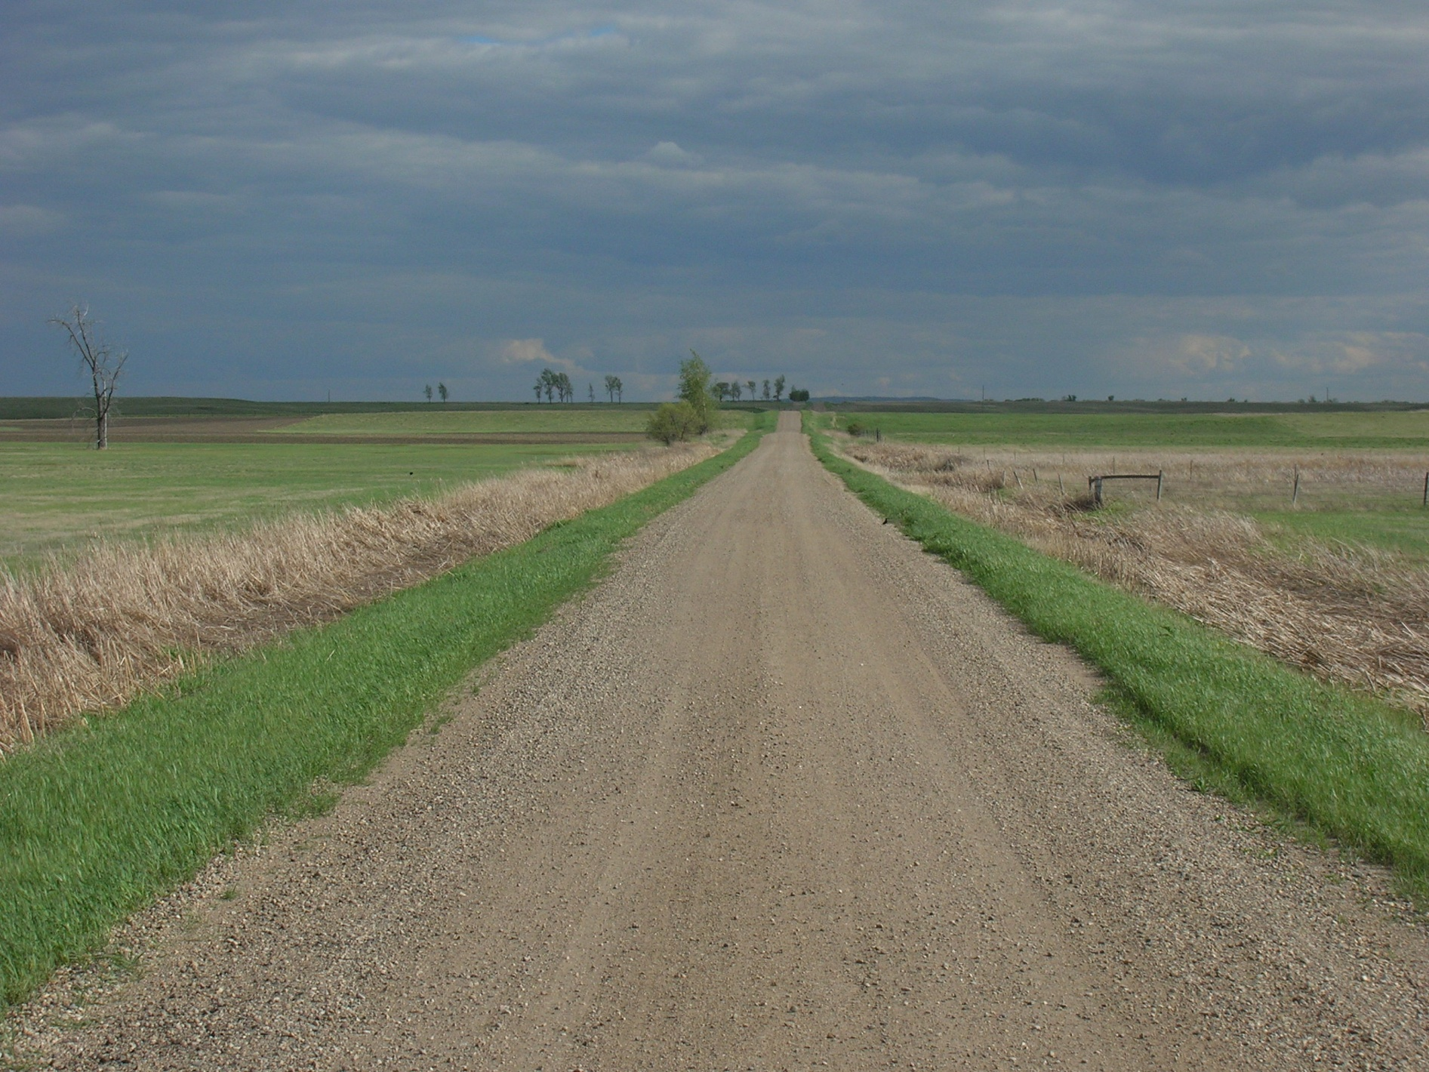
I Became a Tiger
B.S. degree from Clemson University
Summer internship on Bodine Ranch in Velva, ND.
M.S. degree in reproductive physiology from Kansas State University
Ph.D. from Clemson University in forage/animal systems interaction (also served as County Agent for 6 years)

Slide 4
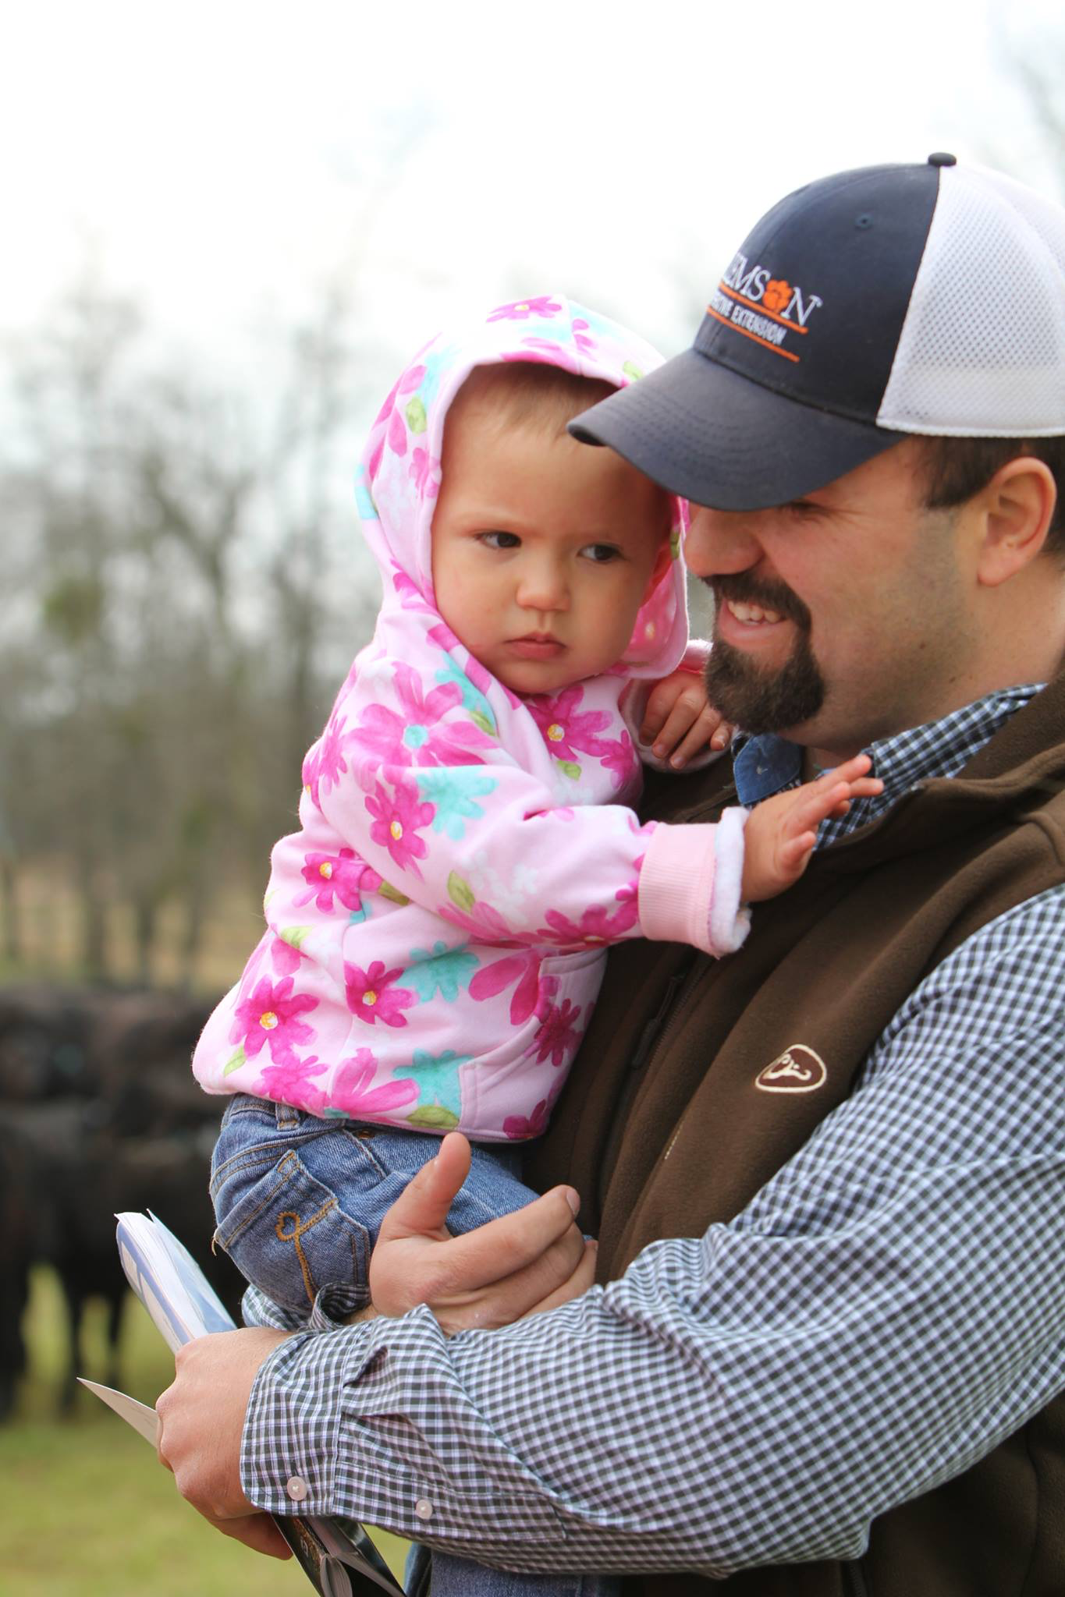
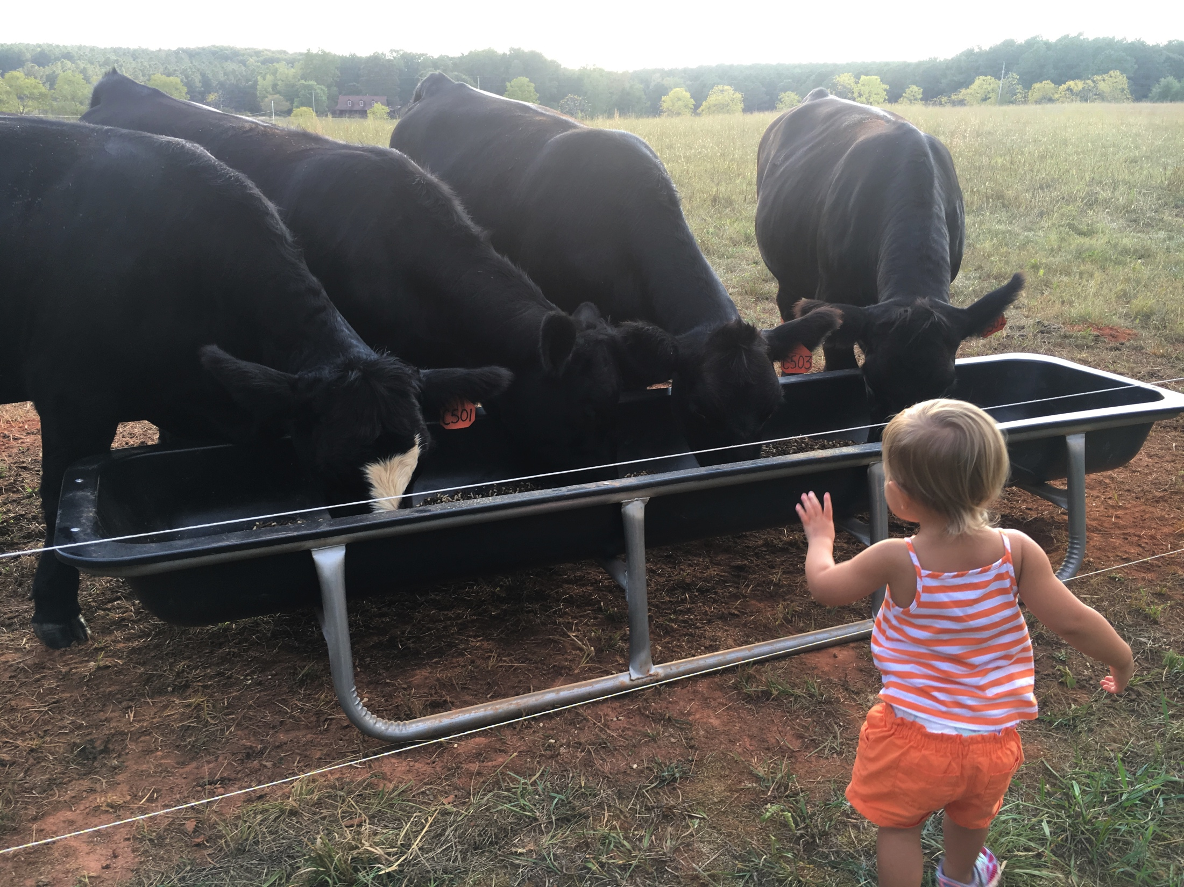
Currently
Clemson University Cooperative Extension Beef Specialist
Livestock and Forages Program Team Leader

Slide 5
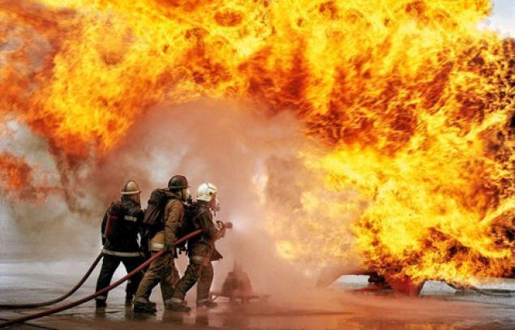
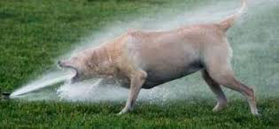
How do we currently educate in Extension?
The fire hose method
Putting out fires
Information overload
Providing information to a broad audience with an even broader knowledge base.
Data suggests the attention span of adults is as short as 8 sec, but no longer than 20 minutes

Slide 6
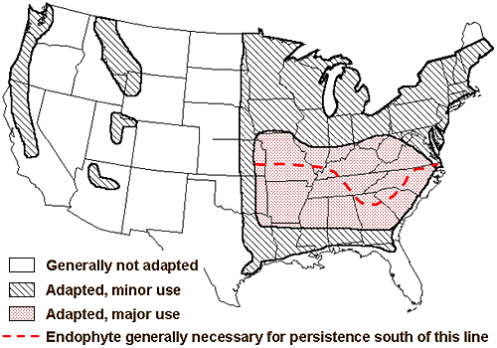
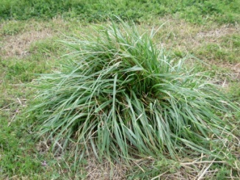
Tall Fescue
Tall fescue (Lolium arundinaceum)
Most widely cultivated pasture grass in the U.S. (Ball et al., 2002)
49 million ac. (Bouton et al., 2001)
8.5 million beef cows (Stuedemann and Seman, 2005)
Major and Minor Areas of Tall Fescue Use in the US
Adapted from West (1998)

Slide 7
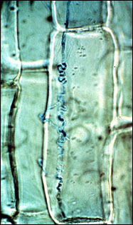
Endophyte ( e+ )
Fescue toxicosis is caused by an endophyte (Neotyphodium coenophialum)
Endophyte produces ergot alkaloids
Increases plant vigor:
Heat/drought tolerance
Insect resistance
Grazing tolerance
Causes fescue toxicosis is cattle

Slide 8
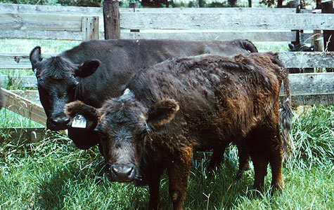
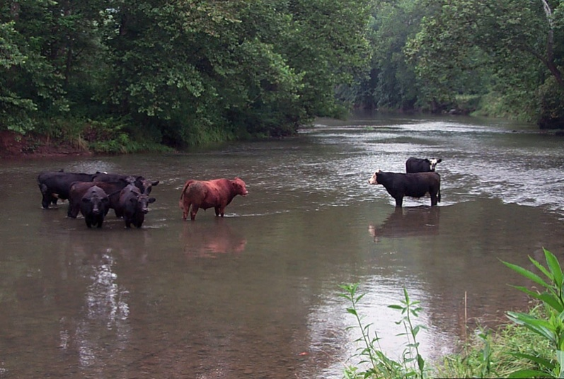
Fescue Toxicosis
Characterized by decreased
weight gain
milk production
conception
serum prolactin
Inability to dissipate heat due to vasoconstriction of vascular system
Estimated cost to beef producers > $1 billion annually (Hoveland, 1993)
Paterson et al., 1995

Slide 9
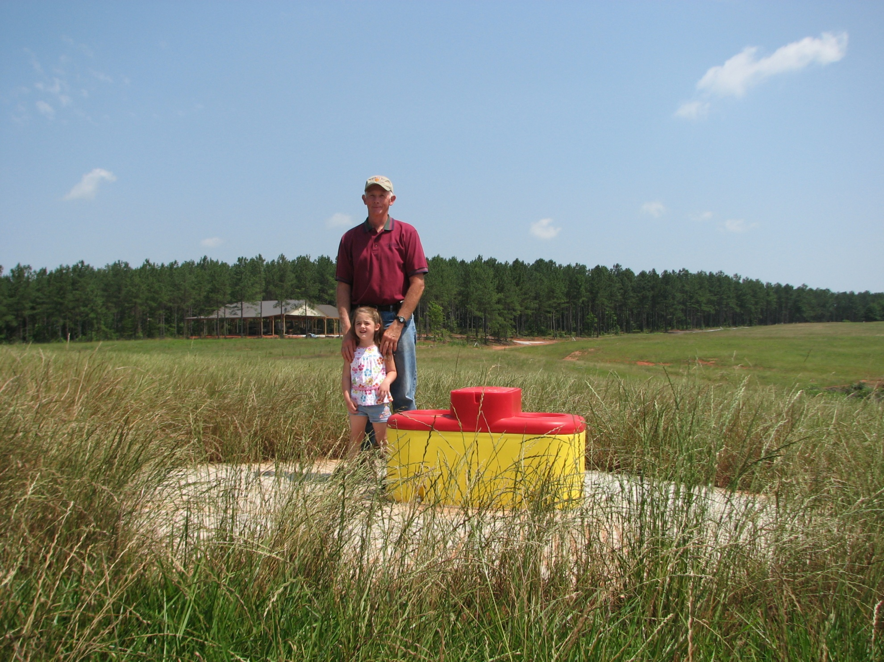
Extension Ignites Research
NEGATIVE IMPACTS OF TOXIC TALL FESCUE ON REPRODUCTION DIFFER ACCORDING TO COW AGE

Slide 10
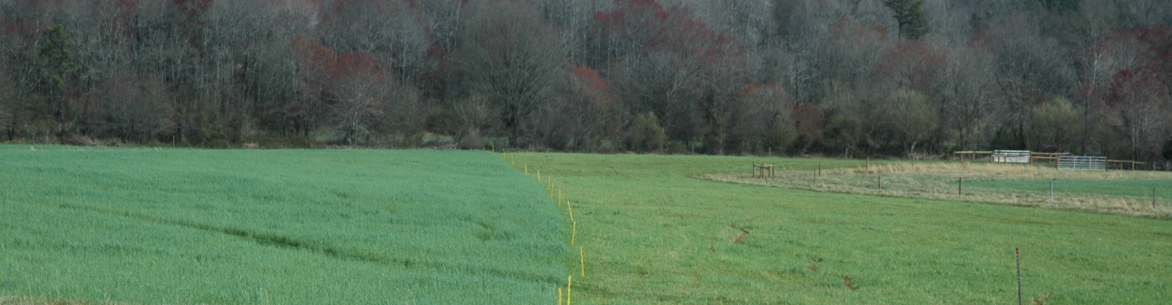
On Farm Producer Data
Upstate South Carolina producer wanted to utilize estrous synchronization and AI for the first time.
We set forth a plan to allow him to implement this.
Working facility location caused the producer to move cattle from NE+ to E+ tall fescue 2 wk prior to initiation of estrous synch protocol.
Brangus x Angus cattle:
Two (n = 32) & 3 (n = 16) yr old cows (young)
Mature cows (n = 33)

Slide 11
Producer Data Timeline
2nd Pregnancy Diagnosis
GnRH +
Breed
Bulls turned in
Initiation of E+
GnRH
PGF_{2α}
CIDR
-24
-10
-3
0
10
Days from TAI
1st Pregnancy Diagnosis

Slide 12
TAI Pregnancy Rate
-------------------------------------------------------------------------------------------------
Pregnancy Rate, %
#

Slide 13
Natural Service Pregnancy Rate
Pregnancy Rate, %

Slide 14
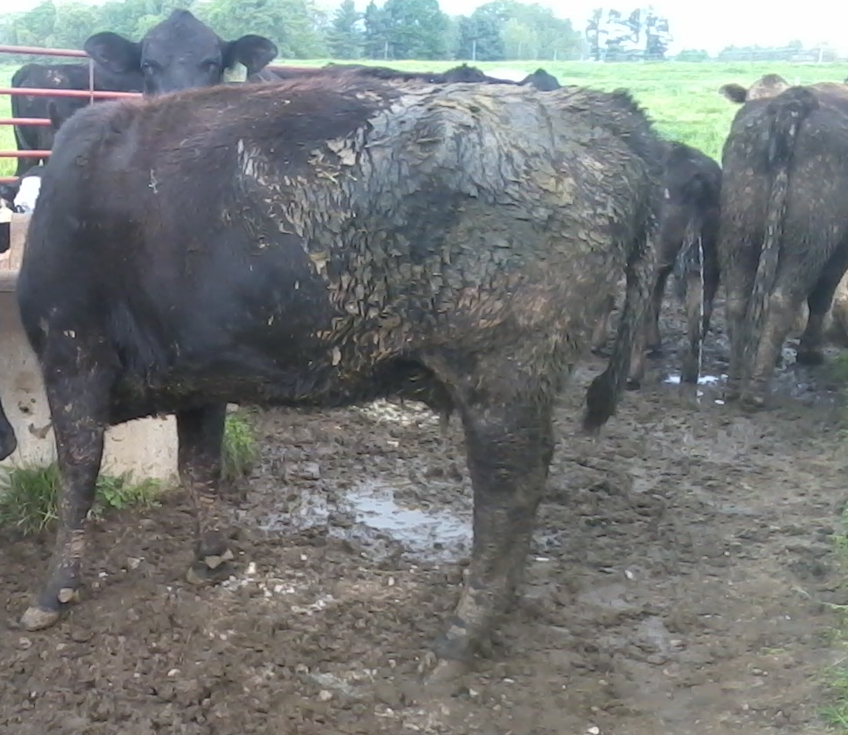
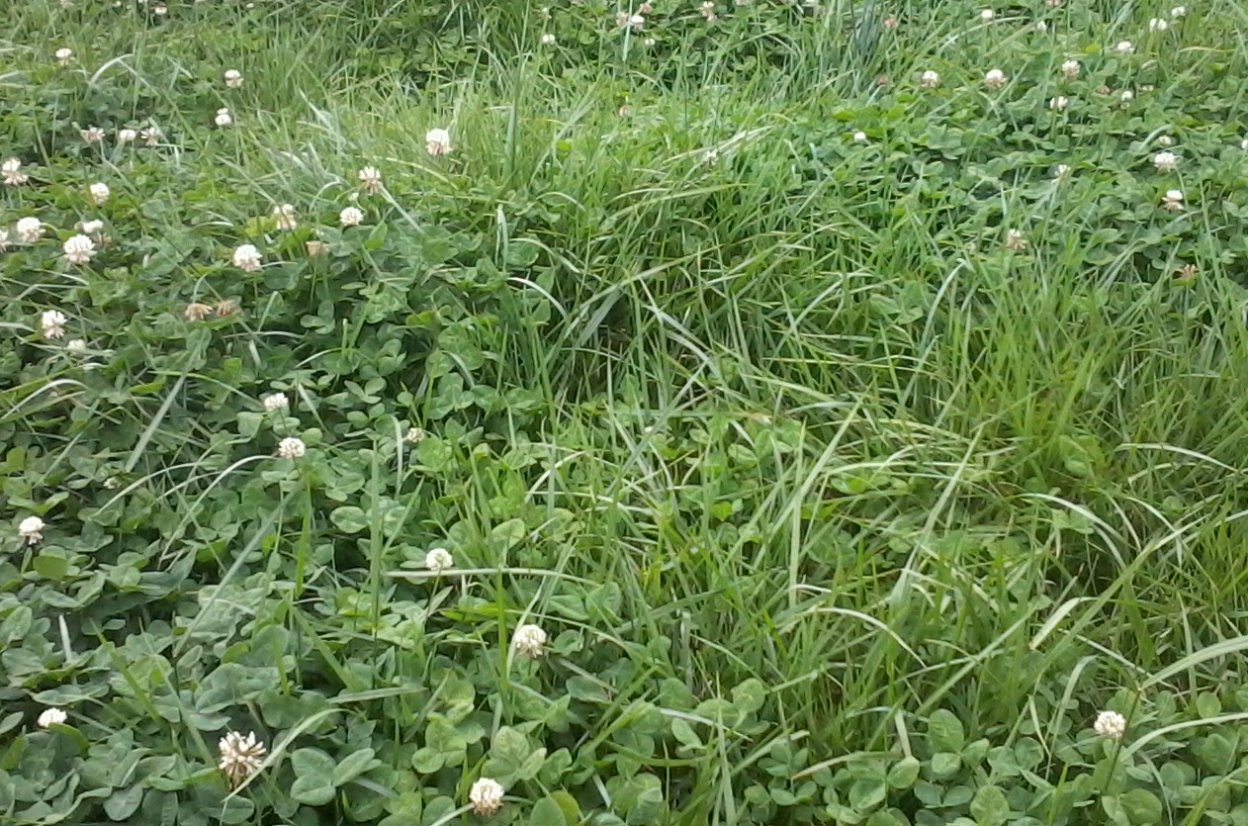
Meeting of the minds
What was happening with the younger cows being exposed to E+ prior to breeding?
When was this happening? And…
How could we address the timing of negative impacts due to E+ exposure?

Slide 15
2 & 3 year old cow, multi-year study
2 & 3 yr old (yr 1, 2 and 3) and Mature (yr 3) Angus and Angus-crossbred cows
Allocated to graze E+ or O (other forages) pre-AI
60 d prior to breeding season
Stratified by age, BCS, and days postpartum
Estrous synchronization & TAI
Reallocated to grazing treatment post-AI
2 x 2 Factorial Design:
Pre-AI (E+ or O)
Post-AI (E+ or O)
Total of 4 treatment groups
E+E+, E+O, OE+, & OO

Slide 16
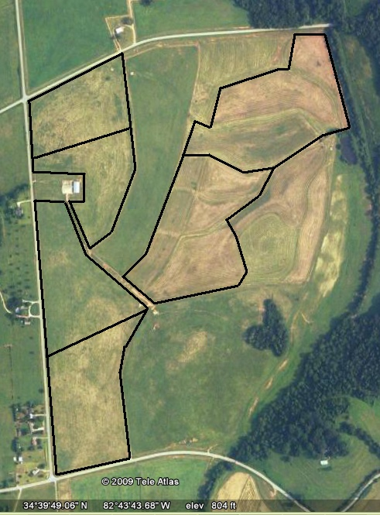
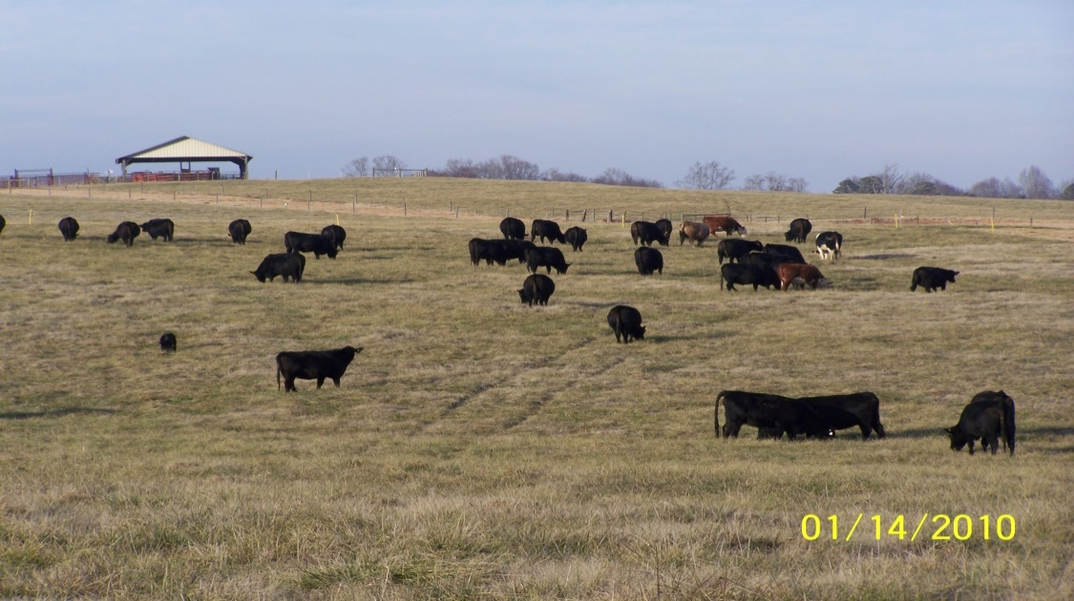
Study Design
50 % Grazing E+
50 % Grazing O
94%
50 % Grazing E+
50 % Grazing O
1/2 cows from each group switched at breeding
74%

Slide 17
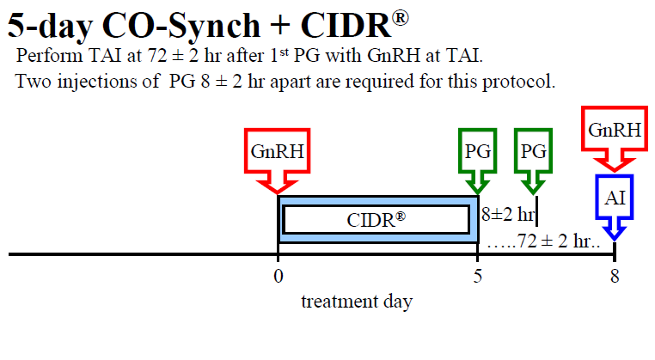
Synchronization

Slide 18
TImeline
PGF x 2 (8h apart)
1st Pregnancy diagnosis
2nd Pregnancy diagnosis
3rd Pregnancy diagnosis
GnRH
GnRH
CIDR
P4 + PRL
P4
TAI
PRL
PRL
PRL
-18
-8
-3
0
30
60
130
Days from TAI

Slide 19
E+
(BCS = 5.11 ± 0.10)

Slide 20
O
(BCS = 5.38 ± 0.10)

Slide 21
Final Pregnancy Rates
Pregnancy Rate, %
E+ = toxic tall fescue; O = other forages

Slide 22
Shifting the Paradigm
We must begin to shift our thinking to a systems approach
This means both Extension and Producer
How does a decision you make about marketing today impact your forage needs two years from today?
How long will your next genetic decision affect your operation?
It is very easy to make decisions in a “silo”, but we need to step outside the “silo” and get the areal or “big” picture effect

Slide 23
Before Converting
Develop or have significant rotational grazing physical structures (fencing and water) and the skills, commitment and discipline to use it. Stop here, don’t go any further, till you get these capabilities.
Need to plan to use pasture for 6 years from date of planting – that is for sure the return on investment time frame. It is probably shorter time than this.
Largest cost – replacing the forage during the 2-3 year conversion period. Plan how the farm can operate with the pastures completely out of service from June 1 of planting year until May 1 of next year.
Plan how the farm can operate May of year 2 till May of year 3 with only about 50% capacity grazing. Fall of year 4 can have full grazing.
Options – reduce number of cows or use supplement and extra hay or rent another pasture
If keeping some pastures in KY31, plan how the KY31 pastures can be grazed so that NO livestock graze a KY31 pasture with seedheads then go to a novel fescue pasture without a 3 day waiting period. This requirement is in place until there is no KY31 in pasture on the farm.

Slide 24
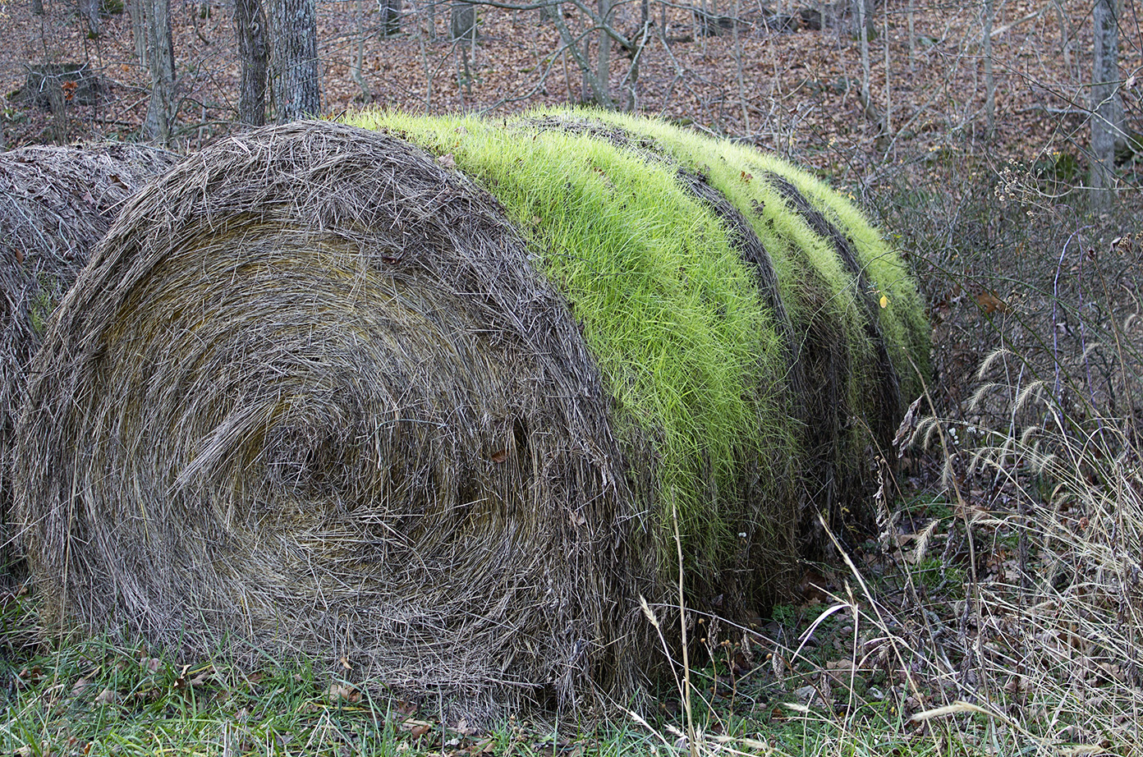
Before Converting
Never –
feed KY31 hay on a novel fescue pasture
feed cows KY31 hay then let them go to a novel fescue pasture within 3 days.
feed any kind of hay except novel fescue hay on novel fescue pastures to prevent competing grasses.
In January prior to planting in September
take a soil sample
add lime (to a pH of 6.2) – before March
P & K within recommended levels – before March
Secure a source for a no-till drill to plant
If you are not willing to do the above things, DO NOT waste time with converting.

Slide 25
How to Accomplish
It is imperative that Extension professionals take a systems approach with future recommendations.
The systems approach needs to be take with our Extension Outreach Programs as well.
What is the proper order of recommendations/Extension programs
Can we more efficiently relay information to our clientele?

Slide 26
Questions

