Slide 1
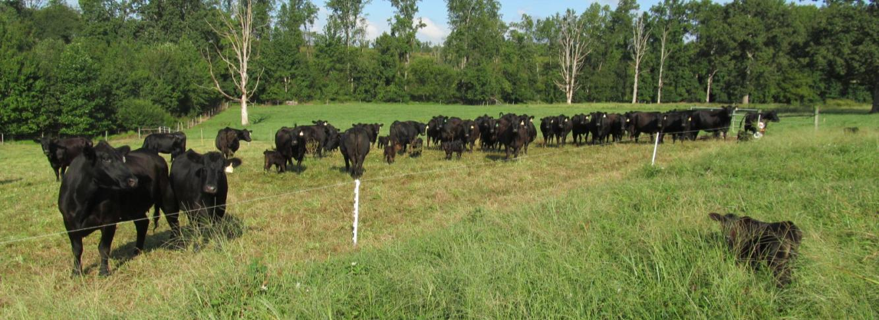

Effectively Using Electric Fences in Pasture-Based Livestock Systems
Dr. Matt Poore
North Carolina State University, Raleigh
Johnny Rogers
Rogers Cattle Company, Roxboro, NC

Slide 2

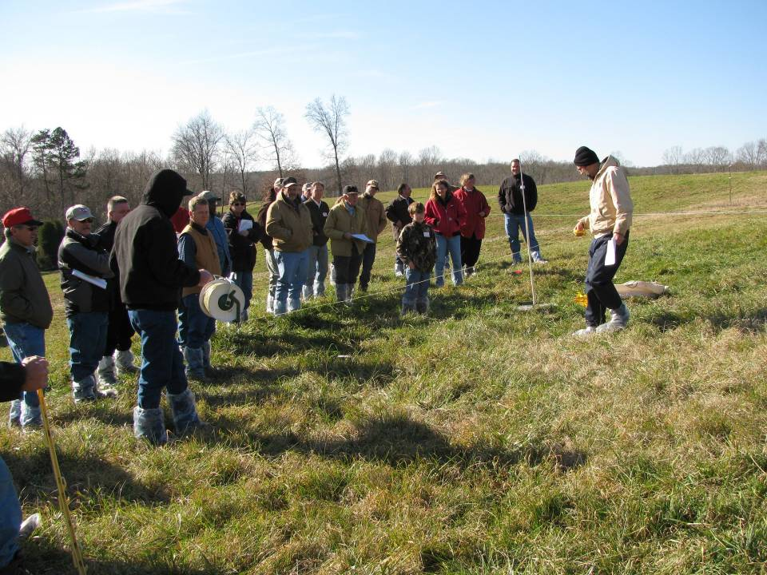
What is Amazing Grazing?
An educational program striving to improve pasture management through a better understanding of Pasture Ecology
  Training for advisors. Extension agents, conservationists, veterinarians, industry consultants
  Training for producers
    Publications
    Hands-on workshops
    Demonstrations
  Applied research
    Grazing systems
    Legumes

Slide 3
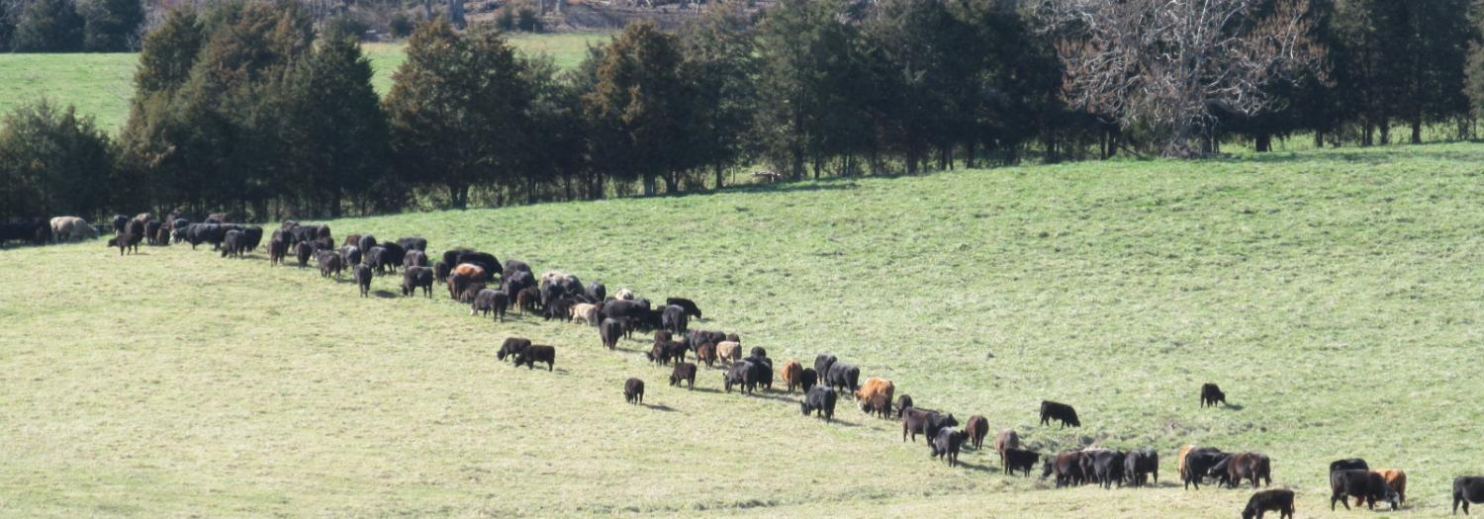

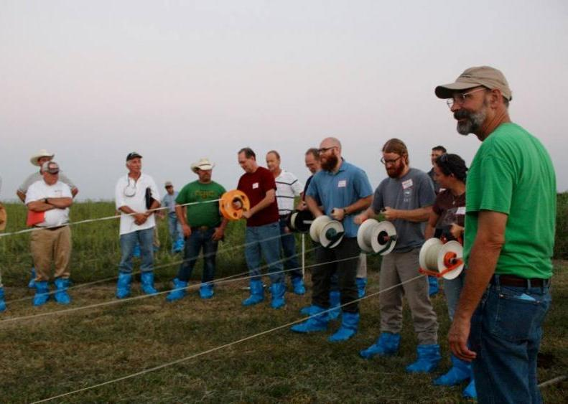
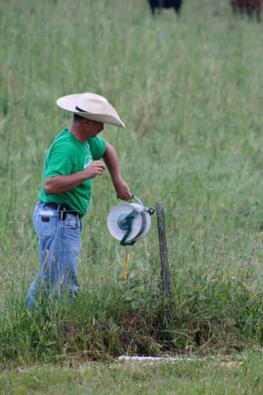
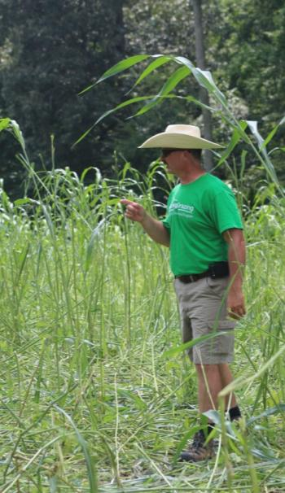

Slide 4
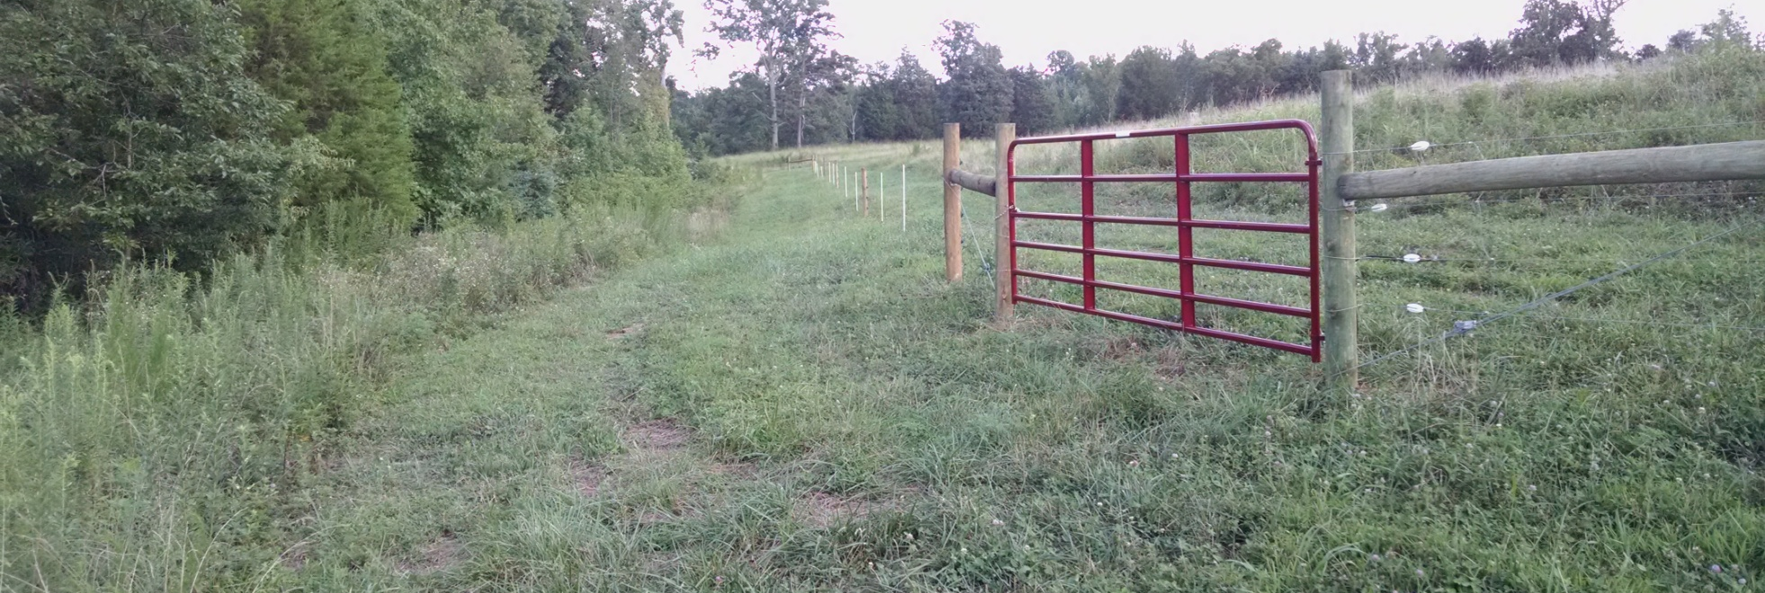
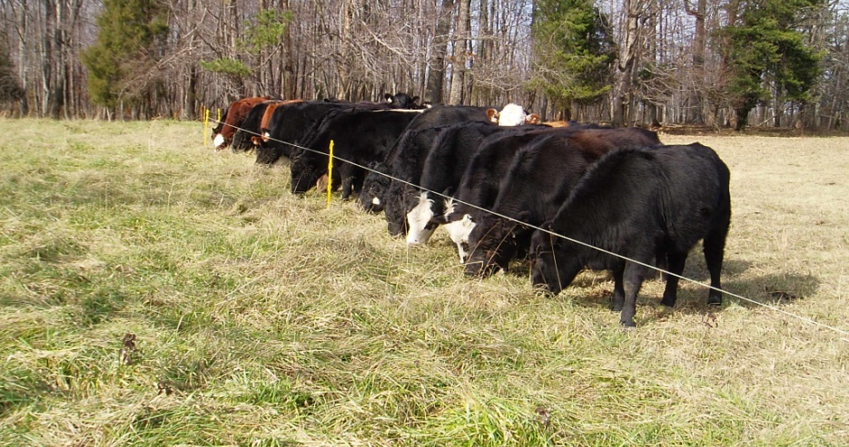
The best systems use
good perimeter fence
and temporary fence
for crossfencing!

Slide 5
Components to an electric fence
Energizer
  Get Plenty of Power
  Joule rating is not consistent between manufacturers but is your best guide. Small acreages 2.5 joules, large acreages >20 joules. 1 joule for 10 to 40 acres depending on expected conditions
Lightening Protection
  A well grounded energizer
  A well grounded electrical service
  A “spark gap” between the box and the fence
  Possibly an induction coil between the spark gap and the energizer

Slide 6
Components to an electric fence
Permanent Fence
  Put most of your effort into braces
  Use “pulpwood posts” not “peeler cores”
  Avoid using steel posts
  Use good quality insulators
Temporary Fence
  Use polywire in most cases for cattle (rather than tape)
  Use medium to high price poly wire (9 strand)
  Use good quality reels
  Stabilize with temporary corners/stretch posts

Slide 7
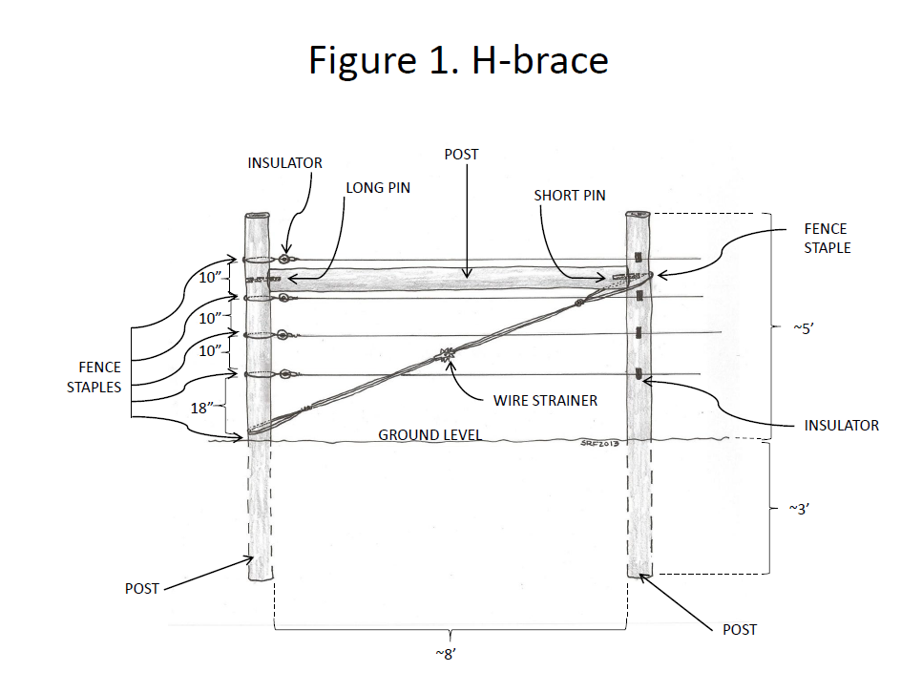

Slide 8
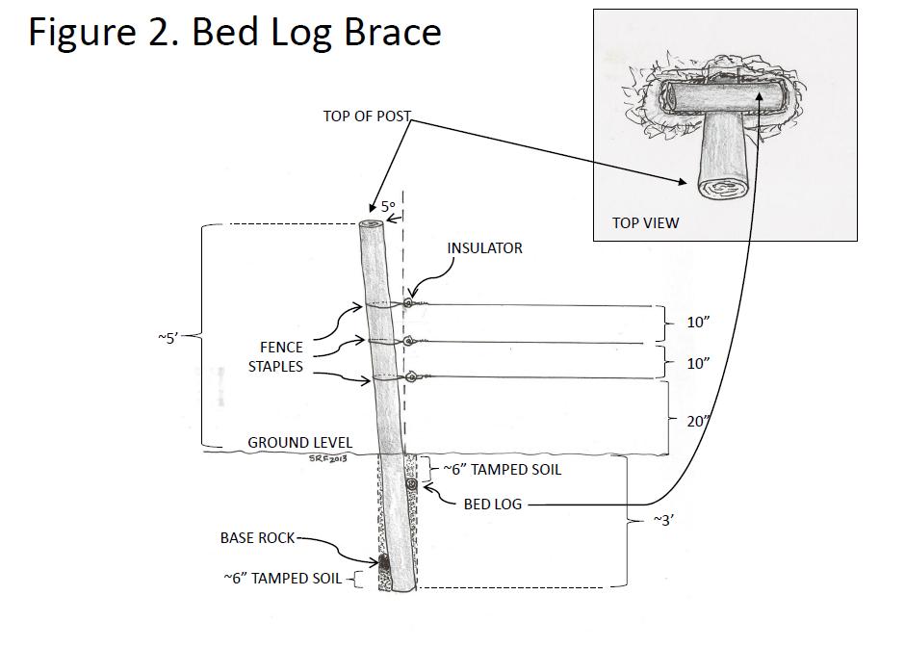

Slide 9
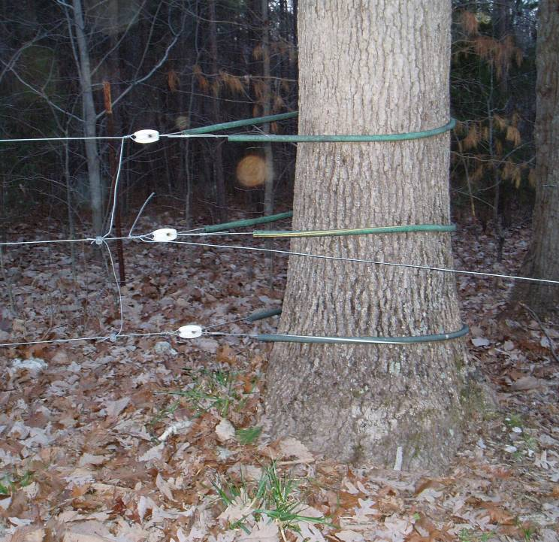

Slide 10
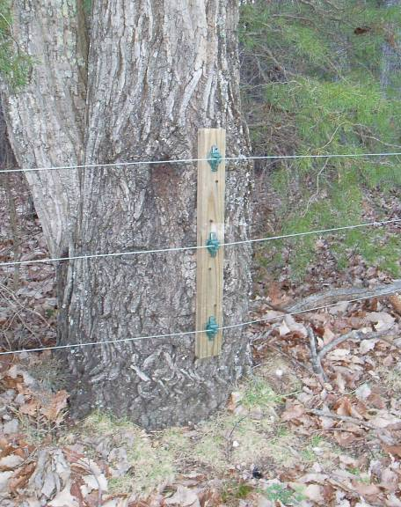
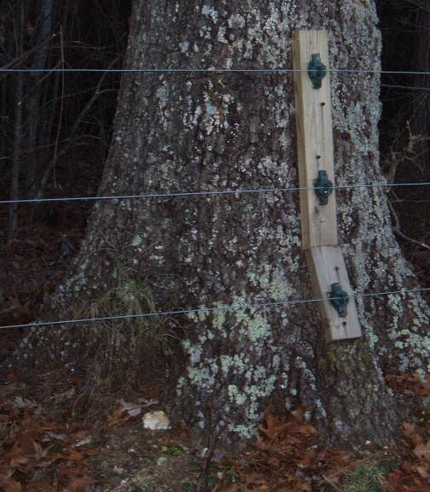

Slide 11
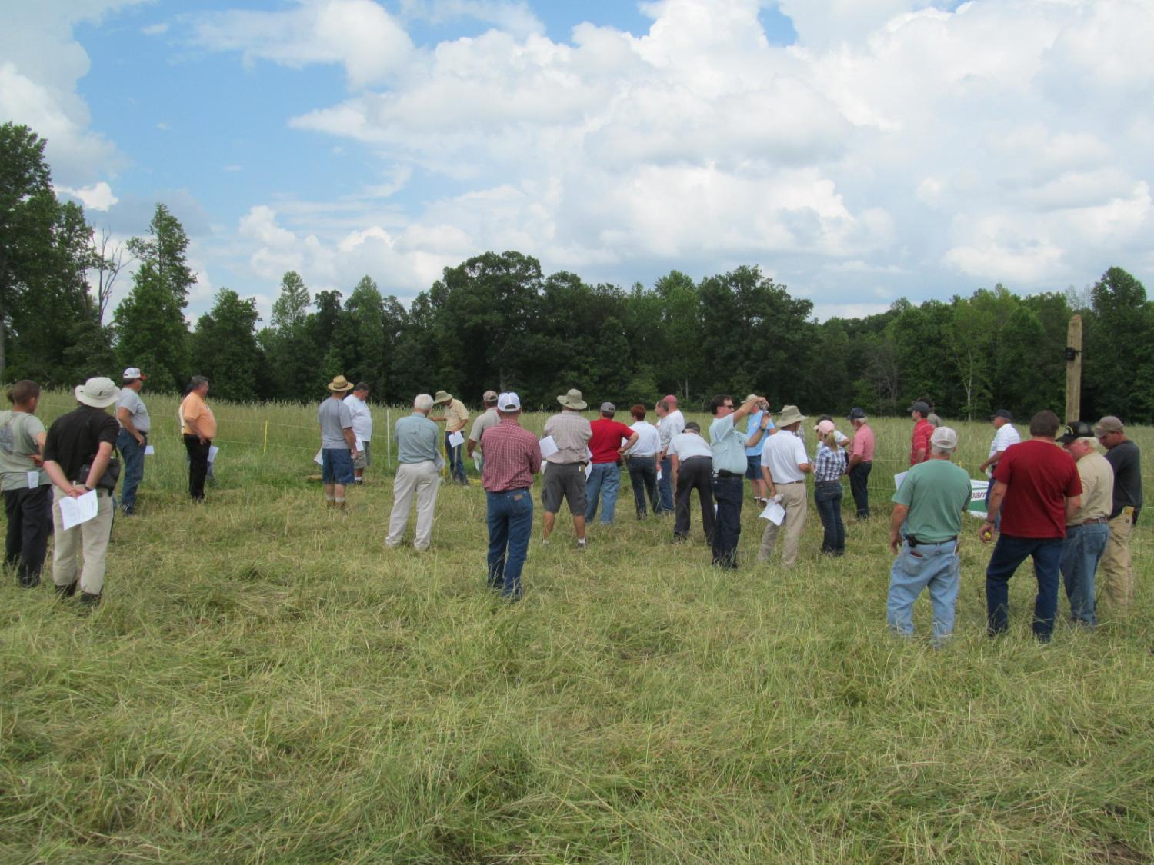

Slide 12
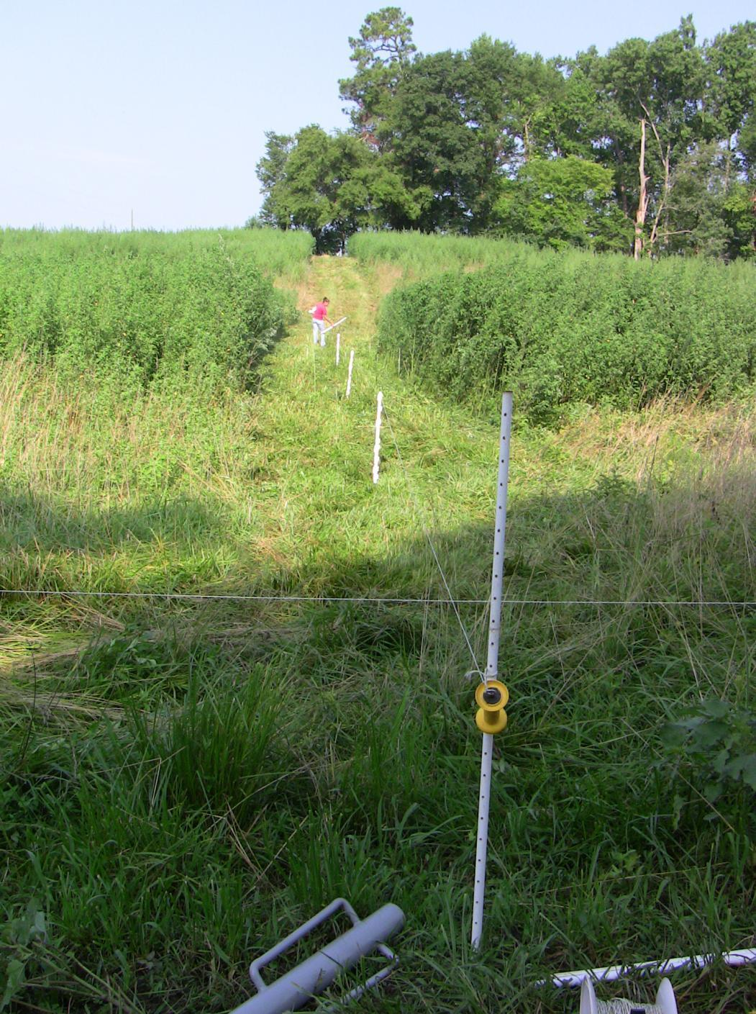

Slide 13
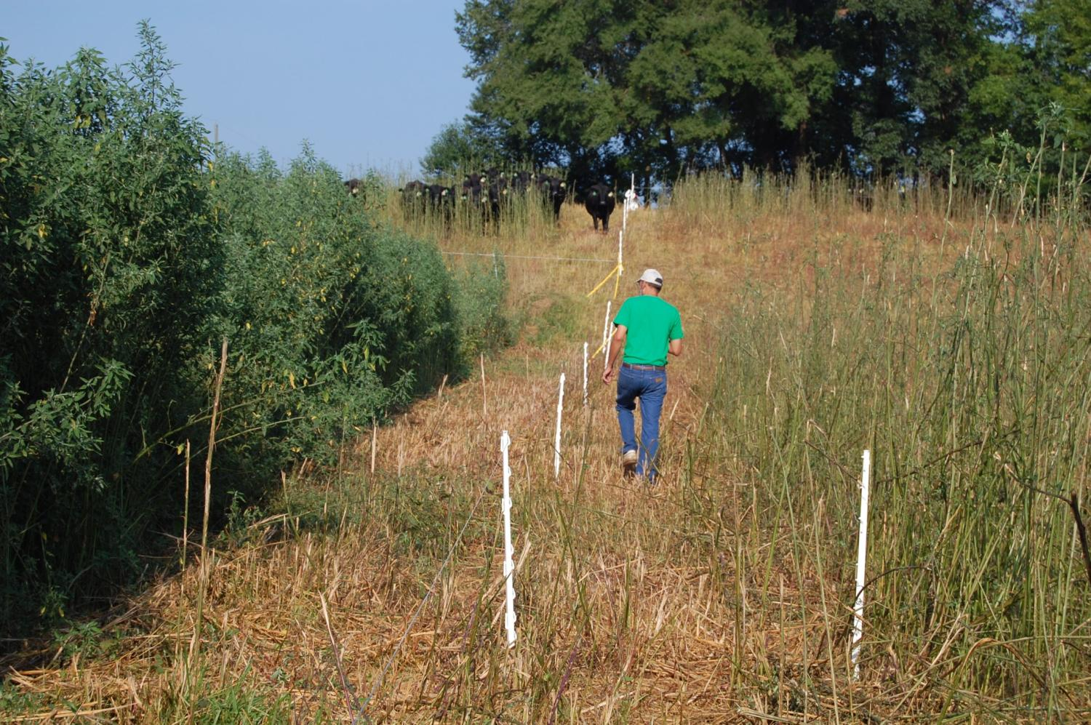

Slide 15
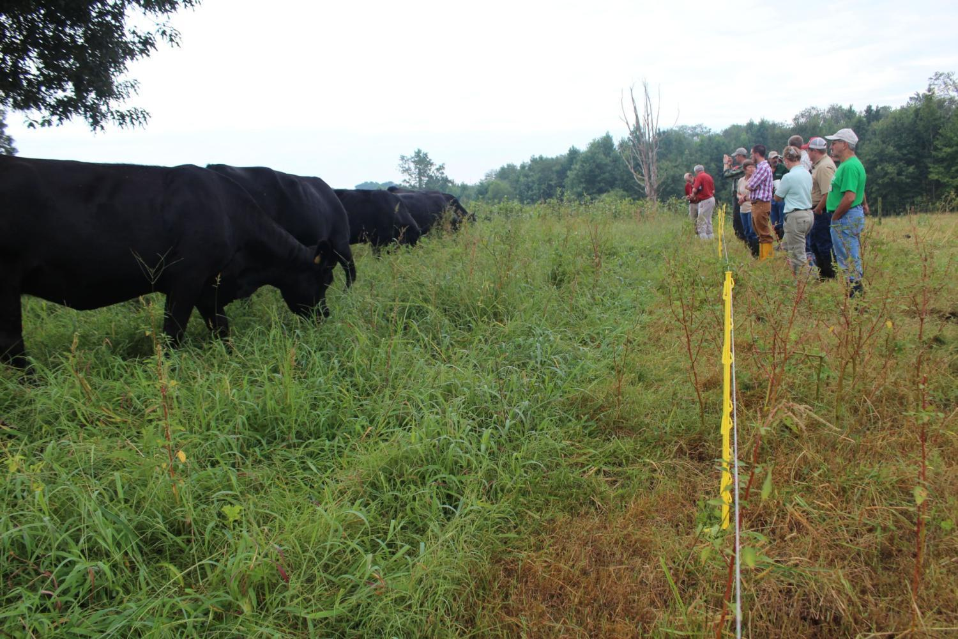
Questions?

Slide 16
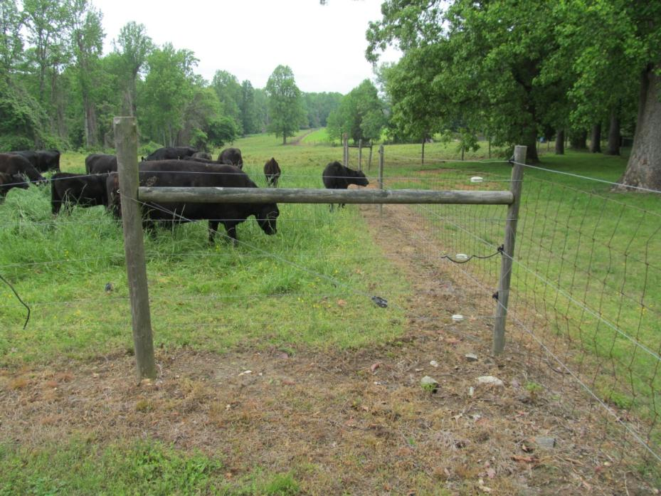
Troubleshooting Electric Fence

Slide 17
Troubleshooting Electric Fence
Scenario 1. Low power on the fence.
Scenario 2. Frequent lightening damage.
Scenario 3. Deer constantly tear down temporary fences.
Problems could be from a weak charger,
vegetation and shorts on the fence,
poor ground, or probably a combination

Slide 18
“1 joule for 10 to 40 acres
depending on expected conditions”
Energizer should keep at least 5 kV on the fence
during good conditions for cattle and 7 kV for small
ruminants:
Minimum needed to control:
Horses < 3 kV
Cattle – 3 kV
Sheep and goats – 5 kV
Deer and wildlife > 5 kV
Successful use of temporary fence will require
controlling deer in most environments.

Slide 19
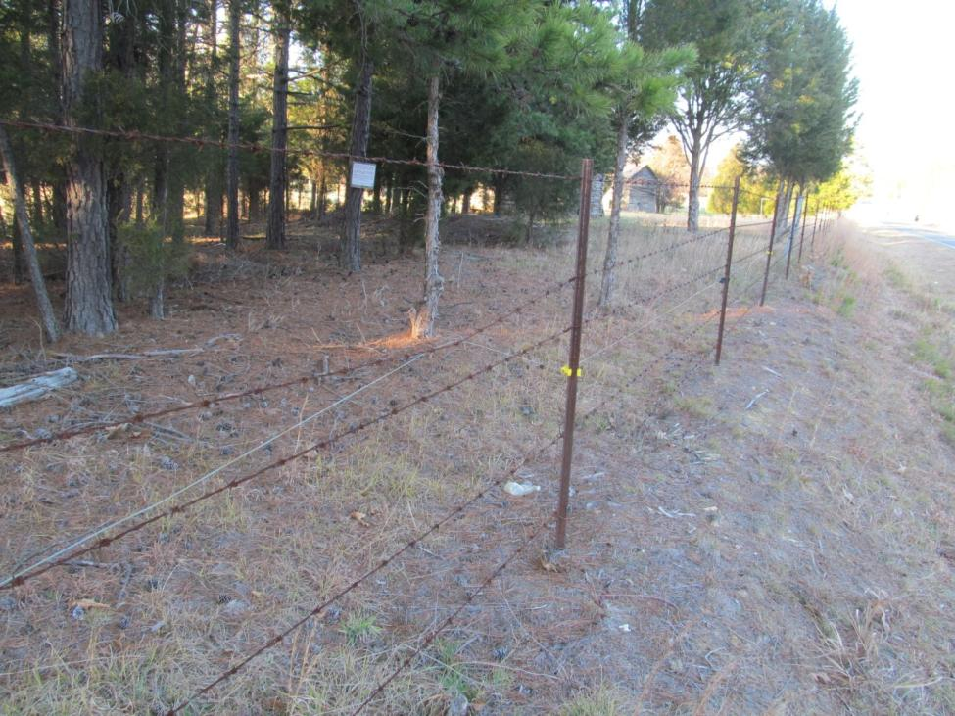
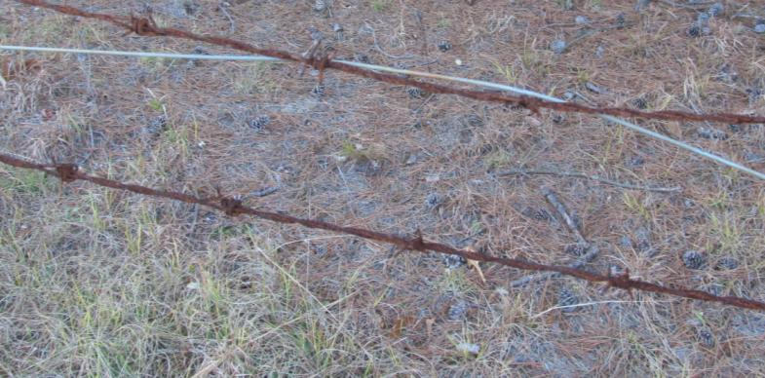
Avoid things that
might cause bad
shorts during
construction
Well grounded metal
Old fences
Wires very low to
the ground
Don’t use t-posts and
stay away from old
barbed wire if at all
possible
Very few energizers can
hold up to this kind of
challenge

Slide 20
Vegetation is the Biggest Long-Term Maintenance Challenge
Fence is a big investment, so it should receive proper maintenance.
Tighten as needed
Repair insulators as needed
Control Vegetation!
  For sure prevent brush and woody species
  Kill or suppress grass
  Use hand labor and or/herbicides
Vegetation can be a huge drain during wet conditions

Slide 21
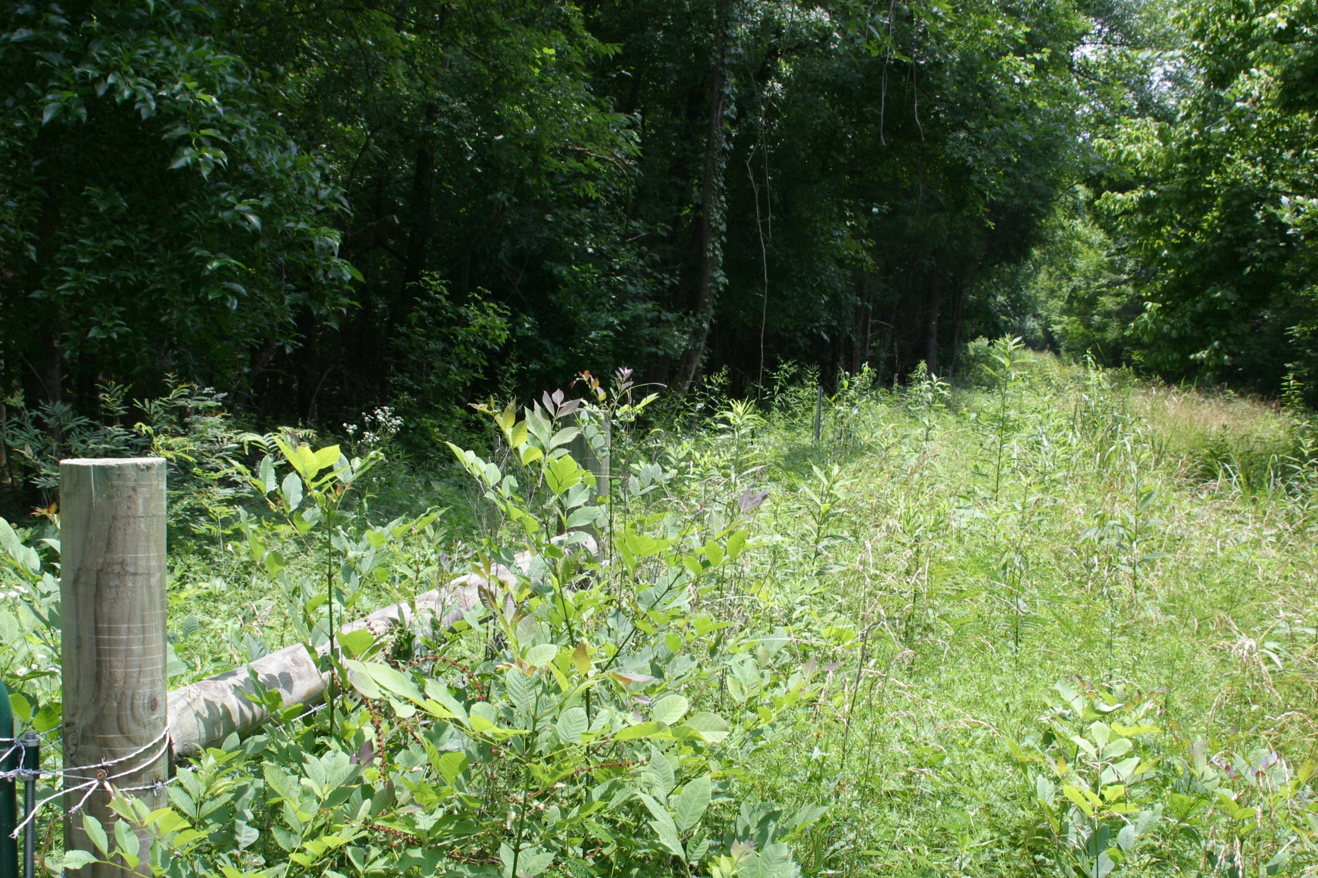


Slide 22
Periodic Spray Will Usually Be the
Most Cost Effective Approach
2% Solution of Glyphosate with surfactant
  Good general herbicide
  Bare ground? Maybe use a suppressive level with grass only (0.25% solution)?
  Low pH of solution corrosive to galvanized wire. Try to avoid direct application to wire.
Tricolpyr products are good for brushy and woody species (Remedy, Pastureguard, Crossbow).
Depends on the species and situation.

Slide 23
Fence VM spray mixture pH
Material | Rate | pH Day 0 | pH Day 7 | pH Day 0 | pH Day 1 | pH Day 7
Water | 1 liter | 7.8 | 7.4 | 7.8 | 7.7 | 7.9
NIS | 0.25% | 7.3 | 6.8 | 6.8 | 6.8 | 6.9
Off-road diesel |  |  |  | 6.9 | 5.6 | 6.0
Arsenal AC | 1% v/v | 7.2 | 6.8
Cimarron/Escort 60XP | 1 oz/100 gal | 7.2 | 6.8
Grazon P+D/Tordon 101 | 2 qt/A | 7.3 | 7.0
Remedy Ultra/Garlon | 3% v/v | 6.8 | 6.4
Remedy Ultra + 2,4-D amine | 3% + 3% v/v | 6.8 | 6.4
Roundup PRO | 3% v/v | 4.8 | 4.8 | 4.7 | 4.6 | 4.7
Roundup PRO + 2,4-D amine | 3% + 3% v/v | 5.3 | 4.9 | 4.9 | 4.8 | 4.9
Tordon 22K | 2 qt/A | 7.6 | 7.0
Weedmaster | 3% v/v |  |  | 6.2 | 6.2 | 6.3
Velpar L | 3 pt/A | 7.5 | 7.8
2,4-D amine | 3% v/v | 6.8 | 6.4 | 6.4 | 6.4 | 6.5
1 liter samples pH measured mix day, 1 and 7 days later; Corning Pinnacle 545 pH meter

Slide 24
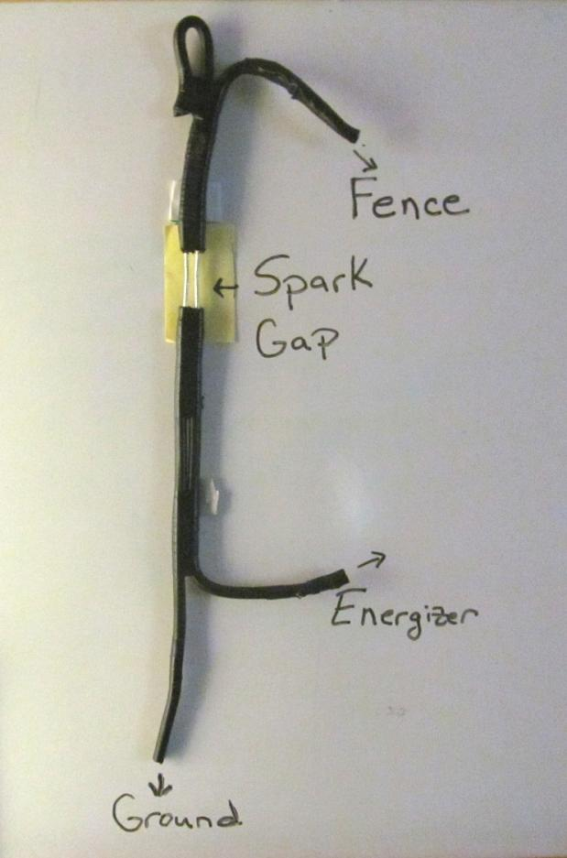
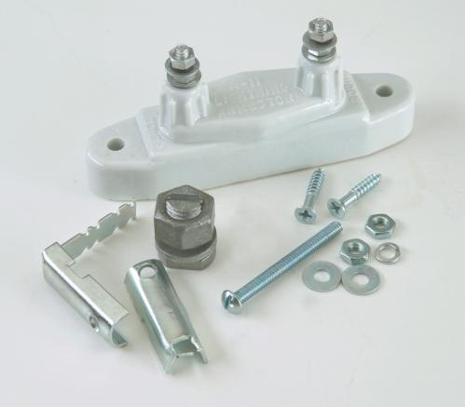
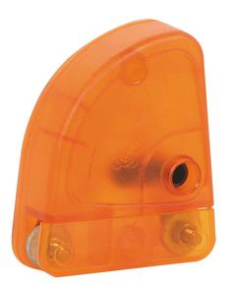
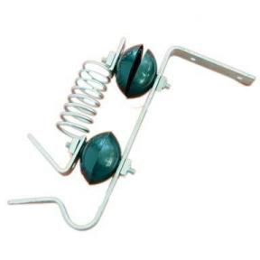
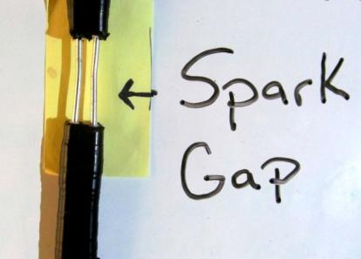
Do what you can to prevent
lightening damage

Slide 25
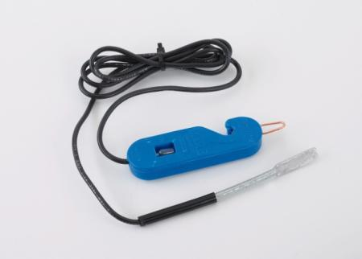
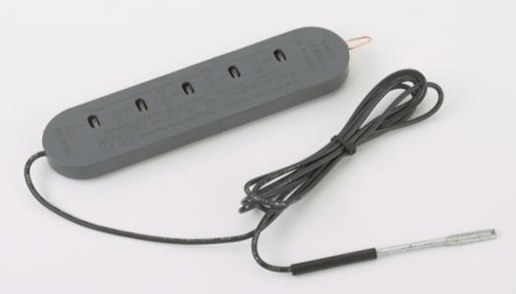

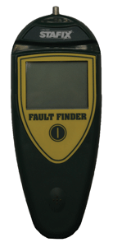
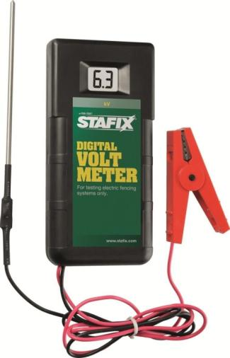
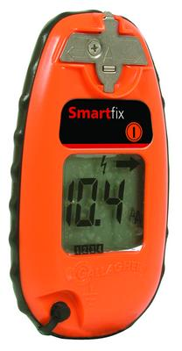
Fence Testers Have Greatly Improved!

Slide 26
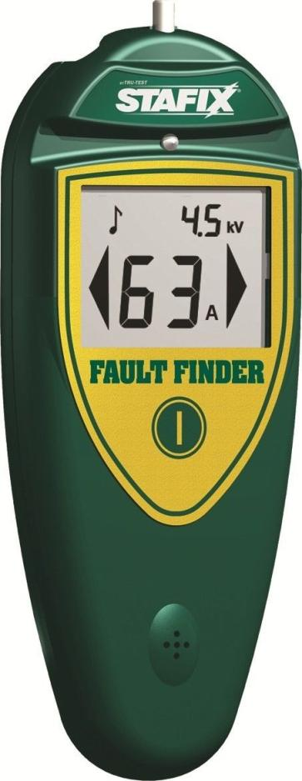
Voltage shows
potential energy
on fence
Amperage shows
movement of electricity
past the point of
Checking
Arrows show the
direction of short
Fault Finders Dramatically Improve Your
Ability to Track Down a Short!

Slide 27
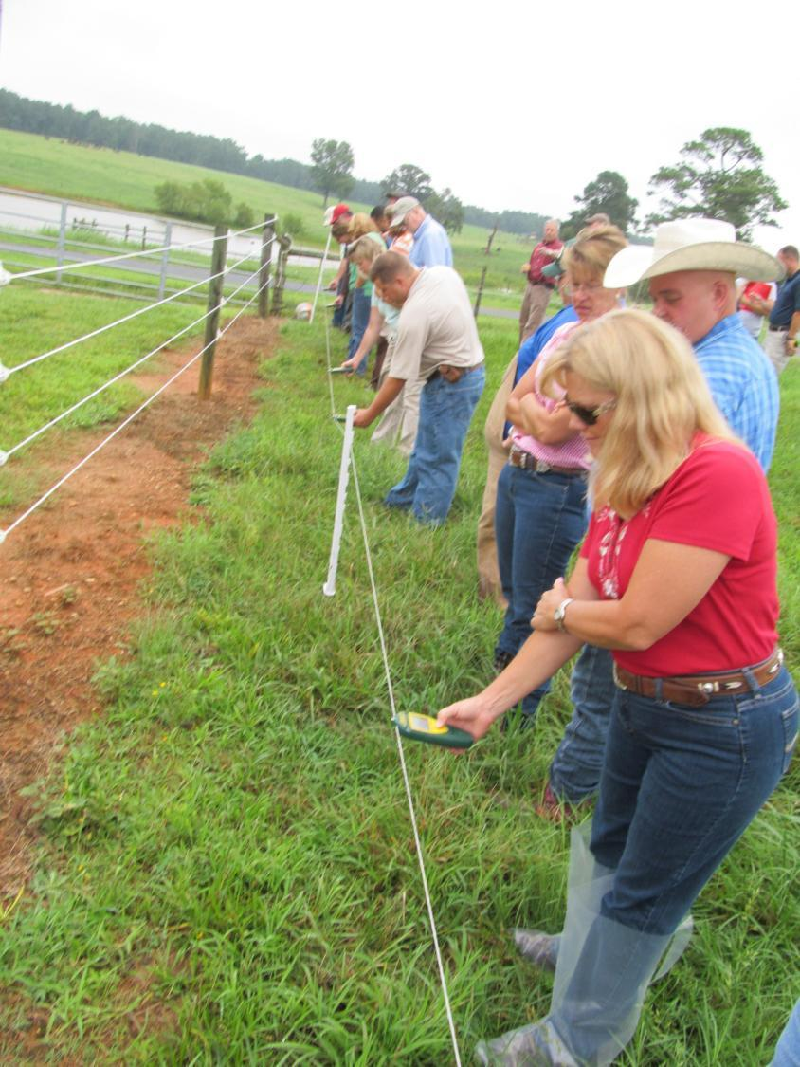

Slide 28
Situation: Low Power due
to inadequate ground
x---------
---------o
0 amps
3.4 kV
6 amps
3.4 kV
5 amps
3.4 kV
4 amps
3.4 kV
3 amps
3.3 kV
2 amps
3.2 kV

Slide 29
Situation: Low Power due
to inadequate ground
x---------
---------o
2.4 kV on ground rod
X
Create a bad
short
0 amps
1.5 kV
16 amps
1.5 kV
0 amps
1.2 kV
0 amps
1.0 kV
0 amps
0.9 kV
0 amps
0.7 kV

Slide 30
Situation: Low Power due
to inadequate ground
x---------
---------o----------o---------o
0 kV when
shorted
0 amps
5.4 kV
6 amps
5.4 kV
5 amps
5.4 kV
4 amps
5.4 kV
3 amps
5.3 kV
2 amps
5.2 kV

Slide 31
Situation: Low power
due to a bad short
x---------
---------o----------o---------o
0 kV
0 amps
2.8 kV
30 amps
2.4 kV
30 amps
2.4 kV
x
4 amps
2.4 kV
3 amps
2.3 kV
2 amps
2.2 kV

Slide 32
x---------
---------o----------o---------o
0 kV
0 amps
5.4 kV
6 amps
5.4 kV
5 amps
5.4 kV
4 amps
5.4 kV
3 amps
5.3 kV
2 amps
5.2 kV

Slide 33
Design or modify the system so it is
easy to trace the flow of electricity
Tie wires together on the leading
side of the “section”
_________________________________
_________________________________
_________________________________
Flow of power
Don’t tie wires together on the
far side of a section for better
troubleshooting

Slide 34
Summary
Well managed electric fence is critical to improved grazing management
Keeping high power on the fence solves is key to success
Do your best during construction to minimize future problems
Learn to trouble shoot problems and teach producers how to check their system

Slide 35
The “Amazing Grazing Starter Kit“
(now a special from Pasture Management Systems)
100 - Tread-in Posts. $259
10 - Fiberglass Posts (5 - 7/8 inch x 60 inch,
5 – 11/16 inch x 60 inch), $66.90
2 - Geared Reels, $142
2 - Non-Geared Reels, $70
3 - 1320 ft. rolls 9-strand Poly Wire, $115.47
Light Post Driver, $29.95
Fence Tester (Fault Finder type), $110
Total $669 ($793 full retail)
Less Expensive “Strip Grazing Kit” also available ($289)

Slide 36

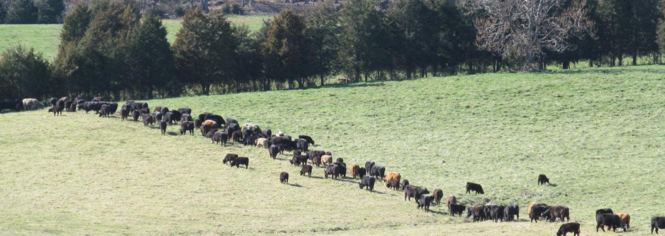


Matt_Poore@ncsu.edu
jrrogers1968@gmail.com
Google: Amazing Grazing CEFS for website

