Slide 1
Temporary Fence Options for Small Ruminants, Pigs and Poultry
Johnny R. Rogers MS, PAS
Amazing Grazing Program Coordinator
North Carolina State University
Owner: Rogers Cattle Company, LLC

Slide 2
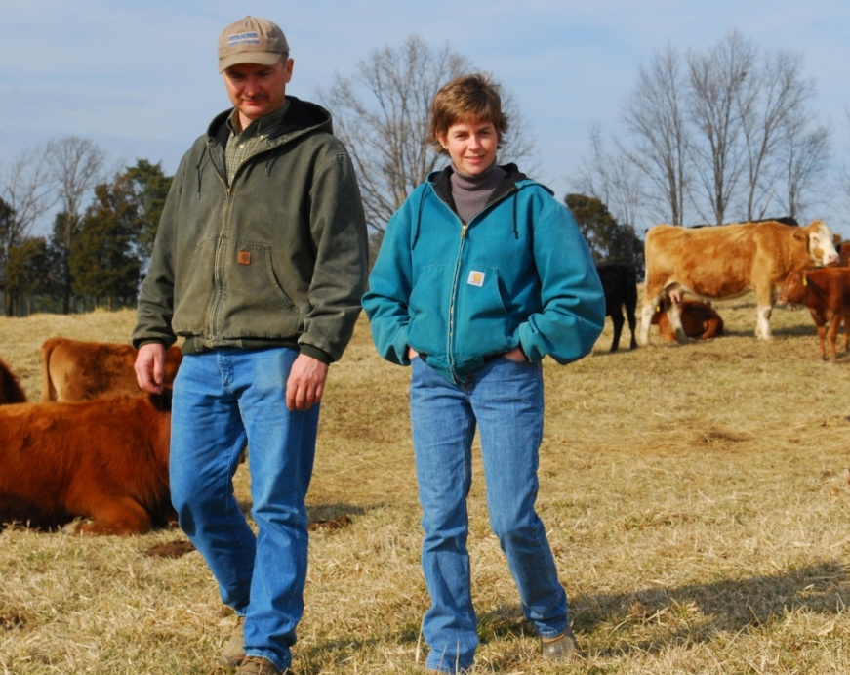
Rogers Cattle Company, LLC
Start up farm with knowledge, money and dreams
Operate on 100% leased land (350 acres)
Limited equipment
Enterprise mix
  Cow-calf/Seedstock (2001)
  Ewes/lambs (2005)
  Meat goats (2002-2009)
  Custom grazing (2002-2010)
  Pasture-Raised Meats
    Beef (2005)
    Lamb (2008)
    Pork (2012)
    Chicken (2011-2014)
    Turkey (2011-2013)

Slide 3
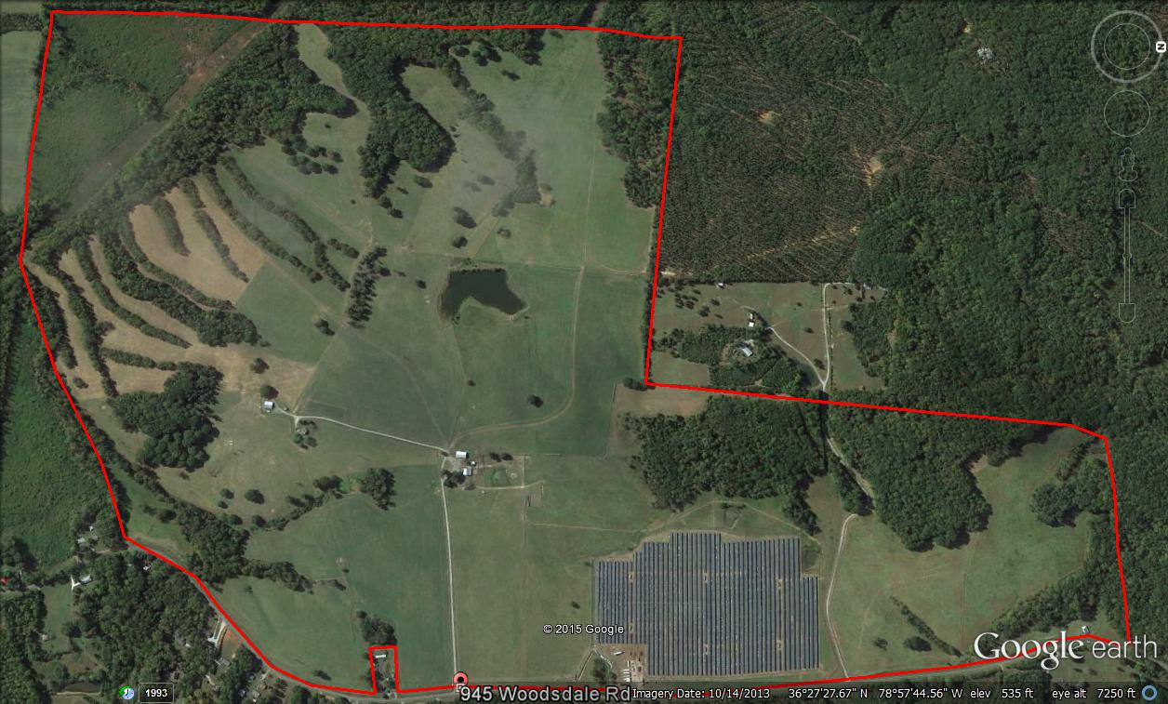

Slide 4
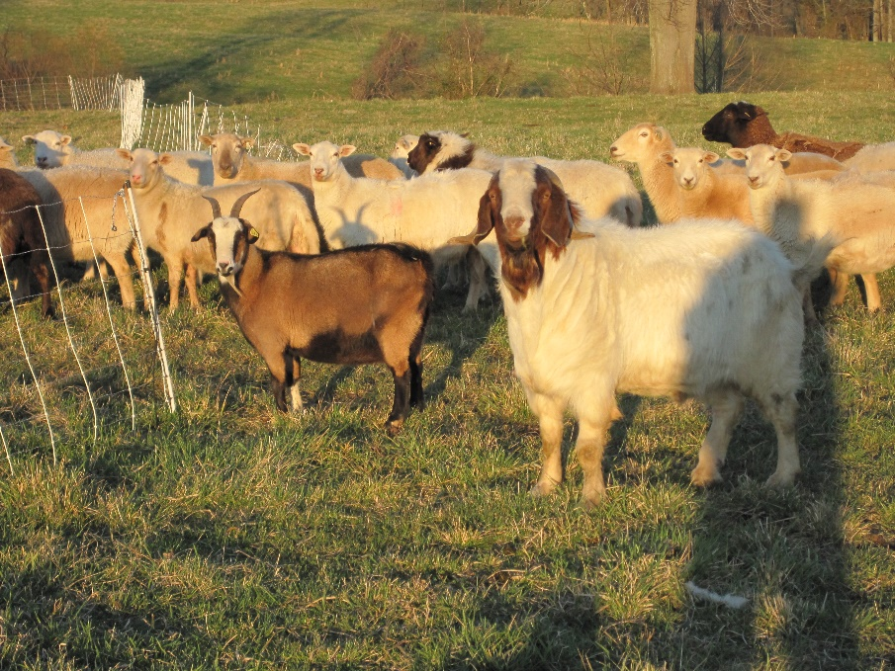
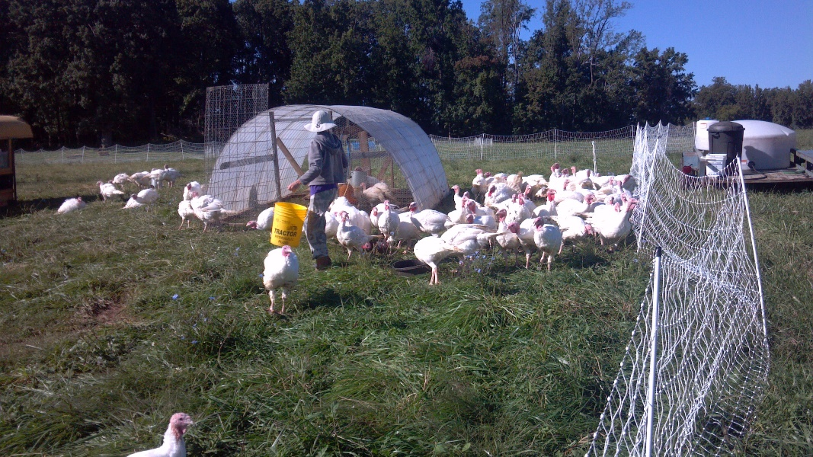
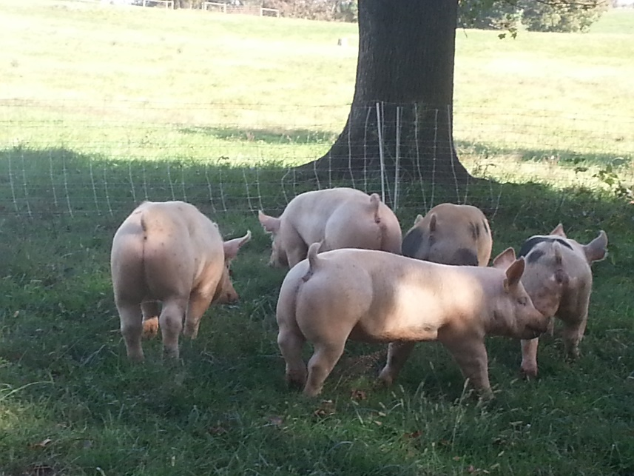
Alternative Livestock Species?
Sheep
Goats
Pastured hogs
Pastured poultry

Slide 5
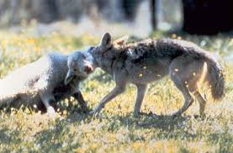
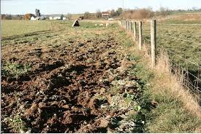
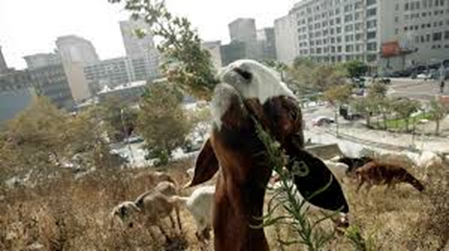
Why Temporary Fence?
Grazing management
  Forage quality/utilization
  Protection of the forage resource
Parasite issues with small ruminants (sheep/goats)
Protect the livestock from ground predators
Protect the forage/woodland resource (hogs)
Landscape Management/Vegetation Control (sheep/goats)

Slide 6
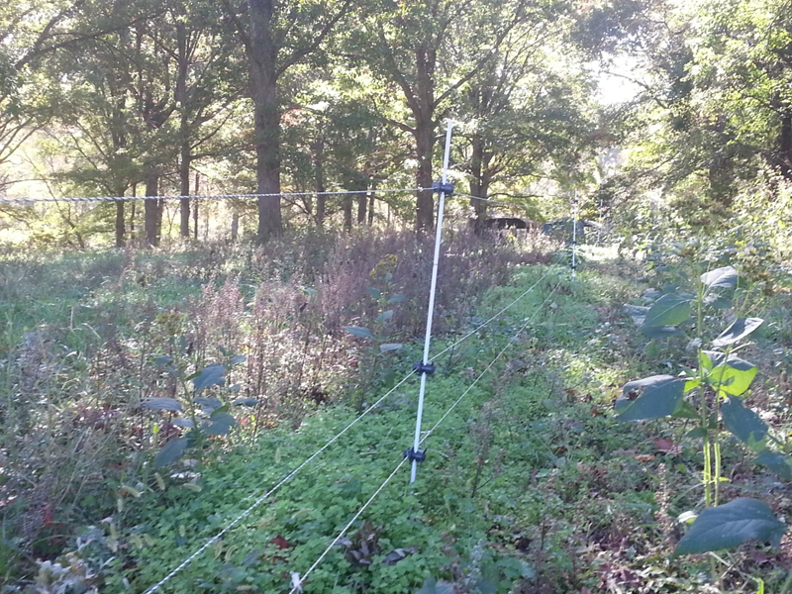
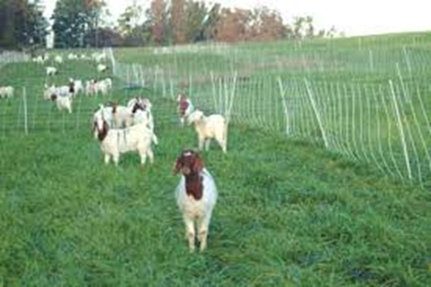
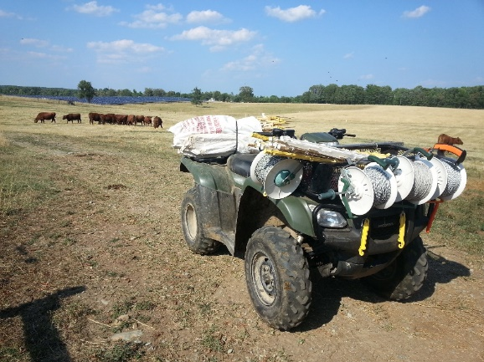
Terminology
Temporary fence: moved daily or weekly
Semi-permanent fence: moved once per season
  With reels
  Without reels
Permanent fence
Mental vs. Physical barrier?

Slide 7
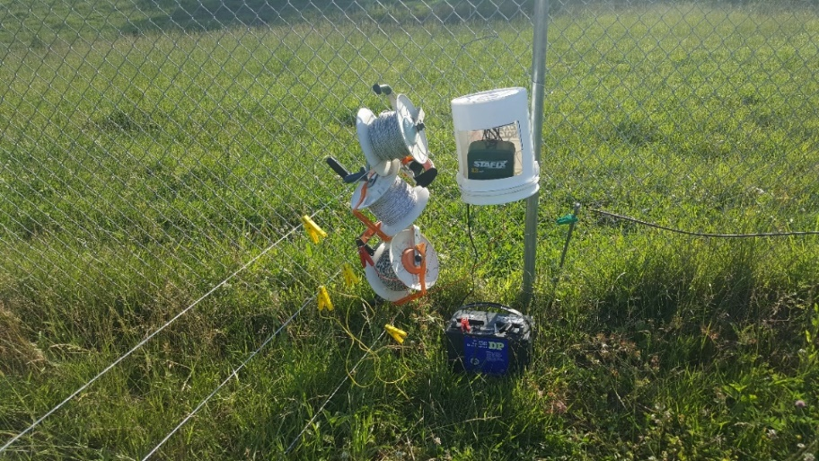
Temporary Fence Basics
How will you energize the fence?
Animals will need to be trained.
Under normal conditions (limited vegetation on the fence)
    Cattle = 5,000 volts (5Kv)
    Sheep/goats = 7,000 volts (7Kv)
Wet conditions and vegetation will load the fence and reduce shocking power.

Slide 8

Temporary Fence Basics
Poly fence products add resistance to existing fence systems.
Thus a larger energizer may be needed when adding temporary fence.
Monitor fence voltage during variable conditions to determine performance.
Energizer size Rule of Thumb: 1 output joule per 10 to 40 acres.
At least three grounds rods will be need for adequate grounding of most energizers.

Slide 9
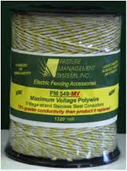
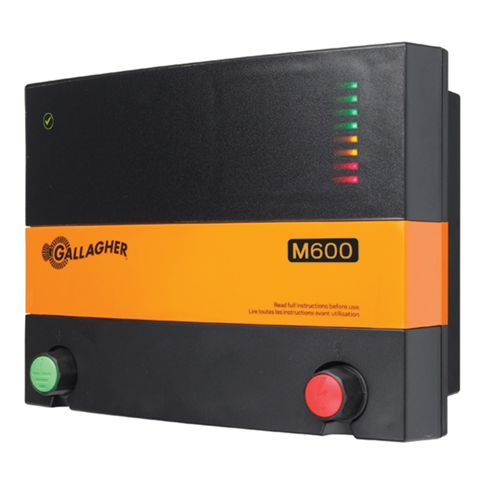


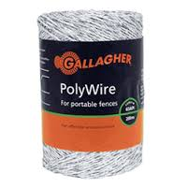
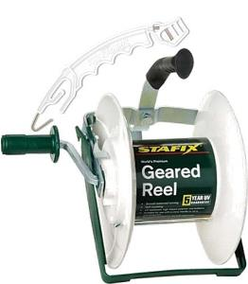
Temporary Fence Equipment

Slide 10
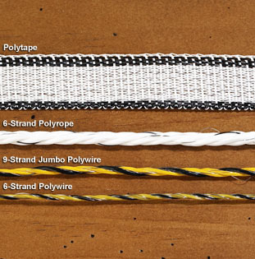
Types of Poly-Fence Products
Polywire (a.k.a. polytwine)
Polyrope
Polytape
9-strand stainless polywire works very well.
Avoid the 5-strand economy polywire.
Polytape is generally less conductive that polywire.

Slide 11
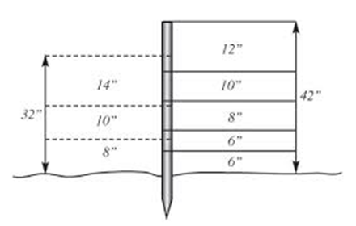
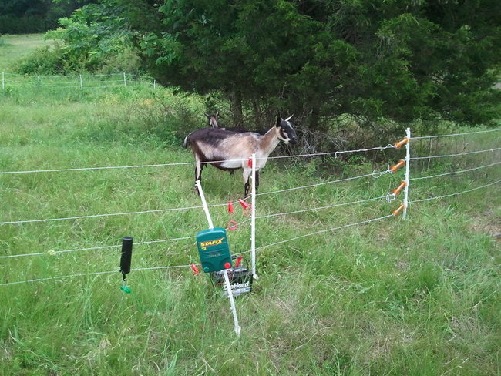
Multi-Strand Polywire
Temporary or semi-permanent
Grazing management:
  Residual forage?
  Temptation?
Spacing options: 8’’; 18” and 32”
  Ewes and lambs
  Mature goats
  Pastured pigs
  Livestock Guardian Dogs
Additional wires for goats/kids
Lower cost: $0.18/foot
Offers minimal predator protection

Slide 12
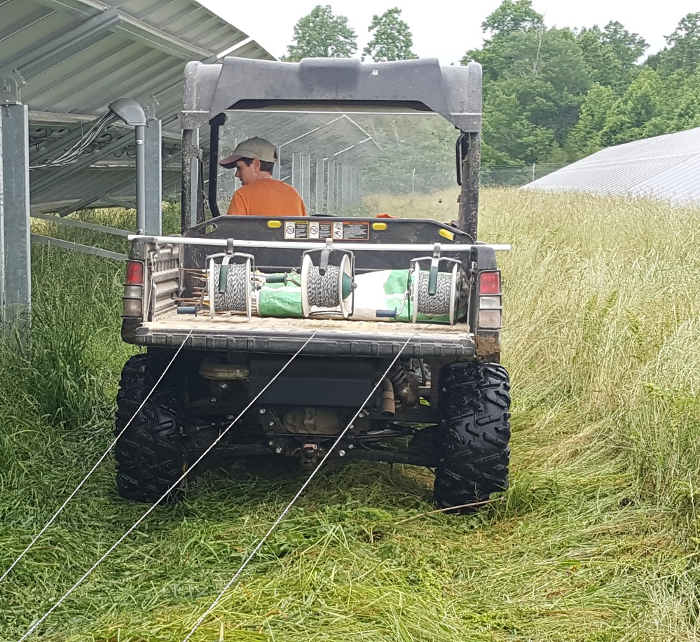
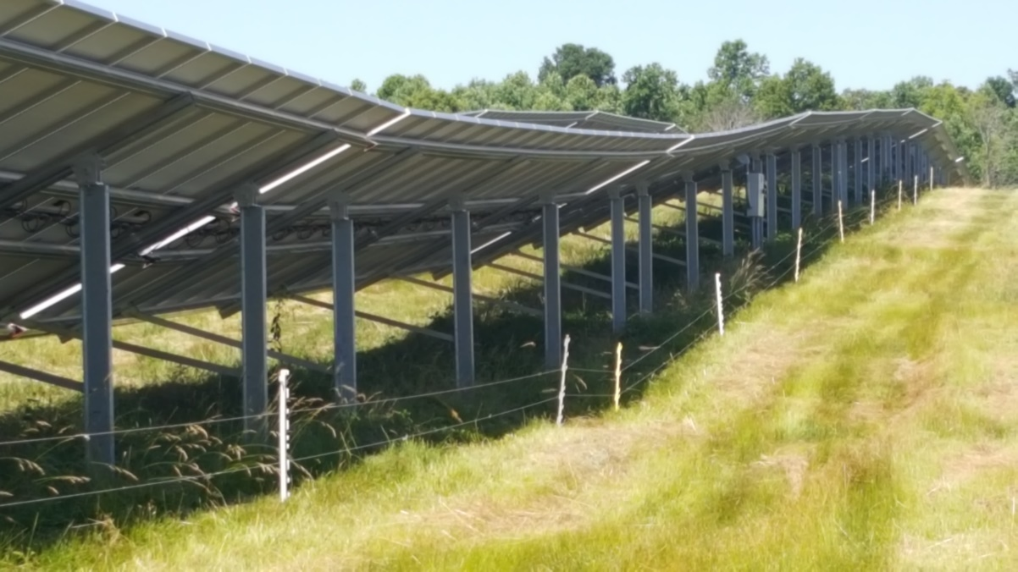



Slide 13
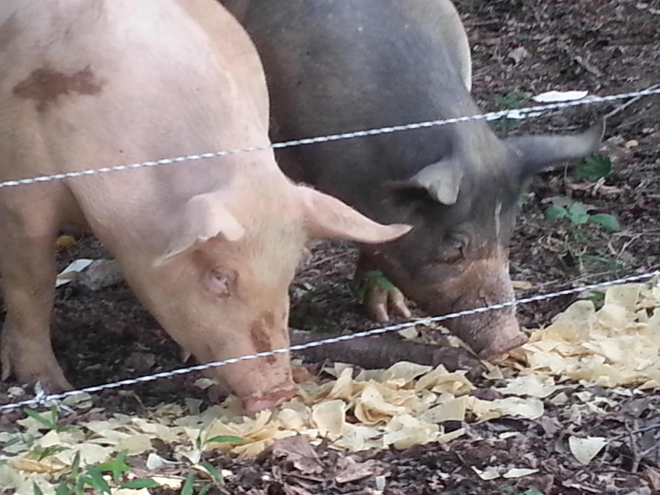
Multi-Strand Polywire
Advantages
Disadvantages
Easy to install and remove
  Long distances
  Wooded areas
Works well with
  Strip grazing
  Pasture raised pork
Easier to control vegetation
Lower cost: $0.18/foot
May not contain livestock
Offers minimal predator protection

Slide 14
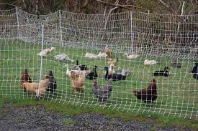
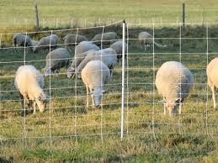
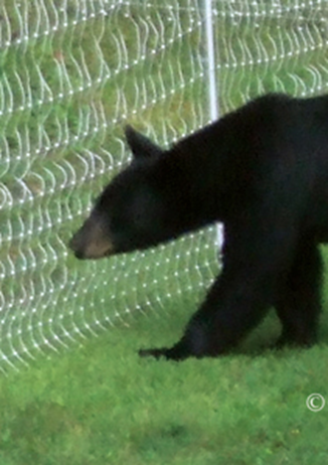
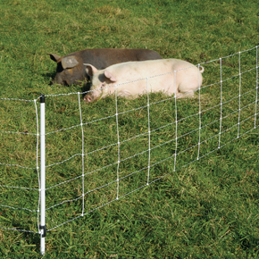
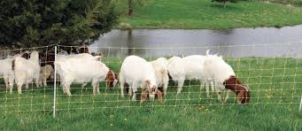
Net Fence:
Polywire version of woven wire/field fence

Slide 15
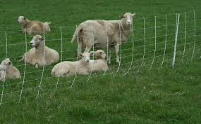
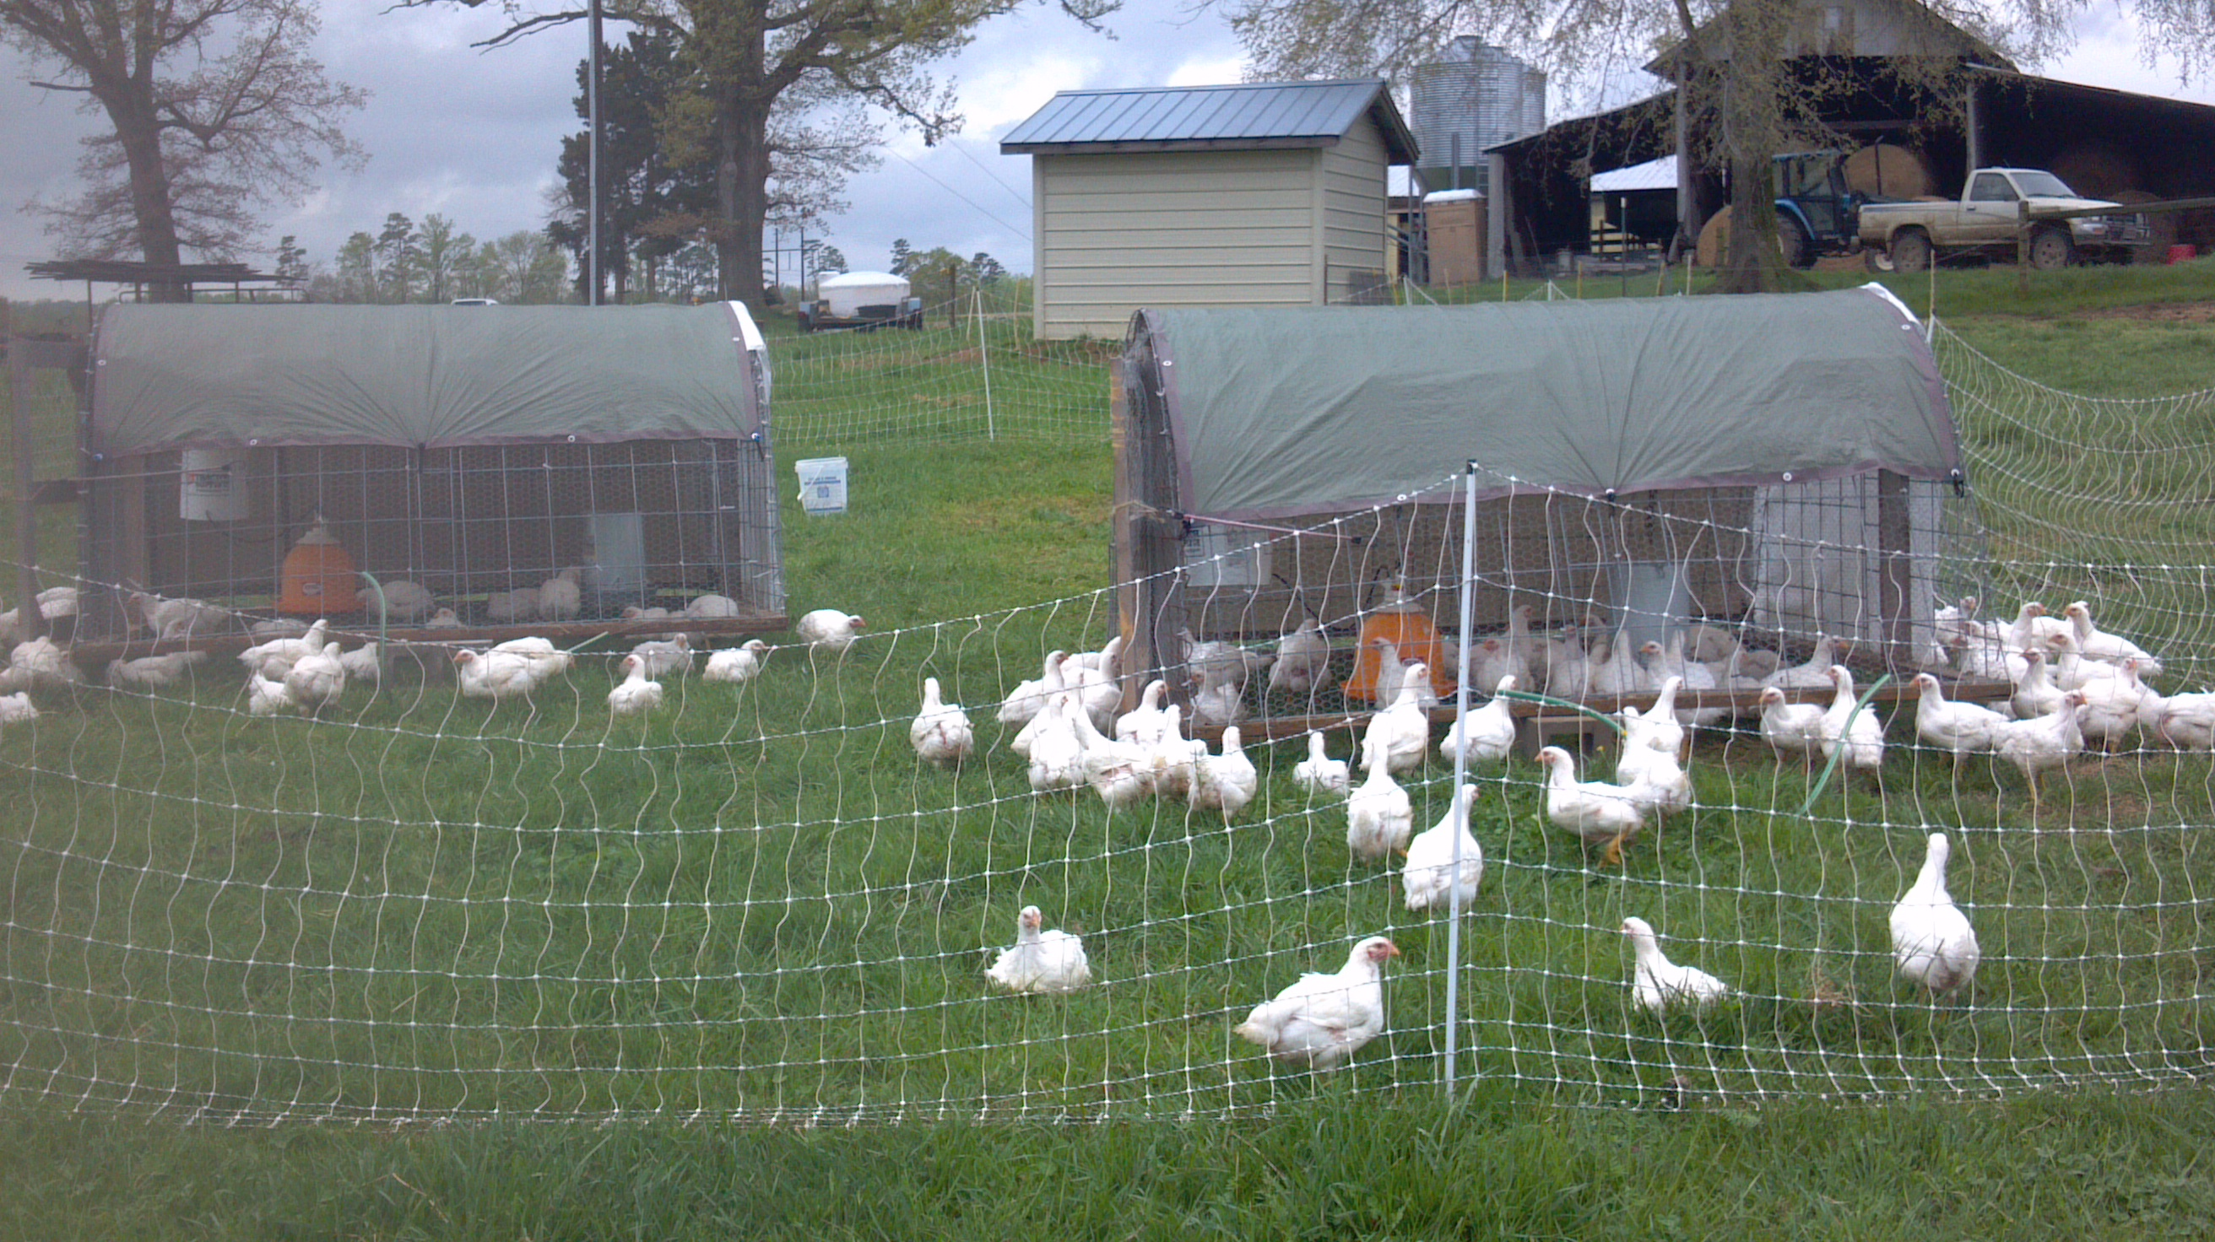
Net Fence:
Polywire version of woven wire/field fence
Name: ElectroNet® 9/35/12
  9 horizontal strands
  35 in. tall
  12 in. between vertical strands
Numerous options
  Length (50 or 100 feet and 82 or 164 feet)
  Height (30 – 48 inches)
  Horizontal strands (number and spacing)
  Vertical strand spacing
  Post size/spacing
  Drivable posts

Slide 16
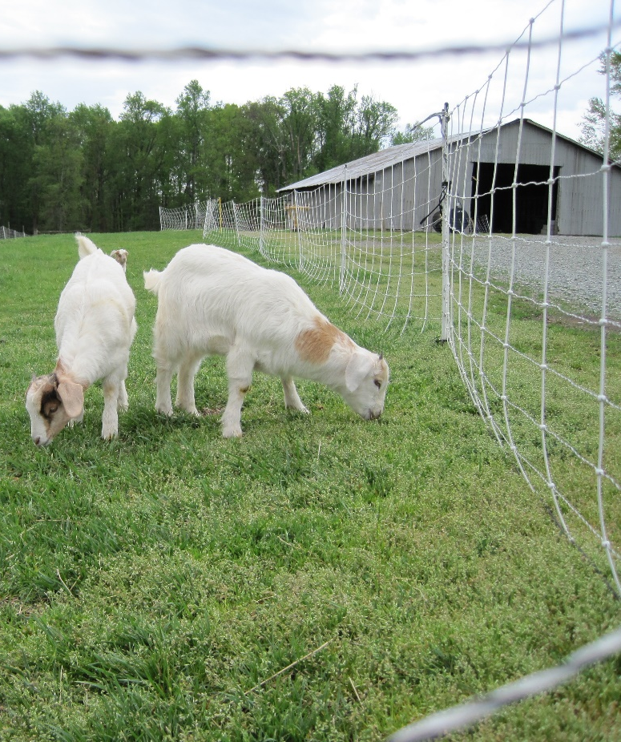
Net Fence Experience
Easy to use if you follow directions
Tall forage should be mowed or ridden down
Wooded areas will challenge your patience, but it is possible.
Excellent ground predator control
Entanglement issues will lambs/kids
Always keep the net electrified

Slide 17
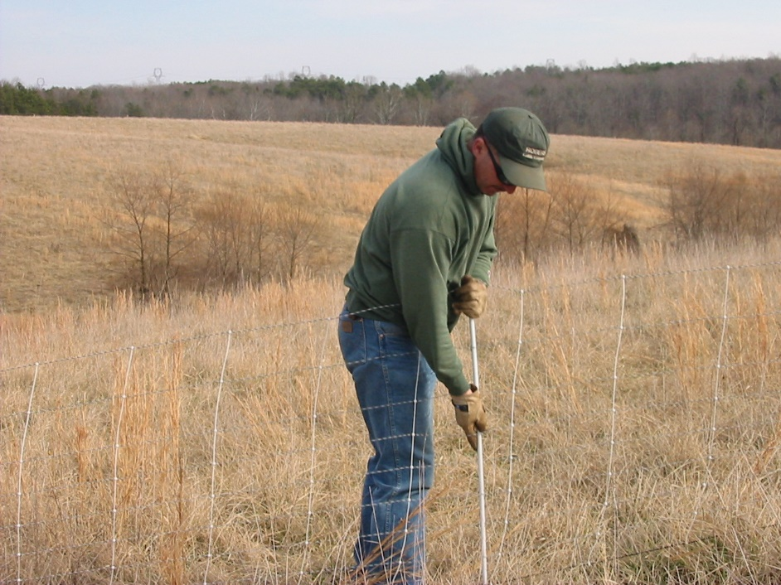
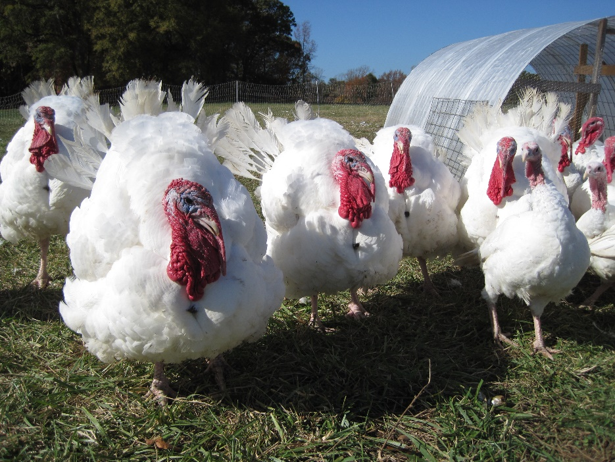
Net Fence Experience
Poultry netting is heavier than sheep/goat netting.
Consider using two short sections rather than one long section.
Energizer requirements
    Poultry net: 0.5 joules/2-100 foot nets
    Sheep/goat net: 0.5 joules/ 4-164 feet nets

Slide 18
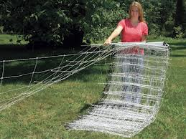
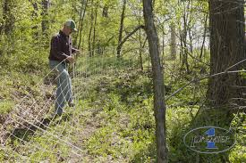
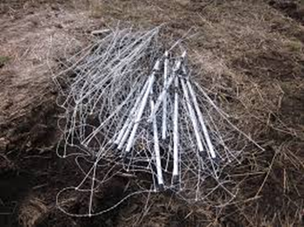
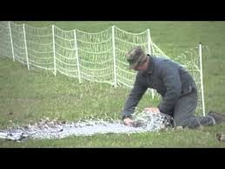
Installation/Storage
http://www.premier1supplies.com/img/product/pdf/401.pdf
https://www.youtube.com/watch?v=g-zEHPNqE0w
https://www.youtube.com/watch?v=ADpXenWfPuk

Slide 19
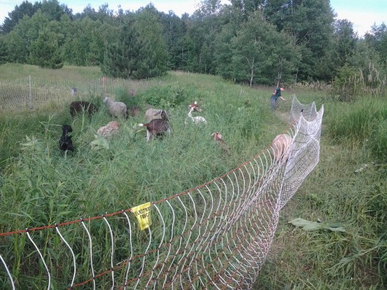
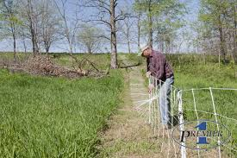
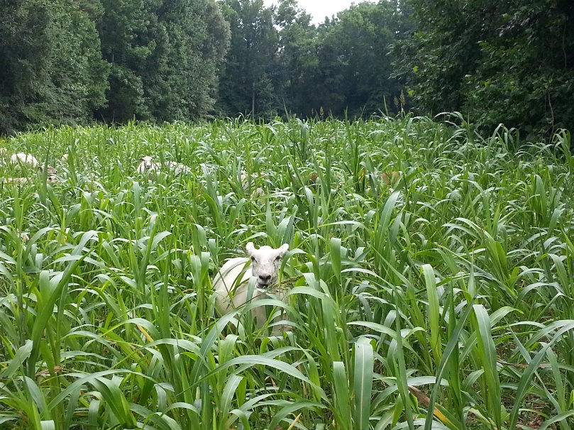
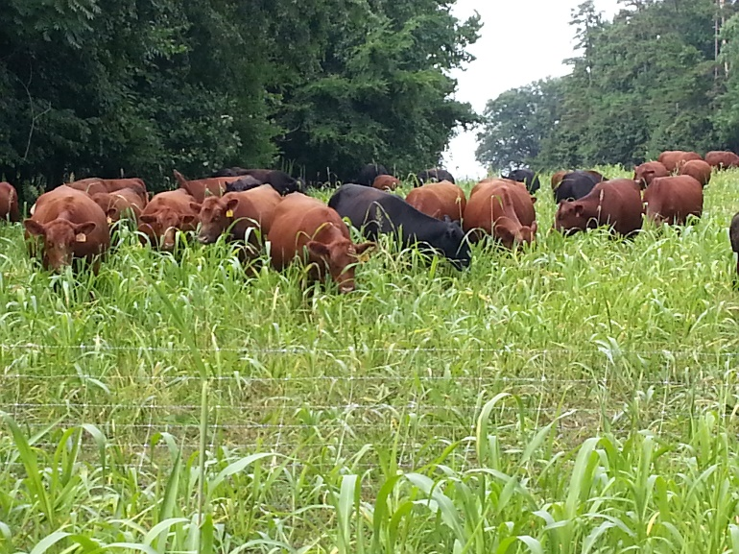
Net Fence Experience

Slide 20
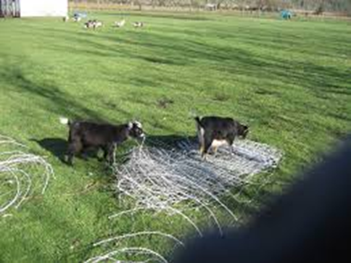
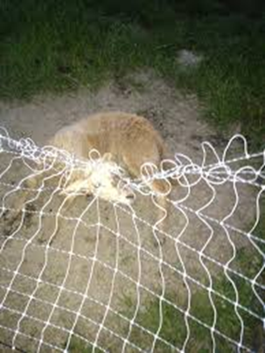
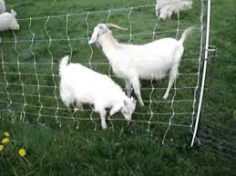
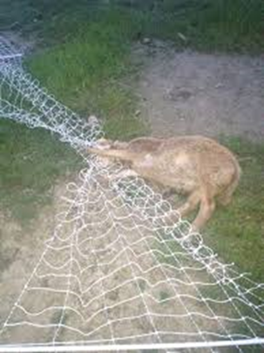
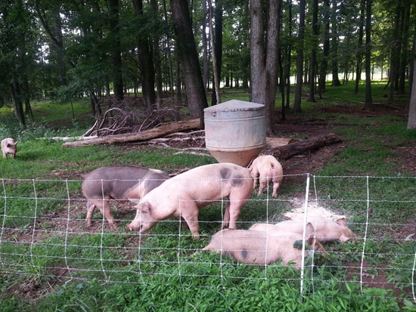
Net Fence Experience

Slide 21
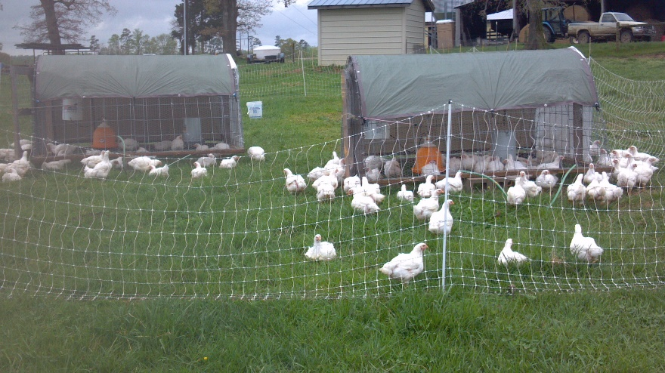
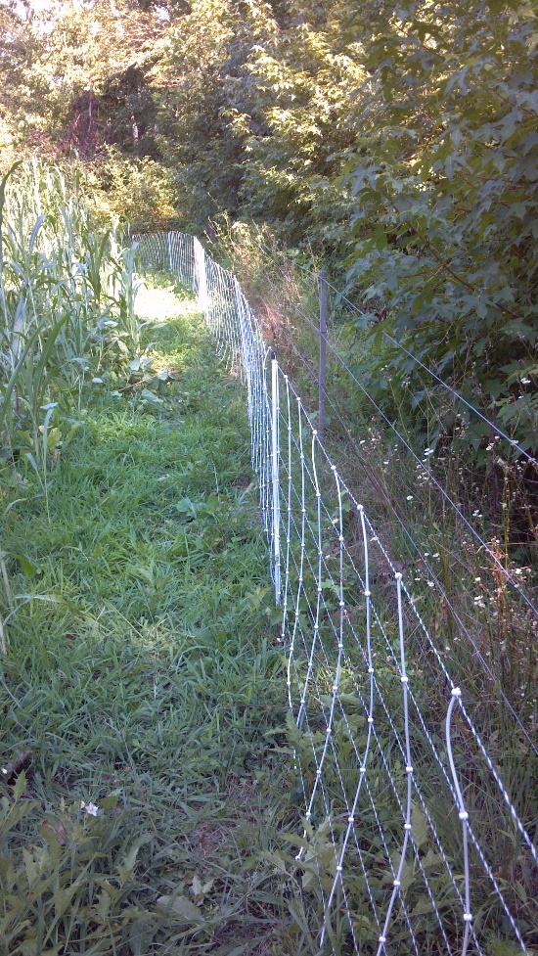
Net Fence Costs
Sheep/Goats
Premier Supply ElectroNet® 9/35/12
  164 feet = 13 lbs.
  82 feet = 7 lbs.
  $0.70/foot
Poultry
Temporary Poultry Net® 12/42/3
  164 feet = 26 lbs.
  82 feet = 14 lbs.
  $0.94/foot

Slide 22
Summary
Temporary fence:
  Allows for improved grazing management
  Enhances livestock health/performance.
  Opens new grazing opportunities.
  Makes pastured poultry feasible.
  Minimizes predator losses.
  Lets small ruminants control vegetation in urban areas.

Slide 23
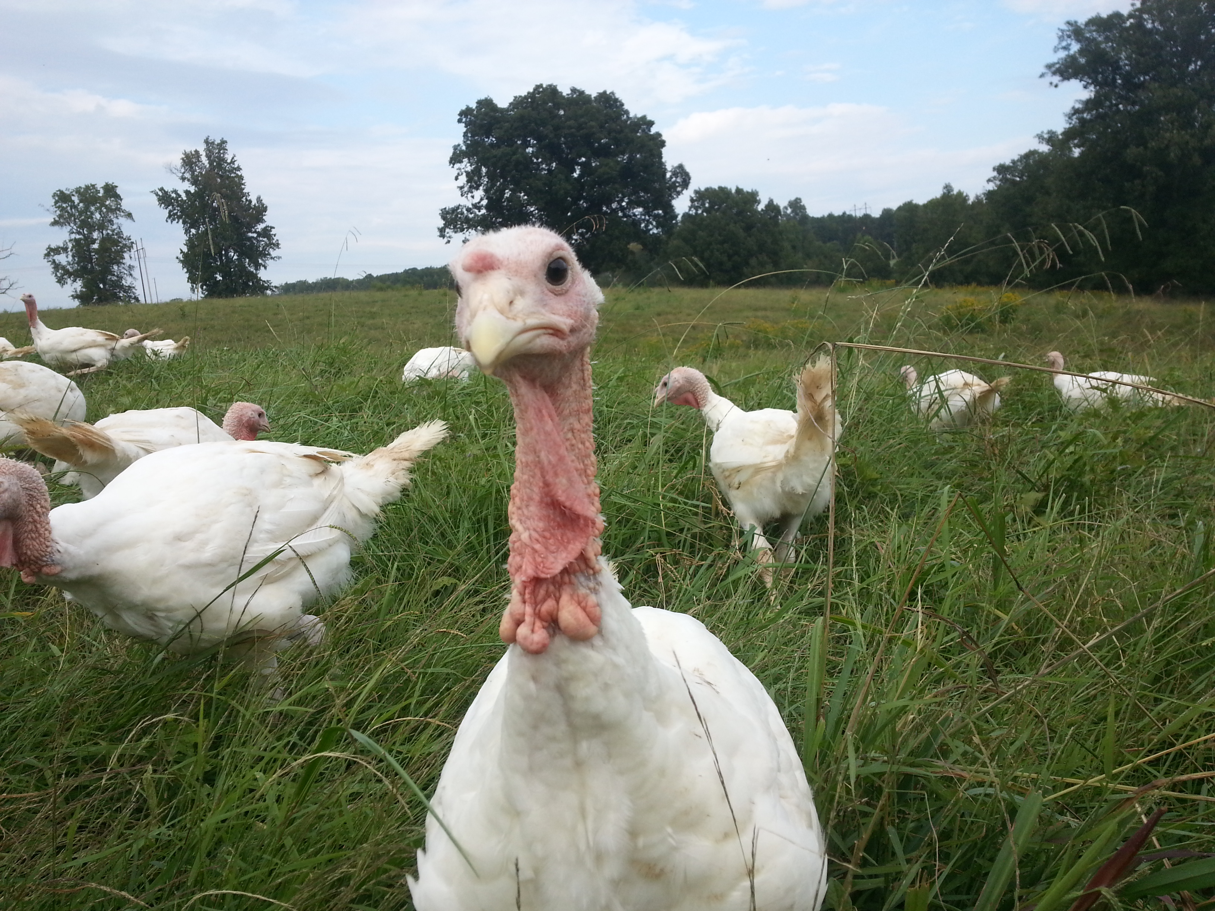
Questions?

