Slide 1
Liquor to Feed: Bourbon & Beer Coproducts
Dr. Jeff Lehmkuhler
Extension Beef Cattle Specialist
University of Kentucky

Slide 2
Corn Liquor & Beer Deep Tradition in Ohio river valley
1770’s Jacob Beam started distilling in Bardstown, KY
Louisville Frankfort, Owensboro and other regions were distilling
George Wiedemann purchased Constans Brewery in Newport, KY in 1890 as George Wiedemann Brewing Co.
  Largest brewery in the state at 100,000 barrels / annually in 1890
  By 1967 capacity was 1,000,000 barrels / year
  Ceased production in 1983 in KY and by 2006 no Wiedemann beer

Slide 3
Craft distilling booming
~ 1995 there were 50 craft distillers, 2015 = 769
  (Chris Morris http://fortune.com/2015/08/01/distilleries-craft-beer-liquor)
Kentucky Bourbon production has increased 300% since 1999
Led to increased availability of stillage, condensed solubles and distillers grains

Slide 4
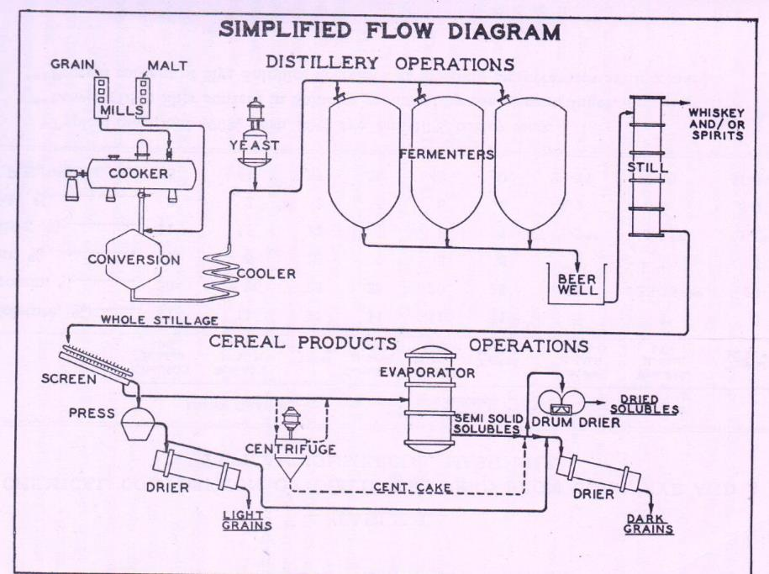
Process of
Distilling
Source of Feeds
Thin Stillage
Boruff 1947 2nd Proc Feeds of Beverage Distilleries

Slide 5
Analysis of Various Slop Products
Item, %DM | Thin | Settled | Whole | Evaporated
Protein, % | 32.5 | 31.9 | 29.6 | 30
Fat, % | 15 | 12.8 | 9.9 | 14.4
Fiber, % | 5 | 6.4 | 7.4 | 4.4
Ca, % | 0.25 | 0.21 | 0.25 | 0.13
P, % | 1.25 | 1.06 | 0.62 | 1.13
Total Solids, % | 4.0 | 4.7 | 8.1 | 16
Water, % | 96 | 95.3 | 91.9 | 84
No. Samples | 10 | 11 | 5 | 2
Garrigus & Good 1942 KY Ag Exp Station Report

Slide 6
Composition Varies by Grain source
 | Wheat |  | Barley |  | Corn
 | Thin Stillage | Distillers Grains | Thin Stillage | Distillers Grains | Thin Stillage | Distillers Grains
Ash | 8 | 4 | 10 | 4 | 7 | 5
EE | 14 | 4 | 16 | 6 | 9 | 10
NDF | 34 | 74 | 32 | 80 | 13 | 45
ADF | 4 | 22 | 8 | 31 | NA | NA
CP | 46 | 26 | 37 | 15 | 19 | 30
Starch | 2 | 2 | 1 | 1 | 25 | 8
NSC | 28 | 7 | 38 | 4 | NA | 29
Mustafa, A., Mckinnon, J., Christensen, A. (2000) Asia Australian J. Animal Sci, 13, 1609

Slide 7
Stillage = Slop & Feeding Problems Occurred
1942 Garrigus & Good state 2 common mistakes when feeding slop
  Failure to use other feeds to provide a balanced ration
  Hauling slop too far such that the cost makes it too expensive
They recommended the following
  ½ lb / 100 lb body weight of forage / hay
  3-6 lbs of grain offered to increase dry matter intake
  Yellow ear corn for vitamin A & bloat reducing effect of the cob
  White corn < 3 months
  Free-choice limestone (2-3 oz/d)
  Not more than 3-4 gal / 100 lb live weight gave farmers best results

Slide 8
Feeding Slop
https://youtu.be/U10D9TDYtfs
Video had to be removed from ppt due to size

Slide 9
Cattle Performance on Slop
 | Thin Stillage | Water
Steers grazing crested wheatgrass
Fluid Intake, gal/d | 12.7ª | 7.6^{b}
ADG, lb | 3.08ª | 1.98^{b}
Steers fed growing diets
Fluid Intake, gal/d | 6.3 | 6.0
ADG, lb | 3.52 | 3.52
Gain:Feed (linear effect) | 0.3 | 0.2
Steers fed finishing diets
Fluid Intake, gal/d | 7.1 | 7.1
ADG, lb | 3.52 | 3.08
Gain:Feed (linear effect) | 0.19 | 0.15
Mustafa, A., Mckinnon, J., Christensen, A. (2000) Asia Australian J. Animal Sci, 13, 1609

Slide 10
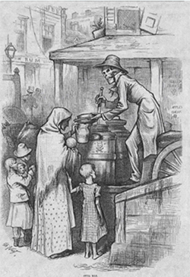
Feeding slop was not without its issues
1878 Harper’s Weekly cartoon by Thomas Nast depicting a ghoulish figure dispensing “swill milk” to an unknowing mother and her children.
Mid-Late 1800’s Germany, France, Europe, America & others were fighting “SWILL MILK”
Led to early food safety regulations

Slide 11
Slop was & Was not the problem
Poor nutrition of cows due to lack of understanding how to feed
Diarrhea excessive protein & fat intakes, Calcium & Vitamin Deficiencies, Low Butterfat from low fiber intakes, etc…
Poor udder sanitation
Adulterated milk – water, egg yolks, chalk, sugar, etc…

Slide 12
Slop feeding today
Current recommendations similar to Garrigus & Good
Use as energy and protein supplement
Increase dietary Ca levels
Feed a balanced ration = good performance

Slide 13
Nutritional Composition of Products
Considerable variation can be observed
Grain source (barley, wheat, sorghum, corn, etc…)
Fat extracted
Solubles added back

Slide 14
Example of Composition of Energy ETOH Products
Feed | DM % | CP % | Nem, Mcal/cwt | Neg, Mcal/cwt | Ca % | P % | S %
CDS | 30-50 | 18-35 | 100-125 | 69-89 | 0.07 | 1.8 | 1.6
Wet DGS | 30-35 | 30-35 | 100 | 68 | 0.05 | 0.8 | 0.7
Mod DGS | 40-50 | 30-35 | 100 | 68 | 0.05 | 0.8 | 0.7
Dry DGS | 90 | 28-32 | 100 | 68 | 0.04 | 0.8 | 0.7
Based on several sources including company literature, National Research Council, and United States-Canadian Tables of Feed Composition.
Today fat not being extracted from bourbon derived distillers
Sulphur levels generally lower = lower risk of toxicity from bourbon source

Slide 15
Condensed Distillers Solubles (Syrup)
Observed Increased Availability
High in Fat and Protein
Handling Issues
~ $75 / ton DM @ 30% DM
Craigslist Ad

Slide 16
Lick Tanks for CDS
Wheel-type lick tanks can be used
  Doran et al., 2008 ISU Beef Report
  Intakes were 2.7 to 8.1 lb DM or ~ 15 to 30 lbs as-fed
  As pasture quality / availability declined, CDS intake increased
  Spoilage can occur with warm temperatures

Slide 17
Spraying CDS on Windrow
Application using modified liquid fertilizer trailer
Rates were 16, 20 and 32%
Observed no detrimental impact of applying CDS to windrows pre-baling
J.M. Warner MS Thesis Univ Nebraska 2012

Slide 18
Research Update – Fed Daily Open Troughs
2015 Preliminary Data Dr. Eric Vanzant & Alex Altman

Slide 19
Wet Distillers Grains Storage
Shelf-life varies with storage method and temperatures
Excluding oxygen and preventing airborne molds lowers spoilage losses
Adding 10-20% processed forage can allow handling & packing into bunkers / bags
Salt can reduce spoilage, cost effectiveness??

Slide 20
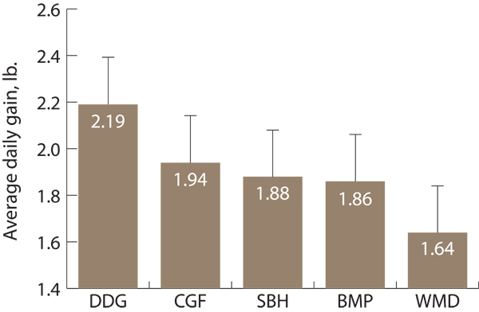
Comparison of Coproducts
Expected due to higher Fat content
http://www.noble.org/ag/research/Articles/ByproductSupplements/index.html

Slide 21
Comparison of Coproducts
Rye balage + 4 lbs of Supplement
Waller, 2011 TN Highland Rim Field Day

Slide 22
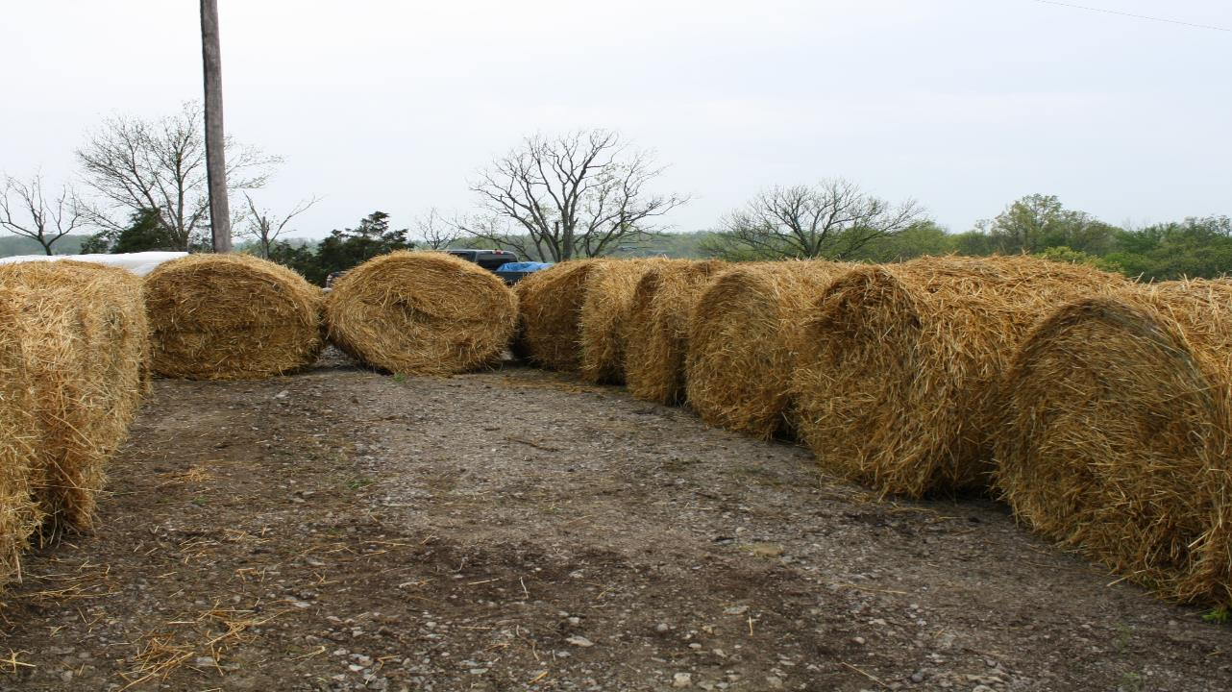
Muck Bales for temporary bunker
~ 12’ X 20’ for 14-15 tons wet cake

Slide 23
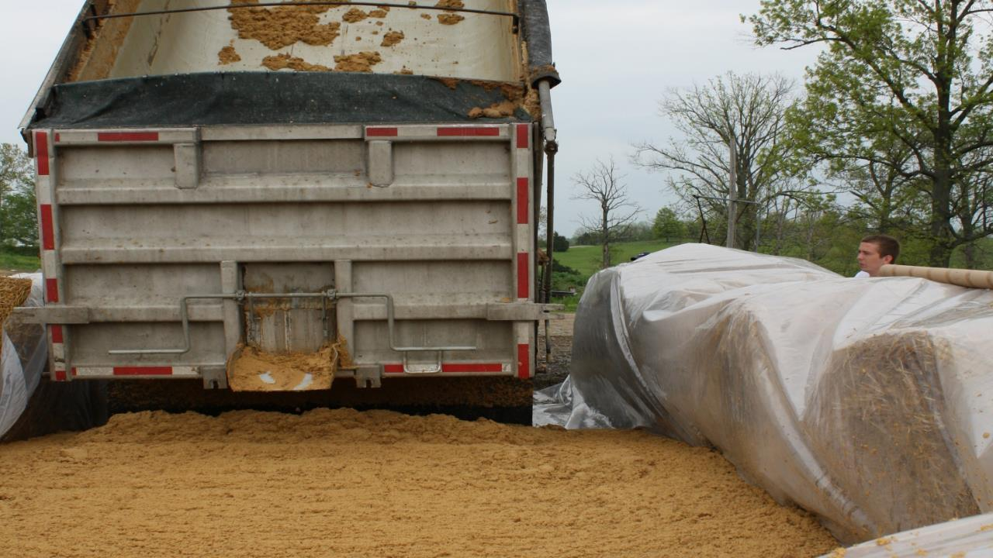
6 mil greenhouse plastic liner

Slide 24
Sulfate Reduction in the Rumen
High Sulfur / Sulfate Intake
(Feed + Water)
H₂S and S²⁻
Eructation
H₂S Inhalation
Lung Tissue Damage
Cell Damage
S²⁻ Absorption
?
PEM
Secondary Viral or Bacterial Infections
Poor Animal Performance
Adapted from Kung et al. 1998

Slide 25
Wet Brewers Grains
Generally mostly barley that has been malted
Husk will result in lower energy values, digestibility
Moisture levels are often much higher
22% DM, 0.93 Mcal Nem/lb, 0.62 Mcal Neg/lb, 26% CP

Slide 26
Beef Heifers Wintered
 | Corn Silage | 66% Corn Silage 34% Wet Brewers | 62% Wet Brewers 11% Corn 26% Fescue Hay
ADG, lb | 1.1 | 1.6 | 1.2
Feed:Gain | 9.5 | 6.3 | 6.1
Crickenberger and Johnson, JAS 1982

Slide 27
Wet Brewers feedlot
 | Barley/Canola | Brewers | Wheat DG
DMI | 21.9 | 21.0 | 22.7
ADG | 2.9 | 2.9 | 2.9
Feed:Gain | 7.6 | 7.3 | 7.7
Relatively low inclusion rates resulted in similar performance to control diet
Brewers similar to Wheat-based Distillers Grains when fed to constant energy
Ojowi, McKinnon, Mustafa, and Christensen, Can J Anim Sci, 1997

Slide 28
General Feeding Recommendations
Adjust mineral program to high Calcium, no Phos
Up to 40% of diet DM for low Sulphur product
Mindful of moisture content of total ration as inclusion rates increase, especially for slop
Consider handling / storage / transportation expenses

