Slide 1
Pre- and post-weaning calf nutrition September 22nd, 2016
Philipe Moriel, PhD
Assistant Professor – Beef Cattle Nutrition
Range Cattle Research & Education Center
University of Florida, Ona, FL

Slide 2
BOVINE RESPIRATORY DISEASE
$ 800 to 900 million Losses annually (Chirase and Greene, 2001; Anim. Feed Sci 93:217-228)
Number or treatments and income loss
1 treatment = decrease return by $41
2 treatments = decrease return by $58
3 or + = decrease by over $292
Fulton et al. (2002) J. Vet. Diagn. Invest. 12:33–38
Notes:
Leading cause of morbidity and mortality in feedlot is BRD.
Bovine respiratory disease increases morbidity and mortality in stocker and feedlot calves resulting in decreased growth performance and carcass value. In addition, antimicrobial treatments are costly, increasing cost of BW gain and decreasing profitability.
800 to 900 million dolars in losses due to mortality, sickness treatment, poor growth and carcass quality

Slide 3
Effects of sickness on performance and profitability in the feedlot
 | Healthy calves | Sick calves
Number of cattle | 12,306 | 4,047
Medicine treatment cost, $/hd | 0 | 27.03
ADG, Lb | 2.99 | 2.67
Net return, $/hd | 67 | -20.28
USDA Choice or higher, % | 39.6 | 27.5
McNeil et al. (2000) http://animalscience-extension.tamu.edu/frameset.html

Slide 4
Effects of sickness on performance and profitability in the feedlot
 | Healthy calves | Sick calves
Number of cattle | 12,306 | 4,047
Medicine treatment cost, $/hd | 0 | 27.03
ADG, Lb | 2.99 | 2.67
Net return, $/hd | 67 | -20.28
USDA Choice or higher, % | 39.6 | 27.5
McNeil et al. (2000) http://animalscience-extension.tamu.edu/frameset.html

Slide 5
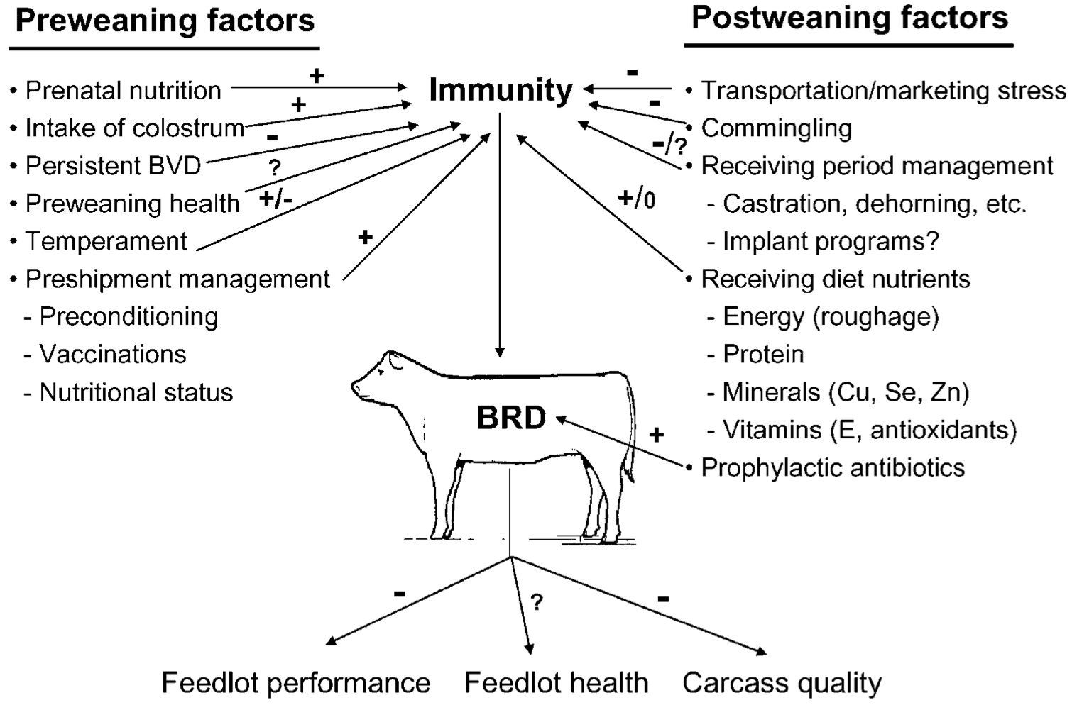
Duff and Galyean (2007) JAS 85:823–840
Notes:
Stresses due to weaning, marketing, and transporta- tion, previous plane of nutrition, genetics, and health history interact with exposure to viral and bacterial agents

Slide 6
Immune System
INNATE
First line of defense
Act within hours
ADAPTIVE
Second line of defense
Act within days
Acute Phase Response

Slide 7
Immune System
INNATE
First line of defense
Act within hours
ADAPTIVE
Second line of defense
Act within days
Acute Phase Response
Fever
Increased metabolism
Liver function
Cell synthesis
Decreased feed intake

Slide 8
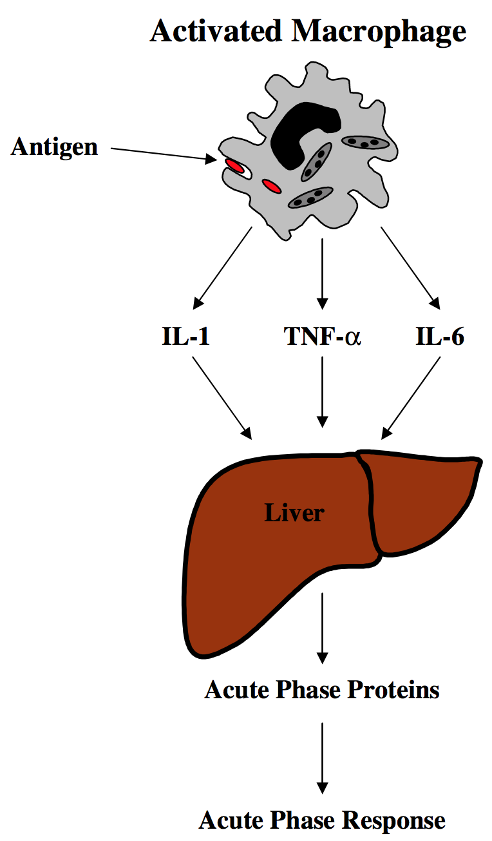
Acute-phase Response
Adapted from Carroll and Fosberg (2007)
Vet. Clin. Food Anim. 23:105-149
Antigen
Dietary amino acids (AA)
Muscle AA mobilization
Notes:
Although the practice has historically been associated with management around emergency forage shortages, significant evidence exists to suggest that early weaning may be a practical and profitable management consideration for Florida cow/calf operations.

Slide 9
Acute-phase Response
Adapted from Carroll and Fosberg (2007)
Vet. Clin. Food Anim. 23:105-149
Antigen
Acute-phase proteins APP
Notes:
Although the practice has historically been associated with management around emergency forage shortages, significant evidence exists to suggest that early weaning may be a practical and profitable management consideration for Florida cow/calf operations.

Slide 10
Acute-phase Response
Adapted from Carroll and Fosberg (2007)
Vet. Clin. Food Anim. 23:105-149
Antigen
Acute-phase proteins APP
Tissue repair, coagulation, metal binding and transport proteins
Notes:
Although the practice has historically been associated with management around emergency forage shortages, significant evidence exists to suggest that early weaning may be a practical and profitable management consideration for Florida cow/calf operations.

Slide 11
Immunological challenge
Notes:
Whereas such a response is invaluable to the health of the animal, it can have severe growth con- sequences.
The greater the APR usually causes greater negative impacts on growth

Slide 12
Acute-phase Response
Adapted from Carroll and Fosberg (2007)
Vet. Clin. Food Anim. 23:105-149
Antigen
Stress
Acute-phase proteins APP
Tissue repair, coagulation, metal binding and transport proteins
Notes:
Stress negatively affects the immune system (Blecha et al., 1984) at a time when the animal is more likely to be exposed to infectious agents as a result of commingling.

Slide 13
Acute-phase Response
Adapted from Carroll and Fosberg (2007)
Vet. Clin. Food Anim. 23:105-149
Antigen
Stress
Muscle AA mobilization
Dietary amino acids (AA)
Acute-phase proteins APP
Tissue repair, coagulation, metal binding and transport proteins
Notes:
Although the practice has historically been associated with management around emergency forage shortages, significant evidence exists to suggest that early weaning may be a practical and profitable management consideration for Florida cow/calf operations.

Slide 14
Stress and immune function

Slide 15
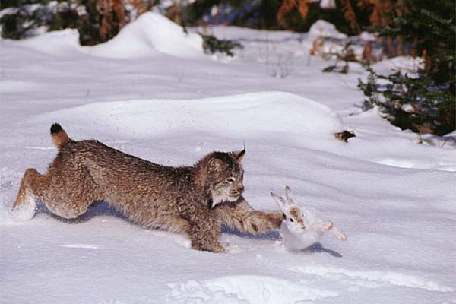
“Fight or Flight response”
Cortisol
Provide energy
Escape predator

Slide 16
Carrol and Forsberg (2007) Vet Clin Food Anim 23:105-149
Stress in cattle
Psychological stress
Physiological stress
Nutrient deficiency
Physical stress
Injury
Heat or cold stress
Fatigue
Disease
Hunger and thirst
Fear
Commingling
Novel environment
Loud or unusual noises
Restraint

Slide 17
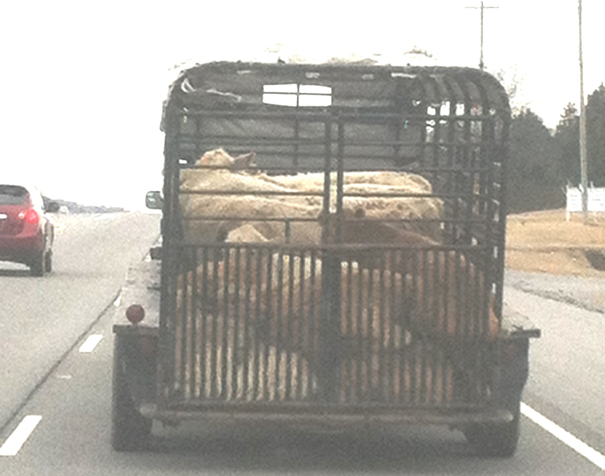
NC STATE UNIVERSITY

Slide 18
Weaning

Slide 19
Weaning

Slide 20
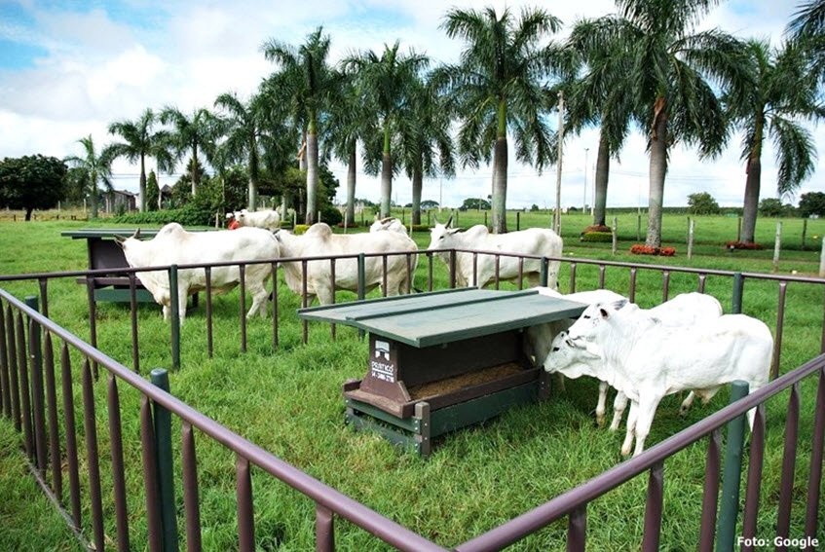
Creep-feeding Pre-weaning performance

Slide 21
Unlimited and limited creep-feeding increased weaning weights
Stricker et al., 1979
Hixon et al., 1982
Lusby and Wettemann, 1986
Faulkner et al., 1994
Sexten et al., 2004
Moriel and Arthington, 2013a,b
Which one to use?

Slide 22
Adapted from Faulkner et al. (1994) JAS 72:470-477
Faulkner et al. (1994) JAS 72:470-477.
 | No Creep | Limited creep | Unlimited creep
Sup. intake, Lb/calf/day | 0 | 2.2 | 5.0
Sup. intake (84 days), Lb | 0 | 187 | 422
Sup. cost @ $0.19/Lb, $/head | 0 | $35.51 | $80.15
Initial weight, Lb | 319 | 297 | 297
Final weight, Lb | 484 | 525 | 555
Weight gain, Lb | 165 | 228 | 258
Added gain, Lb | . | 63 | 93
Feed conversion of added gain |  | 2.9 | 4.5
Cost of added gain, $/Lb |  | $0.56 | 0.86
Income, $/calf | $1,016.70 | $1,103.19 | $1,166.10
Return, $/calf | $1,016.70 | $1,067.69 | $1,085.95

Slide 23
Adapted from Faulkner et al. (1994) JAS 72:470-477
Faulkner et al. (1994) JAS 72:470-477.
 | No Creep | Limited creep | Unlimited creep
Sup. intake, Lb/calf/day | 0 | 2.2 | 5.0
Sup. intake (84 days), Lb | 0 | 187 | 422
Sup. cost @ $0.19/Lb, $/head | 0 | $35.51 | $80.15
Initial weight, Lb | 319 | 297 | 297
Final weight, Lb | 484ª | 525^{b} | 555^{c}
Weight gain, Lb | 165ª | 228^{b} | 258^{c}
Added gain, Lb | . | 63 | 93
Feed conversion of added gain |  | 2.9 | 4.5
Cost of added gain, $/Lb |  | $0.56 | 0.86
Income, $/calf | $1,016.70 | $1,103.19 | $1,166.10
Return, $/calf | $1,016.70 | $1,067.69 | $1,085.95

Slide 24
Adapted from Faulkner et al. (1994) JAS 72:470-477
Faulkner et al. (1994) JAS 72:470-477.
 | No Creep | Limited creep | Unlimited creep
Sup. intake, Lb/calf/day | 0 | 2.2 | 5.0
Sup. intake (84 days), Lb | 0 | 187 | 422
Sup. cost @ $0.19/Lb, $/head | 0 | $35.51 | $80.15
Initial weight, Lb | 319 | 297 | 297
Final weight, Lb | 484ª | 525^{b} | 555^{c}
Weight gain, Lb | 165ª | 228^{b} | 258^{c}
Added gain, Lb | . | 63 | 93
Feed conversion of added gain |  | 2.9 | 4.5
Cost of added gain, $/Lb |  | $0.56 | 0.86
Income, $/calf | $1,016.70 | $1,103.19 | $1,166.10
Return, $/calf | $1,016.70 | $1,067.69 | $1,085.95

Slide 25
Adapted from Faulkner et al. (1994) JAS 72:470-477
Faulkner et al. (1994) JAS 72:470-477.
 | No Creep | Limited creep | Unlimited creep
Sup. intake, Lb/calf/day | 0 | 2.2 | 5.0
Sup. intake (84 days), Lb | 0 | 187 | 422
Sup. cost @ $0.19/Lb, $/head | 0 | $35.51 | $80.15
Initial weight, Lb | 319 | 297 | 297
Final weight, Lb | 484ª | 525^{b} | 555^{c}
Weight gain, Lb | 165ª | 228^{b} | 258^{c}
Added gain, Lb | . | 63 | 93
Feed conversion of added gain |  | 2.9 | 4.5
Cost of added gain, $/Lb |  | $0.56 | 0.86
Income, $/calf @1.30/lb | $629.20 | $682.50 | $721.50
Return, $/calf | $629.20 | $646.99 | $641.35

Slide 26
Adapted from Faulkner et al. (1994) JAS 72:470-477
Moriel and Arthington (2013) JAS 91:1371–1380
 | Treatment
Item | Non-sup | Limit creep-fed | SEM | P-value
Calf BW, lb
d 0 | 289 | 291 | 8.4 | 0.76
d 102 | 482 | 504 | 9.3 | 0.05
Calf ADG, lb/d
d 0 to 102 | 1.89 | 2.07 | 0.066 | 0.07
Supplement DMI, lb/d
d 0 to 102 | 0 | 35.7

Slide 27
Adapted from Faulkner et al. (1994) JAS 72:470-477
Moriel and Arthington (2013) JAS 91:1371–1380
 | Treatment
Item | Non-sup | Limit creep-fed | SEM | P-value
Calf BW, lb
d 0 | 289 | 291 | 8.4 | 0.76
d 102 | 482 | 504 | 9.3 | 0.05
Calf ADG, lb/d
d 0 to 102 | 1.89 | 2.07 | 0.066 | 0.07
Supplement DMI, lb/d
d 0 to 102 | 0 | 35.7
+0.18 lb/d added gain

Slide 28
Adapted from Faulkner et al. (1994) JAS 72:470-477
Moriel and Arthington (2013) JAS 91:1371–1380
 | Treatment
Item | Non-sup | Limit creep-fed | SEM | P-value
Calf BW, lb
d 0 | 289 | 291 | 8.4 | 0.76
d 102 | 482 | 504 | 9.3 | 0.05
Calf ADG, lb/d
d 0 to 102 | 1.89 | 2.07 | 0.066 | 0.07
Supplement DMI, lb/d
d 0 to 102 | 0 | 35.7
Supplement cost $/head @$0.19/lb | 0 | $6.78
Income added gain, $/head @$1.30/lb | 0 | $23.87
Net return, $/head | 0 | $17.09
+0.18 lb/d added gain

Slide 29
Creep-feeding Post-weaning performance

Slide 30
Adapted from Arthington et al. (2008) JAS 86:2016-2023
Post-weaning performance | No Creep | Unlimited creep (45 days)
ADG, Lb/d (29 days post-weaning) | 1.94ª | 2.31^{b}
Concentrate intake, % of BW
Week 1 | 1.30ª | 1.62^{b}
Week 2 | 2.04 | 2.13
Week 3 | 2.28 | 2.26
Hay intake, % of BW
Week 1 | 0.66ª | 0.42^{b}
Week 2 | 0.57 | 0.47
Week 3 | 0.47 | 0.45

Slide 31
Carcass weight
Creep vs. non-creep fed steers
Lancaster et al. (2007a,b)
Greater for creep-fed in year 1, but not year 2
Faulkner et al. (1994)
Greater for creep-fed
Similar for creep-fed and non-creep fed
Tarr et al., 1994
Myers et al., 1999
Shike et al., 2007

Slide 32
Preconditioning Beef Calves

Slide 33
Precondition = “to condition, train, or accustom in advance” American Heritage Dictionary
No standardized definition as it applies to beef cattle before, during, and/or after weaning and shipping
Management practices around weaning time
Optimize animal’s immune system and health
Minimize stress
Lalman and Smith ANSI-3529

Slide 34
Arthington et al. (2008) JAS 86:2016-2023

Slide 35
PRECODITIONING VS. NON-PRECONDITIONING
Adapted from Roeber et al. (2001) Prof. Anim. Sci. 17:39–44

Slide 36
Benefits for producers
Greater weight gain before shipping
Reputation for high quality cattle
Lalman and Smith ANSI-3529

Slide 37
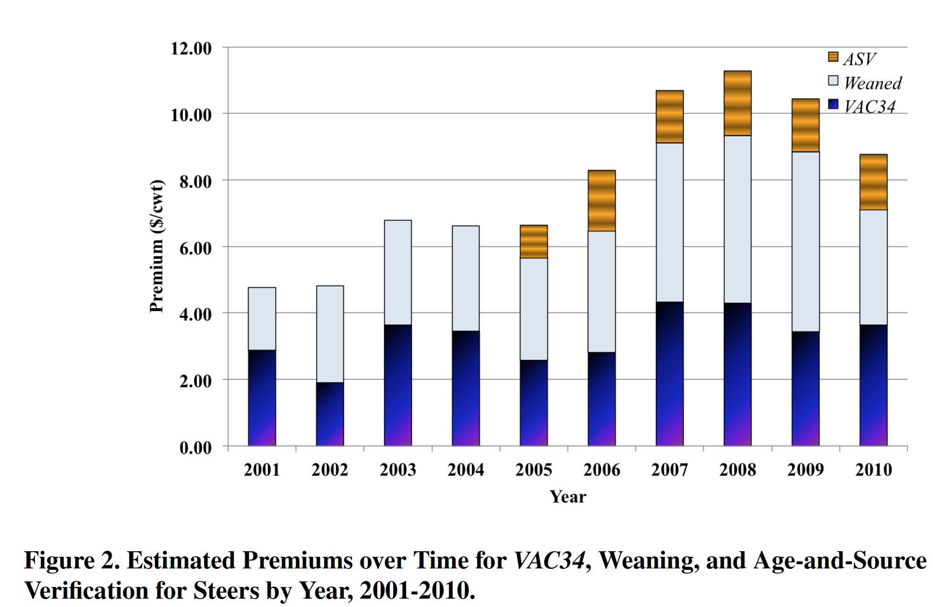
Preconditioning Scenarios

Slide 38
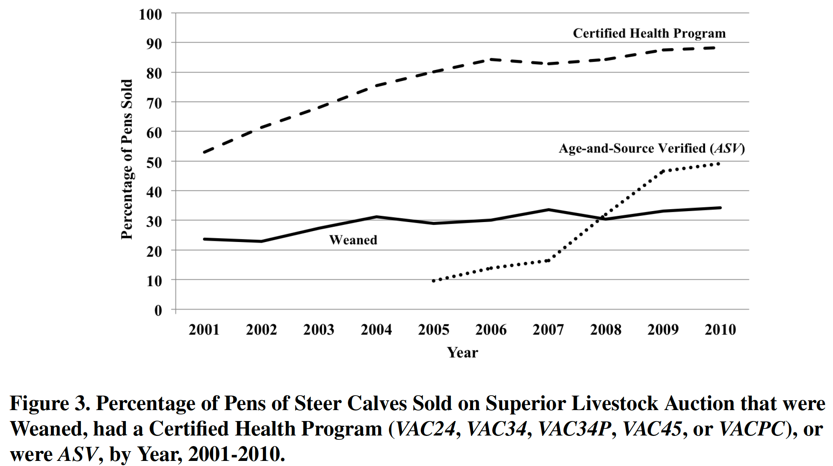

Slide 39
NC STATE UNIVERSITY
North Carolina State University research

Slide 40
Acute-phase Response
Adapted from Carroll and Fosberg (2007)
Vet. Clin. Food Anim. 23:105-149
Antigen
Stress
Muscle AA mobilization
Dietary amino acids (AA)
Acute-phase proteins APP
Tissue repair, coagulation, metal binding and transport proteins
Notes:
Although the practice has historically been associated with management around emergency forage shortages, significant evidence exists to suggest that early weaning may be a practical and profitable management consideration for Florida cow/calf operations.

Slide 41
NC STATE UNIVERSITY
Experiment 1 – Dietary Protein Concentration
July 2014
Increasing protein concentration
45-day preconditioning program
Increase Weaning weights??
Pay for extra cost of increase protein concentration??

Slide 42
Treatments
NC STATE UNIVERSITY
Isocaloric diets Beef steer ADG = 1.0 kg/d (NRC, 2000)
85% MP n = 6 pens
115% MP n = 6 pens
100% MP n = 6 pens
D -6
D 0
D 42
DIETS: limit-fed at 2.2% of BW, DM basis
Weaning
Feedlot
entry
Feedlot
exit

Slide 43
NC STATE UNIVERSITY
Experiment 1 – Dietary Protein Concentration
MP = Metabolizable Protein requirements

Slide 44
NC STATE UNIVERSITY
 | Treatment
Item | 85% MP | 100% MP | 115% MP
ADG, lb/day | 1.83 | 2.64 | 2.97
Total weight gain, lb | 77 | 110 | 126
Total feed intake, lb | 405 | 482 | 522
Total feed cost, $/head | $ 60.75 | $ 72.30 | $ 78.15
Labor and vaccine, $/head | $ 15.00 | $ 15.00 | $ 15.00
Total cost, $/head | $ 75.15 | $ 89.30 | $ 93.15
Cost of gain, $/lb of gain | $ 0.98 | $ 0.81 | $ 0.74
Income, Calf gain @ $1.30/lb | $ 100.10 | $ 143.00 | $ 163.80
Net return, $/calf | $ 24.95 | $ 53.70 | $ 70.65
Return compared to 100% MP | - $ 28.75 | * | $ 16.95

Slide 45
Plasma cortisol, ng/mL
NC STATE UNIVERSITY
Trt x time: P = 0.07
b
ab
a
a
a
a
b
ab
a
a
a
a
a
a
a
a
a
a
a
a
a
a
a
a
a
a
a
a
a
a
*
*
*Vaccination

Slide 46
Titers, log₂ - Bovine viral diarrhea virus type 1b
NC STATE UNIVERSITY
Trt x time:
P = 0.03
a a b
a a a
a a a

Slide 47
NC STATE UNIVERSITY
Frequency of concentrate supplementation during preconditioning
Major concern: Feeding costs and labor
Concentrate supplementation
3 vs. 7 days per week
 | Mon | Tue | Wed | Thru | Fri | Sat | Sun | TOTAL
 | --------------- Concentrate offer ---------------
Supp. 7x | 3 kg | 3 kg | 3 kg | 3 kg | 3 kg | 3 kg | 3 kg | 21 kg
Supp. 3x | 7 kg |  | 7 kg |  | 7 kg |  |  | 21 kg
Project #2014-1885
“The effects of frequency of energy supplementation during preconditioning on growth and immunity of beef steers” Role: PI Period: 1/1/2014 to 12/31/2014
Agency: NC Cattlemen’s Association Amount: $6,888
Agency: Zoetis Animal Health Amount: $5,000
Artioli et al. (2015). J. Anim. Sci. doi: 10.2527/jas2015-9457
Notes:
provide all citizens with access to the wealth of knowledge generated by public universities.

Slide 48
NC STATE UNIVERSITY
Frequency of concentrate supplementation during preconditioning
Daily supp.
Forage Intake
Sun
Mon
Tue
Wed
Thu
Fri
Sat
Supplementation
Supplementation
Supplementation
Artioli et al. (2015). J. Anim. Sci. doi: 10.2527/jas2015-9457
Notes:
provide all citizens with access to the wealth of knowledge generated by public universities.

Slide 49
NC STATE UNIVERSITY
Frequency of concentrate supplementation during preconditioning
Daily supp.
3x/week
Forage Intake
Sun
Mon
Tue
Wed
Thu
Fri
Sat
Supplementation
Supplementation
Supplementation
Artioli et al. (2015). J. Anim. Sci. doi: 10.2527/jas2015-9457
Notes:
provide all citizens with access to the wealth of knowledge generated by public universities.

Slide 50
NC STATE UNIVERSITY
Frequency of concentrate supplementation
Item | Supp 7x/wk | Supp 3x/wk | SEM | P-value
Initial weight (d 0), lb | 480 | 480 | 15 | 0.94
Final weight (d 42), lb | 601 | 575 | 18 | 0.34
ADG, lb/day | 2.86 | 2.27 | 0.15 | 0.01
Total dry matter intake, lb | 419 | 366 | 18 | 0.02
Feed:Gain | 3.48 | 3.84 | 0.11 | 0.09
Artioli et al. (2015). J. Anim. Sci. doi: 10.2527/jas2015-9457
Notes:
provide all citizens with access to the wealth of knowledge generated by public universities.

Slide 51
NC STATE UNIVERSITY
Frequency of concentrate supplementation
Item | Supp 7x/wk | Supp 3x/wk
ADG, lb/day | 2.86 | 2.27
Body weight gain, lb | 121 | 95
Feed cost, $/calf | $ 30.80 | $ 26.83
Labor cost, $/calf | $ 6.00 | $ 3.00
Vaccine cost, $/calf | $ 9.00 | $ 9.00
Total cost, $/calf | $ 46 | $ 39
Income, calf gain @$1.30/kg | $ 157 | $ 124
Return, $/calf | $ 111 | $ 85
*P ≤ 0.05
Artioli et al. (2015). J. Anim. Sci. doi: 10.2527/jas2015-9457

Slide 52
NC STATE UNIVERSITY
Frequency of concentrate supplementation
Trt. x day: P = 0.05
 | Treatments
Item | S7 | S3 | SEM | P-value
Bovine viral diarrhea virus type 1b
Seroconversion, % |  |  |  | Trt. x day
d 21 | 12.8ª | 20.5ª | 8.81 | 0.06
d 42 | 100.0^{b} | 78.8ª
 |  |  |  | Treatment
Mean titers, log₂ | 2.51 | 1.46 | 0.306 | 0.03
^{a-b} Within day, means without a common superscript differ (P ≤ 0.05)
Artioli et al. (2015). J. Anim. Sci. doi: 10.2527/jas2015-9457
Notes:
provide all citizens with access to the wealth of knowledge generated by public universities.

Slide 53
NC STATE UNIVERSITY
Frequency of concentrate supplementation during preconditioning
Forage Intake
3x/week
at 1% of BW
Sun
Mon
Tue
Wed
Thu
Fri
Sat
Supplementation
Supplementation
Supplementation
Notes:
provide all citizens with access to the wealth of knowledge generated by public universities.

Slide 54
NC STATE UNIVERSITY
Frequency of concentrate supplementation during preconditioning
3x/week at 0.5% of BW
Forage Intake
3x/week
at 1% of BW
Sun
Mon
Tue
Wed
Thu
Fri
Sat
Supplementation
Supplementation
Supplementation
Notes:
provide all citizens with access to the wealth of knowledge generated by public universities.

Slide 55
NC STATE UNIVERSITY
1. Frequency vs. level of energy supplementation for preconditioning calves.
Factorial design of frequency (7 vs. 3x/wk) vs. level (0.5 vs. 1.0% of BW) of supplementation
To be submitted to JAS in December 2015
Funding source: “Enhancing the utilization of wet brewers grains by beef cattle producers” Role: PI Amount: $16,000 Agency: New Belgium Brewery Company, Asheville, NC Amount: $5,000 Agency: Zoetis Animal Health
Concentrate DM Intake 0.5% of BW
3x weekly
Mo, Wed, Fri
7x weekly
Daily
Concentrate DM Intake 1.0% of BW
3x weekly
Mo, Wed, Fri
7x weekly
Daily
3x0.5 7x0.5 3x1.0 7x1.0
Moriel et al. (2016) J. Anim. Sci. 94:3030–3041
Notes:
provide all citizens with access to the wealth of knowledge generated by public universities.

Slide 56
NC STATE UNIVERSITY
Frequency vs. level of energy supplementation for preconditioning calves.
 | Treatment
Item | 3X0.5 | 7X0.5 | 3X1.0 | 7X1.0 | SEM | P-value
BW, kg |  |  |  |  |  | Freq. x rate x day
d 0 | 212 | 213 | 214 | 213 | 2 | 0.43
d 42 | 255 | 253 | 258 | 262 | 3.4
d 0 to 42 |  |  |  |  |  | Freq. x rate
ADG, kg/d | 1.01 | 0.96 | 1.04 | 1.15 | 0.104 | 0.43
Total DMI, kg | 185 | 174 | 192 | 196 | 10.2 | 0.48
G:F | 0.23 | 0.23 | 0.23 | 0.25 | 0.011 | 0.58
Serum titers against Bovine Viral Diarrhea Virus type 1b on d 42
Freq. x day
P = 0.06
No serum BVDV1-b titers detected on d 0
Moriel et al. (2016) J. Anim. Sci. 94:3030–3041
Notes:
provide all citizens with access to the wealth of knowledge generated by public universities.

Slide 57
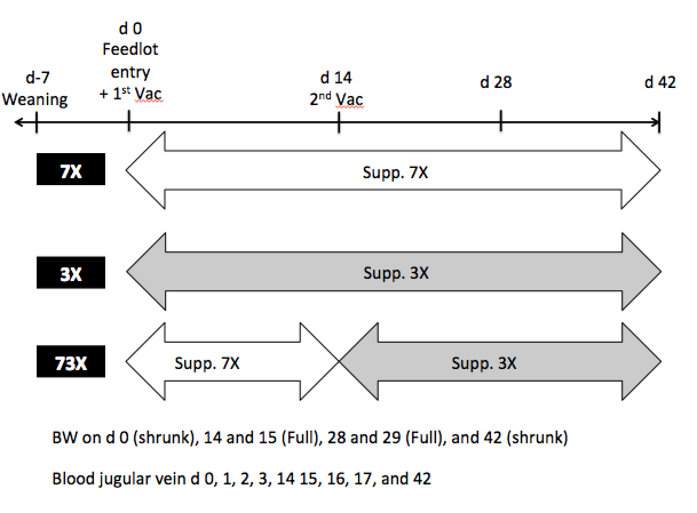
NC STATE UNIVERSITY
Notes:
provide all citizens with access to the wealth of knowledge generated by public universities.

Slide 58
NC STATE UNIVERSITY
 | Treatment |  |  |  | P-value
Item | 3X | 7X-3X | 7X | SEM | Trt
ADG, lb/d
d 0 to 43 | 1.89 | 2.12 | 1.96 | 0.137 | 0.44
Total DMI, lb/d
d 0 to 43 | 424 | 442 | 439 | 8.7 | 0.38
G:F | 0.196 | 0.212 | 0.191 | 0.0135 | 0.57
Notes:
provide all citizens with access to the wealth of knowledge generated by public universities.

Slide 59
NC STATE UNIVERSITY
 | Treatment |  |  |  |  | P-value
Item | 3X | 7X-3X |  | 7X | SEM | Trt | Day | Trt x day
Haptoglobin, mg/dL | 0.443a | 0.370b |  | 0.373b | 0.025 | 0.04 | <0.0001 | 0.94
Infectious bovine rhinotracheitis
Serum titers, log2 | 0.29a | 0.88b | 0.79b |  | 0.179 | 0.05 | <0.0001 | 0.24
Parainfluenza-3
Seroconversion, %
d 14 | 36.0a | 76.6b | 57.b |  | 8.24 | 0.09 | <0.0001 | 0.04
d 42 | 100.0 | 98.0 | 98.9
Notes:
provide all citizens with access to the wealth of knowledge generated by public universities.

Slide 60
Thank you
Philipe Moriel pmoriel@ufl.edu

